Slide 1
Trade Barriers and Trading Blocs
International Trade

Slide 2
Balance of Trade
Balance of Trade: The difference between a country's total exports and total imports
Total Exports – Total Imports = Balance of Trade
Notes:
Film, Finance: What is Balance of Trade?: https://www.youtube.com/watch?v=YIHkUujsUpA

Slide 3
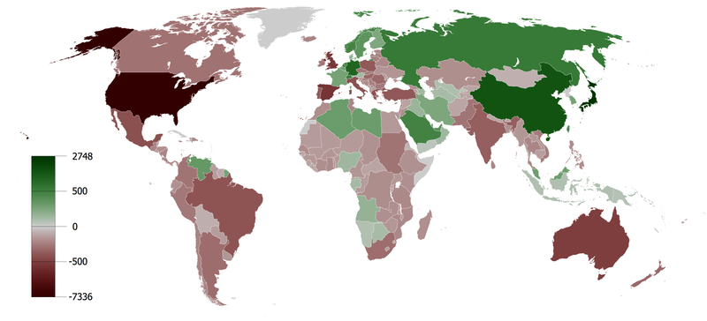
Balance of Trade
Trade Surplus: When a country exports more than it imports
Notes:
This is an image of the Cumulative Current Account Balance. It takes into consideration balance of trade and net cash transfers. Ask student which color represents a surplus. The answer is shades of green.
Image in Creative Commons (1980-2008): https://commons.wikimedia.org/wiki/File:Cumulative_Current_Account_Balance.png

Slide 4
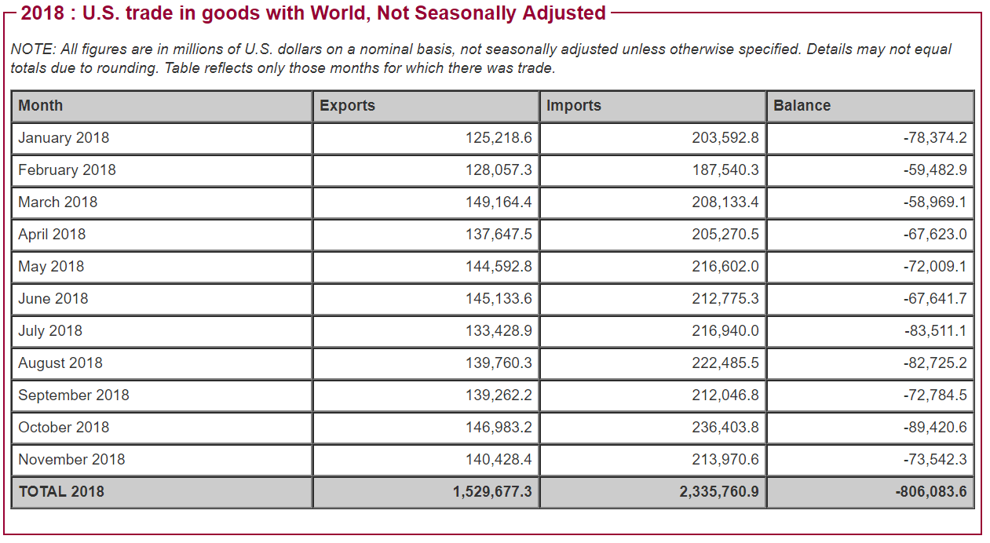
Balance of Trade
Trade Deficit: When a country imports more than it exports

Slide 5
Balance of Trade
IMPORTS create a deficit
EXPORTS create a surplus
© Leah Cleary 2019

Slide 6
Surplus or Deficit?
A nation has $4 million in imports and $3 million in exports
Deficit
A nation has $8 billion in exports and $10 billion in imports
Deficit
A nation has $1 billion in exports and $5 million in imports
Surplus
A nation has $2 billion in imports and $1 billion in exports
Deficit

Slide 7
Trade Barriers
Protectionism: Restricting imports through government regulation
Trade Barriers: Limit trade between countries
© Leah Cleary 2019

Slide 8
Trade Barriers
The purpose is usually to protect domestic jobs and industries.
Tariffs
Quotas
Embargoes
Standards
Subsidies

Slide 9
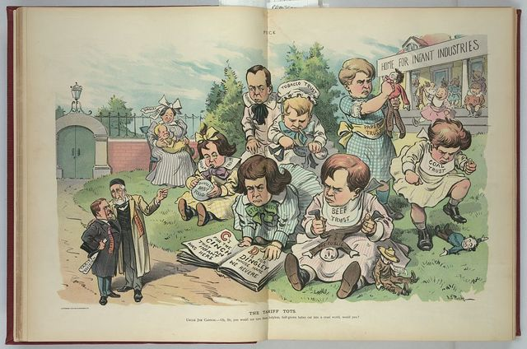
Trade Barriers
Tariffs: A tax on imported goods

Slide 10
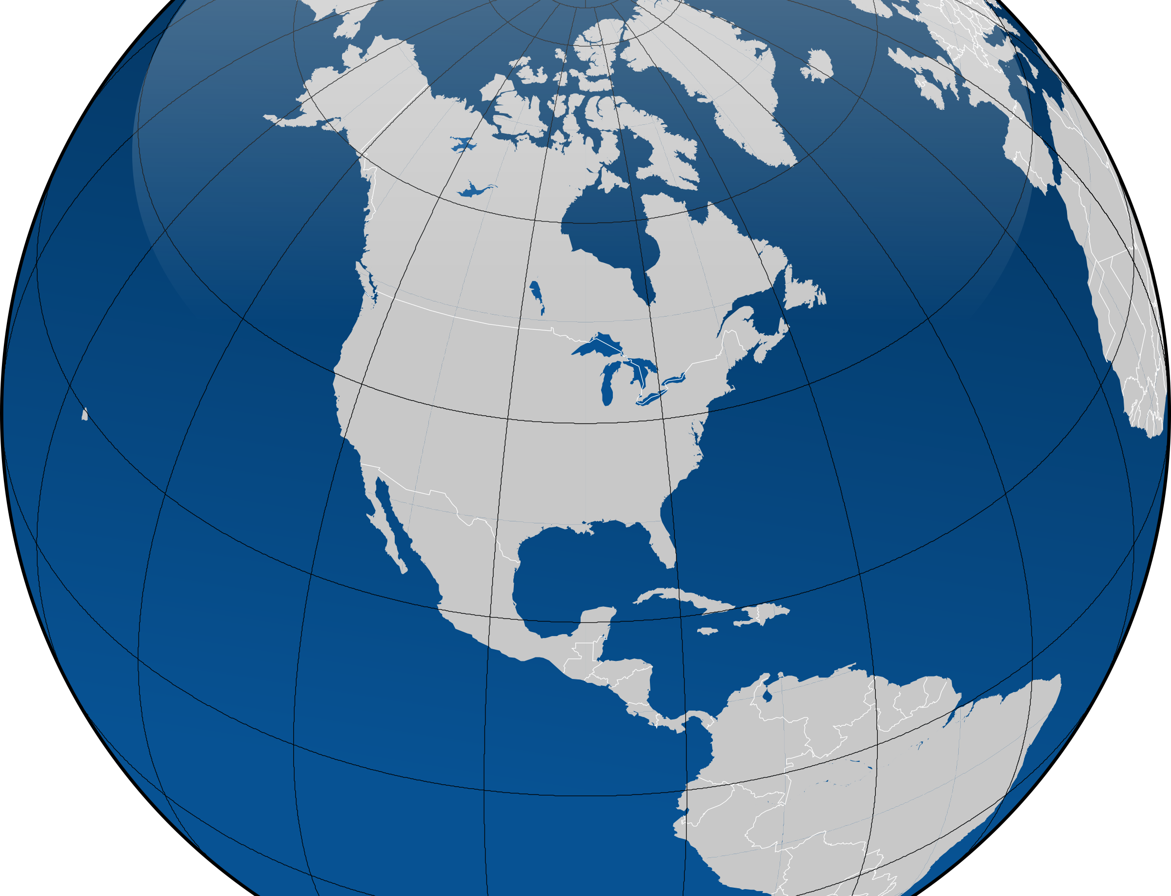
Trade Barriers
Quotas: Limitations on the quantity of specific goods that may be imported from certain countries during a given time period
© Leah Cleary 2019

Slide 11
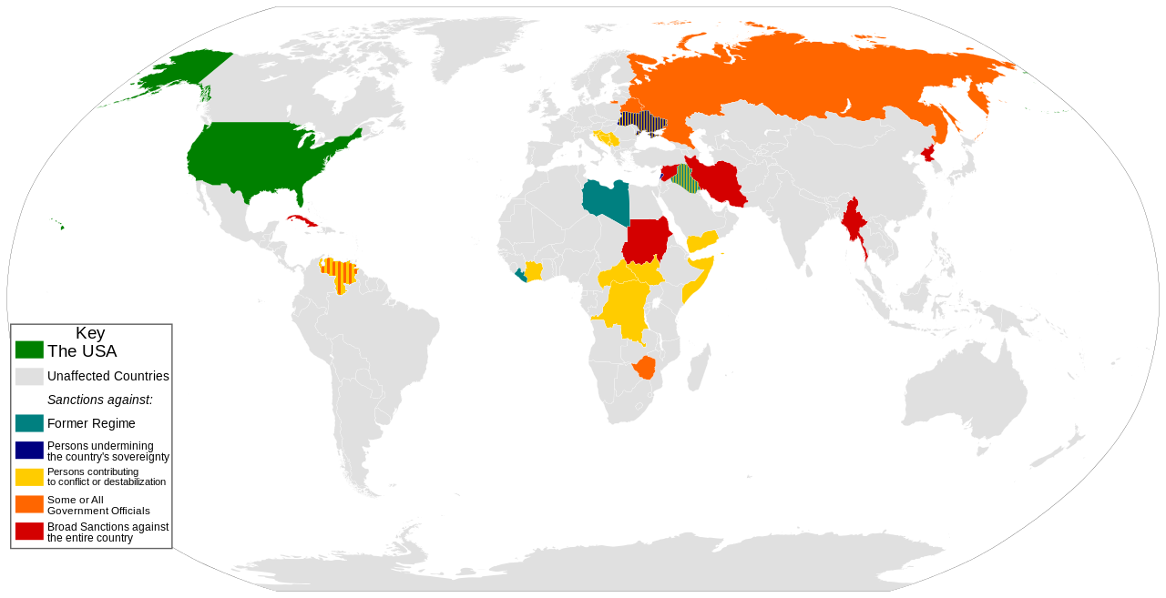
Trade Barriers
Embargoes: An official ban on trade activity with a particular country for political reasons.
© Leah Cleary 2019

Slide 12
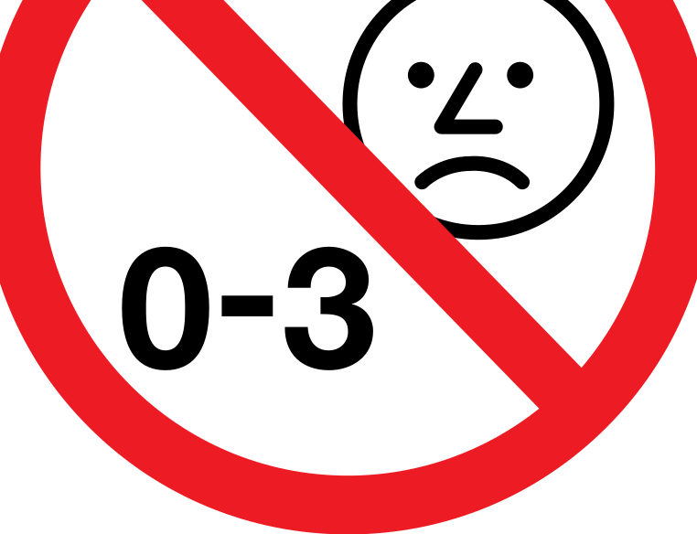
Trade Barriers
Standards: Specific requirements products must meet before they can be imported into a country
© Leah Cleary 2019

Slide 13
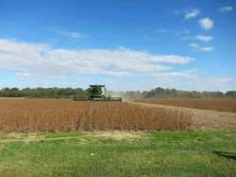
Trade Barriers
Subsidies: Government payments to assist an industry or business so that the price of a good may remain competitive.
© Leah Cleary 2019

Slide 14
Definition
Purpose
Cost
Benefit
Tariffs
A tax on imported goods
Protect domestic business
Higher consumer prices
As prices rise, demand
by causing the price of
Resources may be allocated
falls, encouraging
imported goods to rise.
toward goods for which the
domestic purchases.
nation does not have a
comparative advantage.
The other nation may
retaliate with trade barriers.
Quotas
Limitations on the
More severe than tariffs
Resources may be allocated
Competition is limited
quantity of specific goods
by limiting the amount of
toward goods for which the
for domestic producers.
that may be imported
a good being imported, it
nation does not have a
from certain countries
protects domestic
comparative advantage.
during a given time period
business.
It can cause shortages of
the good.
It can cause other nations
to retaliate with trade
barriers.
Embargoes
An official ban on trade
To sanction a foreign
Households and firms may
The embargoed nation
activity with a particular
nation/ politically
suffer from not having
may change its
country for political
motivated.
imported goods.
behavior.
reasons.
Higher consumer prices
Standards
Specific requirements
To control the quality of
Nations may set unrealistic
It helps protect unsafe
products must meet
goods coming into a
standards to protect
or substandard goods
before they can be
nation.
domestic goods.
from entering the
imported into a country
Consumers may have to
market.
pay more for the domestic
goods.
Subsidies
Government payments to
To enable domestic
Damage industry and jobs
Domestic producers
assist an industry or
producers to be globally
in a foreign nation that may
can compete at lower
business so that the price
competitive.
have the comparative
prices with foreign
of a good may remain
advantage.
producers.
competitive.
Protects domestic jobs

Slide 15
What Type of Barrier is It?
In order to convince Iran to stop developing nuclear weapons, the U.S. stopped trading with them.
Embargo
The U.S. imposed a tax on Chinese steel in order to give the U.S. steel industry a corner on the market.
Tariff
The government pays U.S. farmers to produce soy beans so their prices can be competitive.
Subsidy
The U.S. sent back a shipment of dog food from China because it wasn’t labeled properly.
Standards
The WTO gave the U.S. permission to limit the number of Chinese textiles coming into the U.S.
Quota

Slide 16
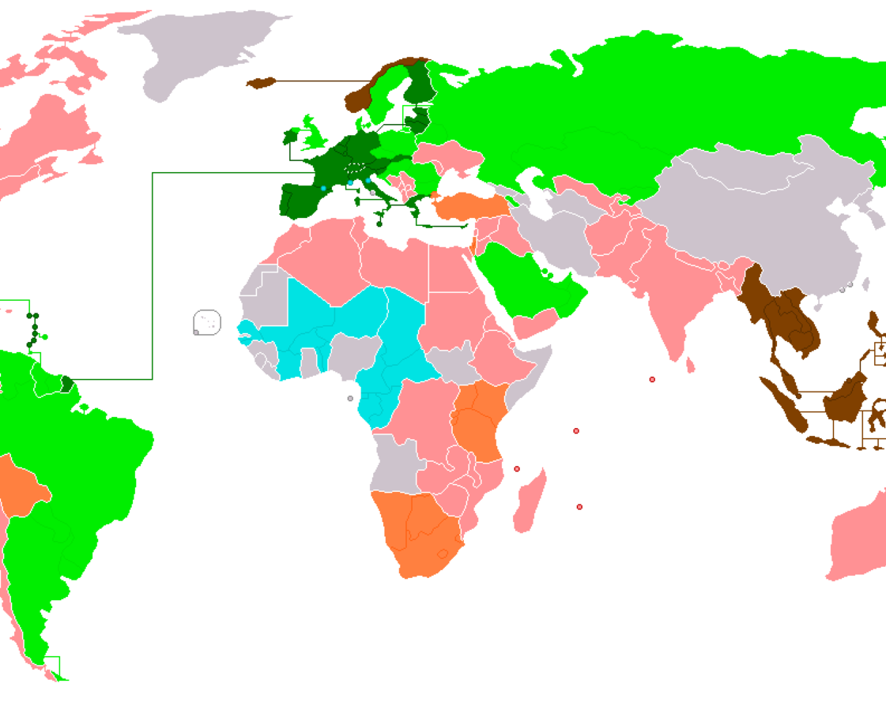
Trading Blocs
Free Trade: No limits on trade between countries
Trading Blocs: A group of neighboring countries that promote trade with each other and create barriers to limit trade with other blocs
© Leah Cleary 2019

Slide 17
Trading Blocs
World Trade Organization (WTO)—oversees trading blocs in an effort to promote free trade
European Union (EU)
North American Free Trade Agreement (NAFTA)
Association of Southeast Asian Nation (ASEAN)

Slide 18
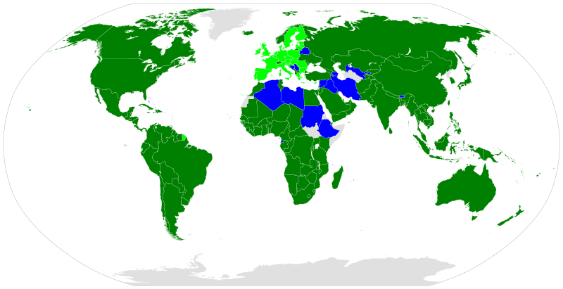
Trading Blocs
World Trade Organization (WTO)
© Leah Cleary 2019

Slide 19
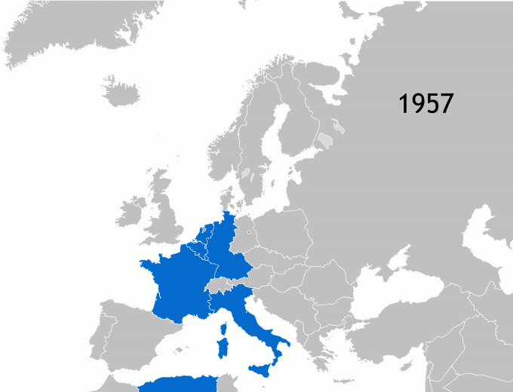
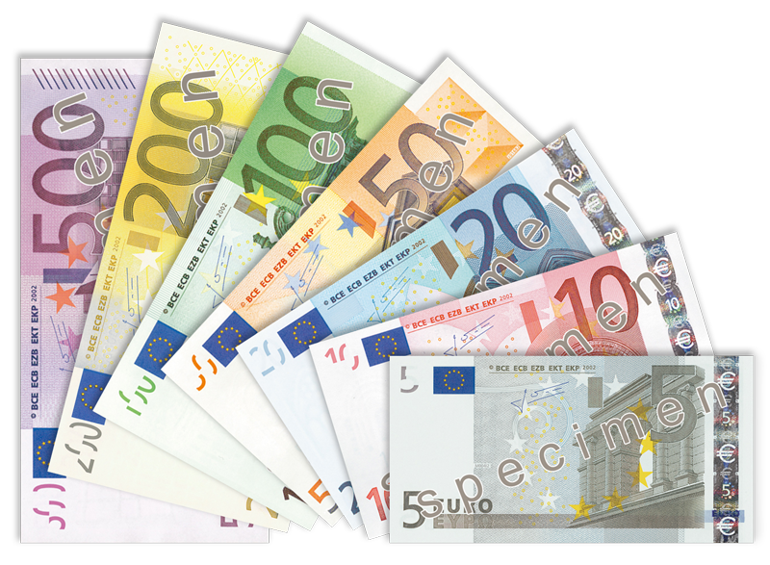
Trading Blocs
European Union (EU)

Slide 20
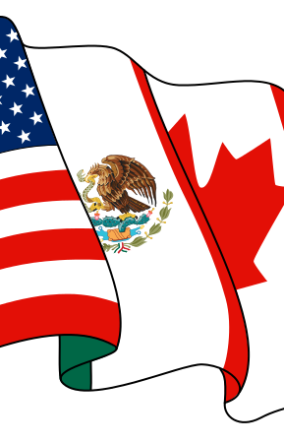
Trading Blocs
North American Free Trade Agreement (NAFTA)

Slide 21
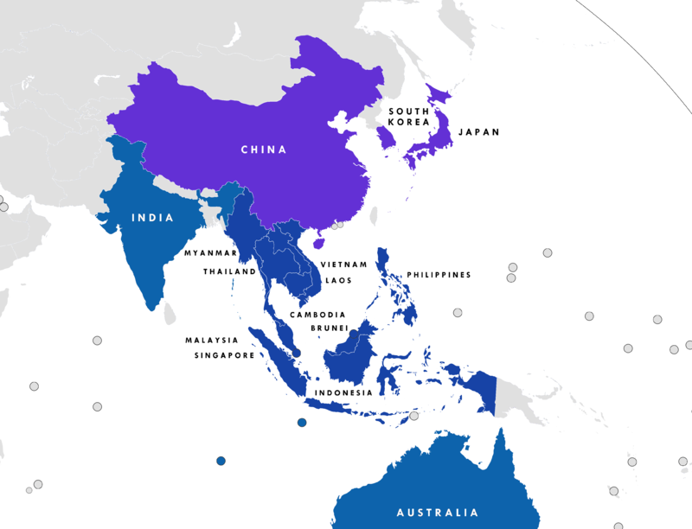
Trading Blocs
Association of Southeast Asian Nations (ASEAN)
© Leah Cleary 2019

