Slide 1
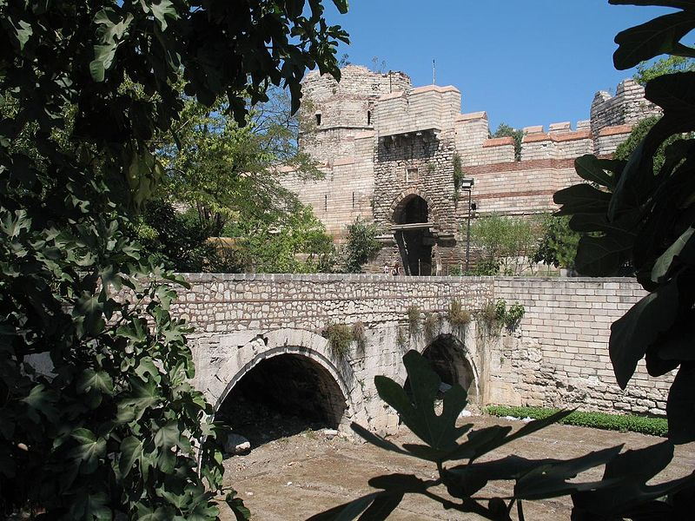
The Byzantine Empire

Slide 2
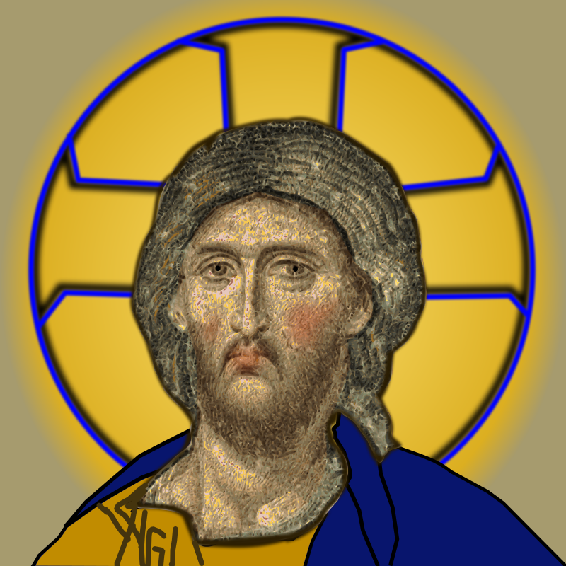
Beginnings
330 C.E. Constantine Built the city of Constantinople at Byzantium
Bosporus Strait, where Europe and Asia meet
Crossroads for trade

Slide 3
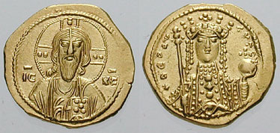

Slide 4
New Rome
Greek
Egyptian, Syrian, Arabic, Armenian, Jewish, Persian, Slavic, Turkish…
Eastern Orthodox Christianity

Slide 5
Emperor Justinian
527-565 A.D.
Reconquered Roman territory
Justinian Code
Hagia Sophia
Empress Theodora

Slide 7
History Channel: The Dark Ages (DVD Scenes 5&6, or link 23:15-41:14)
VIDEO
Notes:
Video “History Channel: The Dark Ages:” https://vimeo.com/106872140, show from 23:15-41:14

Slide 8
Eastern Orthodox Church
Emperor=God’s representative on earth
Patriarch=Lead bishop
1054, Great Schism
--Roman Catholic (west)
--Eastern Orthodox (east)

Slide 9
The Hagia Sophia

Slide 10
Monasteries & Convents=religious communities
Helped poor
Ran hospitals & schools
Sent missionaries

Slide 11
Art
Icons=religious portraits
Mosaics=tiny pieces of glass or stone
Illuminated Manuscript=decorated books

Slide 12
Notes:
Images in the Public Domain: https://commons.wikimedia.org/wiki/File:Byzantine_mosaic,_house_entrance.JPG, https://commons.wikimedia.org/wiki/File:Epistles_of_Saint_Peter,_Single_Leaf_from_a_Manuscript_Psalter_and_New_Testament,_about_1084,_Byzantium,_Constantinople,_ink,_tempera,_and_gold_on_vellum_-_Cleveland_Museum_of_Art_-_DSC08417.JPG

Slide 13
Decline and Fall
1204, Western Crusaders
1453, Ottoman Empire
--Constantinople becomes Istanbul
VIDEO
VIDEO
Notes:
Film 1 “1204 sack of Constantinople,” https://www.youtube.com/watch?v=-NIM8dqXA-s
Film 2 “The Fall of Constantinople,” https://www.youtube.com/watch?v=57257U-W9NI

Slide 14
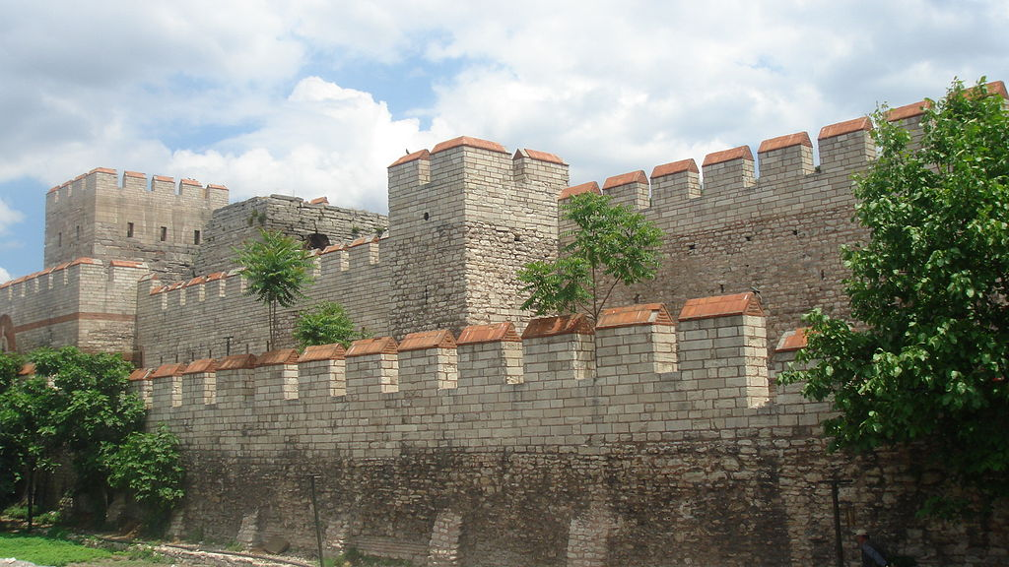
Notes:
Walls of Constantinople Image: By en:User:Bigdaddy1204 - Photograph taken in June 2006 in Istanbul by en:User:Bigdaddy1204. All credits go to him., CC BY-SA 3.0, https://commons.wikimedia.org/w/index.php?curid=880970

Slide 15
VIDEO
Notes:
Images in Public Domain: The Dardanelles Gun, cast in 1464 and based on the Orban bombard that was used for the Ottoman besiegers of Constantinople in 1453 (British Royal Armouries collection).
Video, “They Might Be Giants: Istanbul (Not Constantinople),” Animaniacs Version: https://www.youtube.com/watch?v=vsQrKZcYtqg

