Slide 1
ROME
FROM REPUBLIC TO EMPIRE

Slide 2
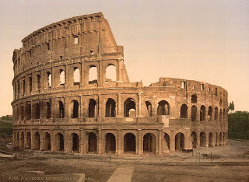

Slide 3
The Republic
Who were the Etruscans?
When was the Roman Republic established?
Define:
Patricians:
Plebeians:
4. What change helped the Plebeians win more rights c. 450 B.C.E?
5. What did the Twelve Tables guarantee to all citizens?
6. Define:
Punic Wars:
7. What became of Carthage by the end of the Punic Wars
https://goo.gl/gbPO6v

Slide 4
Legacy
Government
Laws
Basis of Romance Languages
Legal System

Slide 5
ROMULUS AND REMUS
One of the mythological founding stories of Rome
Raised by a She-Wolf
Romulus Kills Remus
Rome is named after Romulus

Slide 6
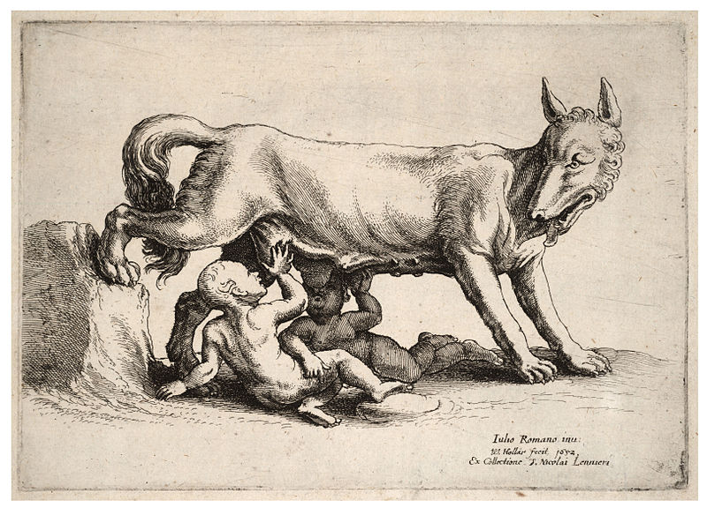

Slide 7
ROMAN REPUBLIC
509 B.C.E – 31 B.C.E.
Ruled by a Bicameral Senate
Patricians = The “nobility,” descended from the first 200 families of Rome

Slide 8
Roman Republic

Slide 9
ROMAN GOVERNMENT
Consuls (like our president, but there were 2):
Ruled for 1 year
Had to wait 5 years to run again
A Dictator could rule for 6 months in times of crisis

Slide 10
Plebeians: 90% of the population:
Merchants, slaves, farmers
No land or family name
Only males were citizens

Slide 11
GOVERNMENT
Plebeian Assembly
Senate
Local Magistrates

Slide 12
DAILY LIFE
Family most important
Early education at home
Commerce and manufacturing important

Slide 13
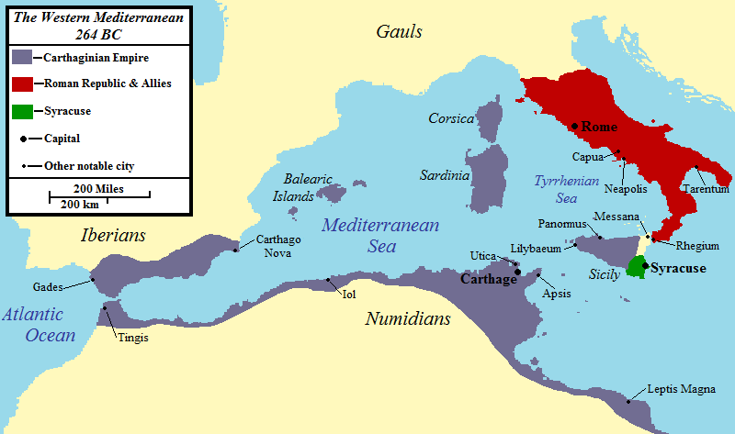

Slide 14
PUNIC WARS
Rome vs Carthage
3 Wars: 264-146 BCE
Fought over expansion and trading power

Slide 15
PUNIC WARS
Carthage = city-state in North Africa
Battles for dominance in the Mediterranean Sea
Rome = strong army
Carthage = strong navy

Slide 17
Hannibal
VIDEO

Slide 18
Legacy of the Punic Wars
Rome really became an empire
But the city of Rome continued to be run as a Republic
We study Rome instead of Carthage

Slide 19
1ST TRIUMVIRATE
Julius Caesar
POMPEY
CRASSUS
VIDEO

Slide 20
Julius Caesar

Slide 21
CAESAR BECOMES DICTATOR
Egypt became an ally
44 BCE He is named dictator for life
Makes Reforms:
Abolished political parties
Revised taxation
Tripled the Senate
**PARTRICAINS HATED CAESAR**

Slide 22
IDES OF MARCH
Assassinated: March 15, 44 BCE
Stabbed over 20 times
His death signifies the end of the Roman Republic
But we know Rome had already been an empire for a long time!

Slide 23
Vocabulary
What began in 509 B.C. and ended with the death of Julius Caesar?
Roman Republic
What were a series of wars fought between Rome and Carthage?
Punic Wars
Who was named Dictator for Life?
Julius Caesar

Slide 24
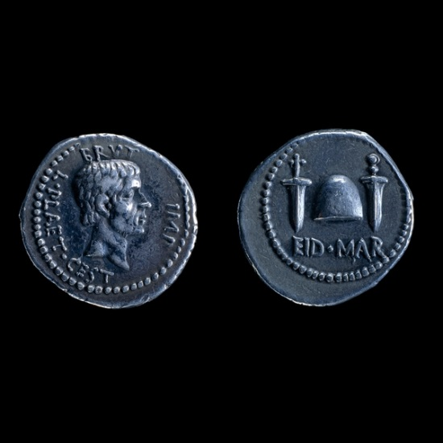

Slide 25
VIDEO

Slide 26
2ND TRIUMVIRATE
Octavian: Caesar’s great nephew
Antony
Lepidus
1 year later, Octavian rules alone

Slide 27
The Empire
https://goo.gl/sRCVNY
1. Define:
Augustus:
Pax Romana:
2. List four accomplishments of the Roman Empire during Pax Romana:
3. By the end of Pax Romana, what was the greatest threat to the empire?
4. Why did Christian persecution stop?
5. When was the Empire split in two?
6. Why was it split in two?
7. List two reasons Rome fell.
https://goo.gl/LnRL7x

Slide 28
AUGUSTUS CAESAR
He and Antony defeated Caesar’s assassins.
Then he and Antony go to war against each other.
Antony gets Cleopatra and Egypt to back him.
Octavian wins at the Battle of Actium in 31 BCE

Slide 32
AUGUSTUS CAESAR
Octavian becomes known as Augustus Caesar
His rule kicks off Pax Romana (Roman Peace)
Vetoed all laws passed by the Senate

Slide 33
Pax Romana
Supported the growth of business and a monetary system
Police and Fire departments organized
Emperors were worshipped as gods and allowed to choose successors

Slide 34
ROMAN ADVANCES
Police and fire protection
Excellent roads
Law: innocent until proven guilty
Aqueducts

Slide 35
Entertainment
Plays
Boxing
Chariot Races
Gladiators

Slide 36
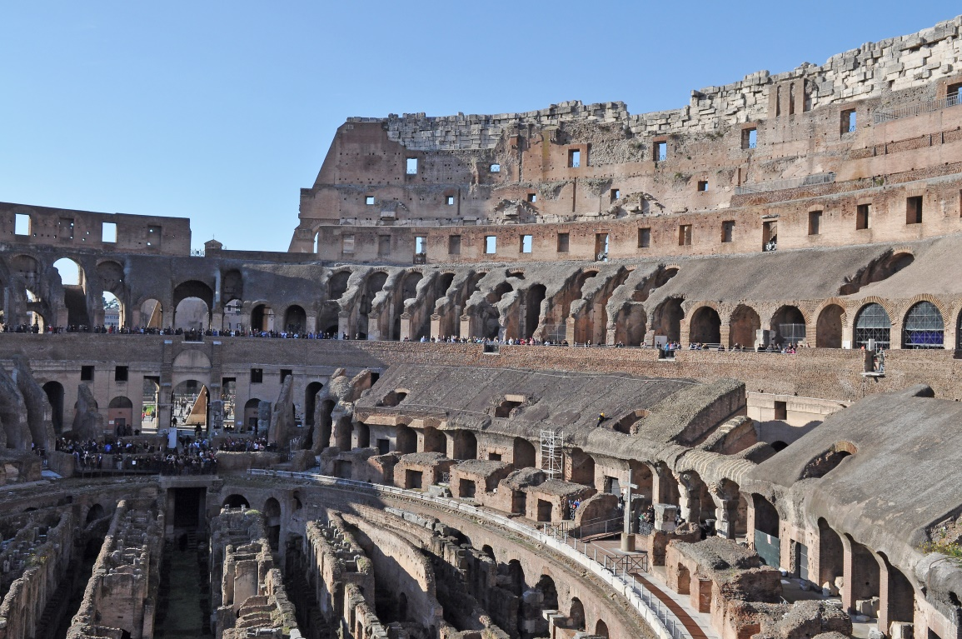
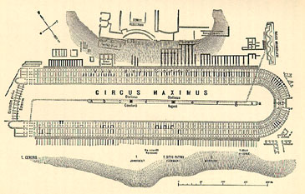
SPORTING ARENAS OF ROME
VIDEO
Colosseum
Circus Maximus

Slide 37
The Julian Line
Tiberius
Caligula
Claudius
Nero

Slide 38
Tiberius, 14-37 CE

Slide 39
Caligula (37-41 CE) and Incitatus

Slide 40
Gratus Proclaims Claudius (41-54 CE) Emperor

Slide 41
Nero, 54-68 CE
VIDEO 1
VIDEO 2

Slide 43
CHRISTIANITY
Monotheistic
Belief in Jesus as the son of God
Roman Caesars thought it brought disunity:
***Christians would not acknowledge Caesar as a god***
Christians were tortured and imprisoned

Slide 44
Accepting Christianity
Persecution ended when Constantine converted
Theodosius made it the official religion of the empire in 380 CE

Slide 45
POPE
Head of the Catholic Church
Vicar of Christ
Most powerful leader in Europe during the Middle Ages

Slide 46
An Empire Divided
Diocletian, 285 CE
Empire ruled by two emperors
One from Rome
One from Byzantium (Constantinople)

Slide 47
Decline of the Roman Empire
Political Instability
Economic & Moral Decline
Inflation
Taxes
Food shortage & Instability
Invasions!

Slide 48
Vocabulary
This collapsed in the West in the 400s A.D.
Roman Empire
Who was the first emperor of the Roman Empire?
Augustus Caesar
What religion began at the beginning of the common era in Palestine and spread world-wide?
Christianity

