Slide 1
RISE OF ISLAM
610 AD MUHAMMAD ACCEPTS ALLAH’S CALLING
ARABIAN PENINSULA
MECCA = TRADE CENTER, CROSSROADS OF MUSLIM WORLD

Slide 2
MUSLIMS OF THE MIDDLE EAST
MUSLIM = “persons who submit to God”
ISLAM = “SUBMISSION TO GOD”
622 Muhammad and followers flee to YATHRIB (Medina)

Slide 3
Hijra

Slide 4
Film Clip from Inside Islam (History Channel)
VIDEO
First 30 minutes
Notes:
Video, History Channel, “Inside Islam,” approx. 1st 30 min.: https://www.youtube.com/watch?v=tU8p2fBN8xY

Slide 5
THE GOLDEN AGE OF ISLAM
800 - 1100
ADVANCES IN LITERATURE, SCIENCE , MEDICINE

Slide 6
FIVE PILLARS OF ISLAM
PRAYER
FAITH
PILGRIMAGE
FAST
CHARITY

Slide 7
Notes:
Calligraphy in Public Domain: http://freeislamiccalligraphy.com/portfolio/al-nisa-4-113/#
Textile with Koranic Inscriptions in Public Domain: https://en.wikipedia.org/wiki/File:Unknown_Islamic_-_Textile_with_Qur'anic_inscriptions_-_Google_Art_Project.jpg

Slide 8
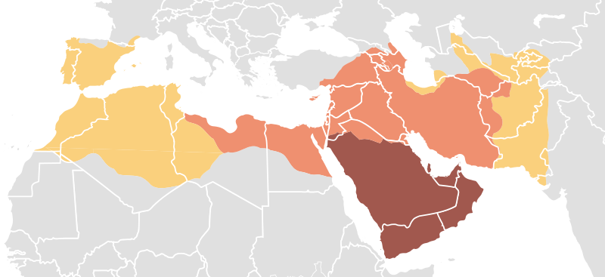
Islamic Expansion
The Age of the Caliphs
Muhammad, 622–632
Patriarchal Caliphate, 632–661
Umayyad Caliphate, 661–750
Notes:
Map in the Public Domain: https://commons.wikimedia.org/wiki/File:Map_of_expansion_of_Caliphate.svg

Slide 9
Expansion
750 = Muslim Empire stretches from Atlantic to Indus River Valley

Slide 10
SPLIT
CA. 661
SUNNI = FOLLOWERS OF MUHAMMUD’S EXAMPLE
SHI’A = CALIPH SHOULD BE A DESCENDANT OF MUHAMMUD
VIDEO
Notes:
Video, “Sunni vs. Shitte,” 2:56: https://www.youtube.com/watch?v=5KLvjs7Yrtw

Slide 11
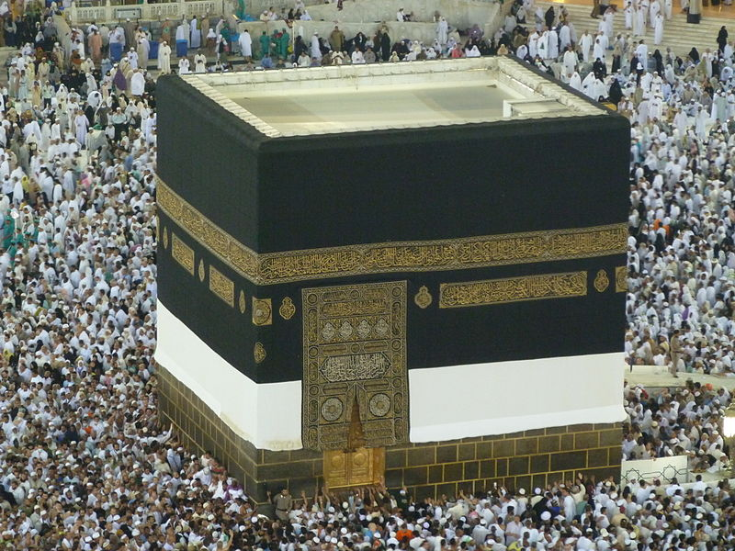
VIDEO

