Slide 1
Productivity, Free Enterprise, and The Role of The U.S. Government

Slide 2
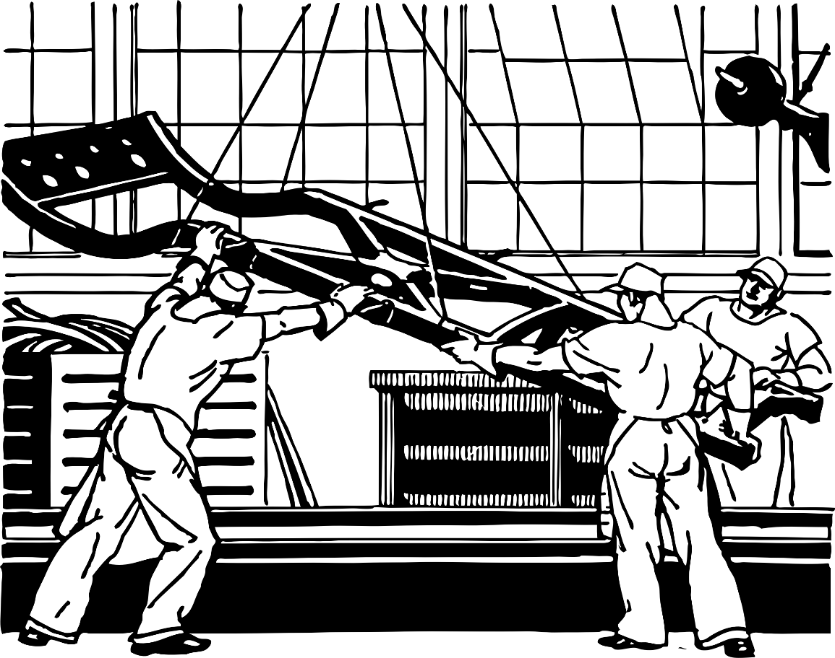
Productivity
The value of a particular product compared to the amount of labor needed to make it.
Efficiency
Notes:
Film, 100 Years of the Moving Assembly Line in 100 Seconds: https://www.youtube.com/watch?v=AgL1ZL_sh08
Ask students how the assembly line has increased productivity.

Slide 3
Macro Vs. Micro
Macroeconomics—Studies economies as a whole; looks at the big picture
Microeconomics—Studies economic behavior of individuals

Slide 4
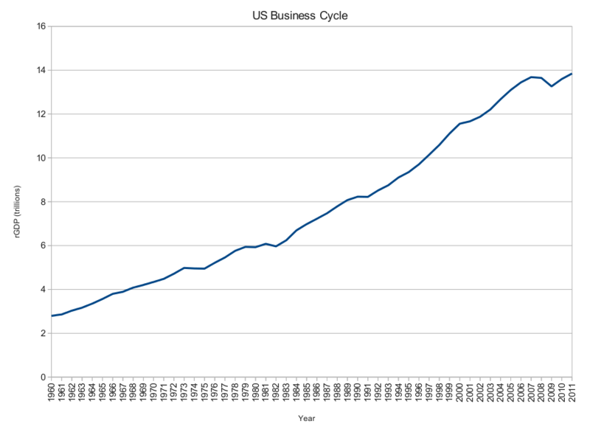
The Business Cycle
Macroeconomics
A period of expansion followed by contraction
Notes:
Film, The Business Cycle (Economic Expansions and Contractions) Explained in One Minute: https://www.youtube.com/watch?v=VwRJzVEUclA
Image, Creative Commons: https://commons.wikimedia.org/wiki/File:Business.cycle.us.png

Slide 5
GDP
Gross Domestic Product— “The monetary value of all the finished goods and services produced within a country's borders in a specific time period.”
GDP Per Capita—A nation’s GDP divided by the number of people in that nation.
Notes:
Definition from https://www.investopedia.com/terms/g/gdp.asp
Film, Gross domestic product (GDP) Comparison: https://www.youtube.com/watch?v=P46pUs5kWj8

Slide 6
Role of Government in a Free Market
Create policies to encourage stability through the ups and downs of the business cycle
The government has goals to help achieve this.

Slide 7
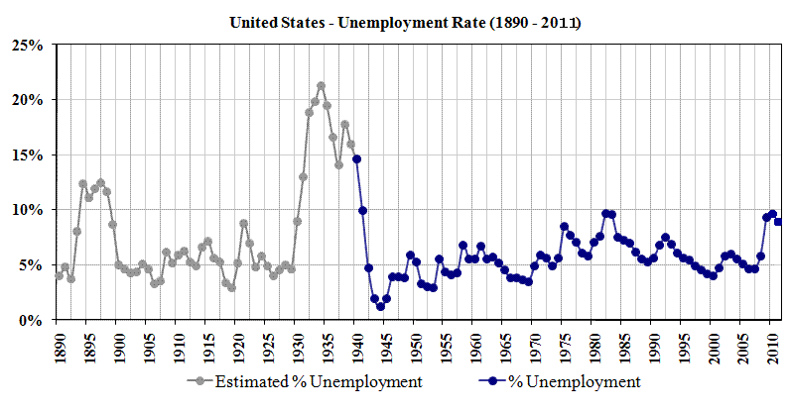
Goals: Employment
Everyone who can work has a job.
There will always be Unemployment—seeking jobs, between jobs, disability
According to the Federal Reserve, a desirable unemployment rate is between 4.5% and 5%.
Notes:
The image animates, so it does not block text in present mode.
Source: https://www.thebalance.com/natural-rate-of-unemployment-definition-and-trends-3305950
Image, in Public Domain: https://commons.wikimedia.org/wiki/File:US_Unemployment_1890-2011.gif

Slide 8
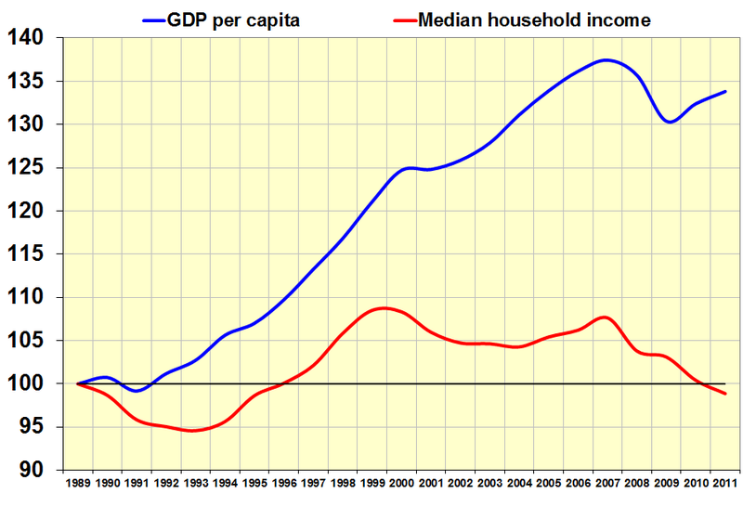
Goals: Growth
The economy must grow for people to increase their standard of living.
Standard of Living—level of economic prosperity
GDP is an indicator of growth.
Notes:
The image animates, so it does not block text in present mode.
Image in Public Domain: https://commons.wikimedia.org/wiki/File:Gdp_versus_household_income.png

Slide 9
Goals: Stability
Avoid drastic price shifts
Drastic changes=loss of consumer confidence
Health of financial institutions=regulate banks
Adjusting interest rates
Notes:
Film, Public sector: Economic stability: https://www.youtube.com/watch?v=dXYbaMg9OMA

Slide 10
Technology
Technology is the process of production.
Technological innovation increases productivity, which increases a nation’s GPD.
Notes:
Image, in the Public Domain from NASA (The Finals of the Zero Robotics competition aboard the ISS: Photographic documentation taken during the execution of the Synchronized Position Hold, Engage, Reorient, Experimental Satellites (SPHERES) Zero Robotics Competition taken in the Japanese Experiment Module (JEM).): https://commons.wikimedia.org/wiki/File:Zero_Robotics_Finals_1.jpg
Film, This Collaborative Robot Works Alongside Humans to Increase Productivity: https://www.youtube.com/watch?v=T8Rs6CCBIZU

Slide 11
Free Enterprise
The market controls productivity and distribution with minimal government interference
Labor is divided (specialization)
Everyone’s wants and needs are satisfied through self-interest
Notes:
Film, Free Enterprise: "Round and Round" 1939 General Motors, Stop Motion Animation: https://www.youtube.com/watch?v=jGqF7PFs-Y4
This is a fun vintage video that attempts to explain free enterprise.

Slide 12
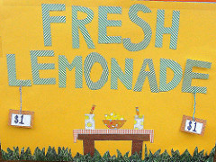
Principles of Free Enterprise
Profit Motive
The main goal is to make money.
Encourages efficiency and financial responsibility
Notes:
Image in Creative Commons by Amy Gizienski: https://www.flickr.com/photos/agizienski/3778965891

Slide 13
Principles of Free Enterprise
Open Opportunity
Anyone can start a business (compete in the marketplace).
Enables economic mobility

Slide 14
Principles of Free Enterprise
Economic Rights
Private Property—people can control their own property
Voluntary Exchange—people can decide what to buy and sell and at what prices
Free Contract—people have a say in what agreements they make
Legal Equality—people have the same legal rights
Competition—if businesses compete, consumers will have choices and prices will be reasonable

Slide 15
Role of Consumer
Consumer Sovereignty— “The power of consumers to determine what goods and services are produced.”
Consumers dictate what will be produced and at what cost through what they purchase
Notes:
Definition from http://www.businessdictionary.com/definition/consumer-sovereignty.html

Slide 16
Notes:
Image: https://commons.wikimedia.org/wiki/File:US_Navy_120104-N-EK905-047_Electrician%27s_Mate_Fireman_Emmett_Brown_trains_as_number_one_nozzleman_during_a_general_quarters_drill_in_the_hangar_bay.jpg

Slide 17
Notes:
Image: https://commons.wikimedia.org/wiki/File:Heiwa_elementary_school_18.jpg

Slide 18
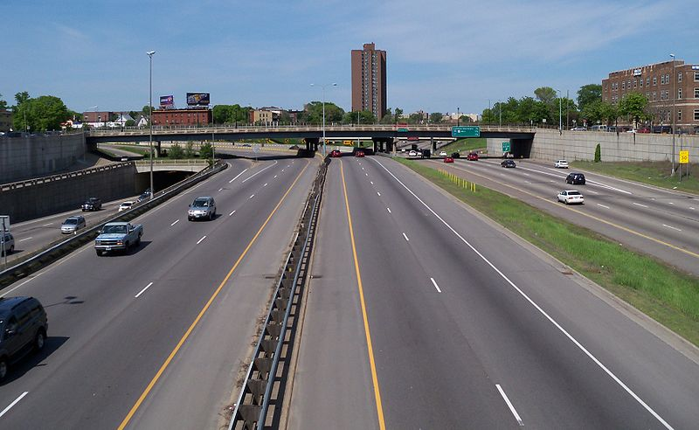
Notes:
Image: https://commons.wikimedia.org/wiki/File:Interstate_35W-Interstate_94_5.jpg

Slide 19
Role of Government
Public Good—shared good or service that is
1. Non-rivalrous (doesn’t go away as it’s consumed)
2. Non-excludable (impossible or impractical to provide for one without providing for all)
3. Paid for with tax revenue
Notes:
Film, Private Sector vs. Public Sector: https://www.youtube.com/watch?v=Dcm4MaA8hfo

Slide 20
Role of Government
Public Sector
Private Sector

Slide 21
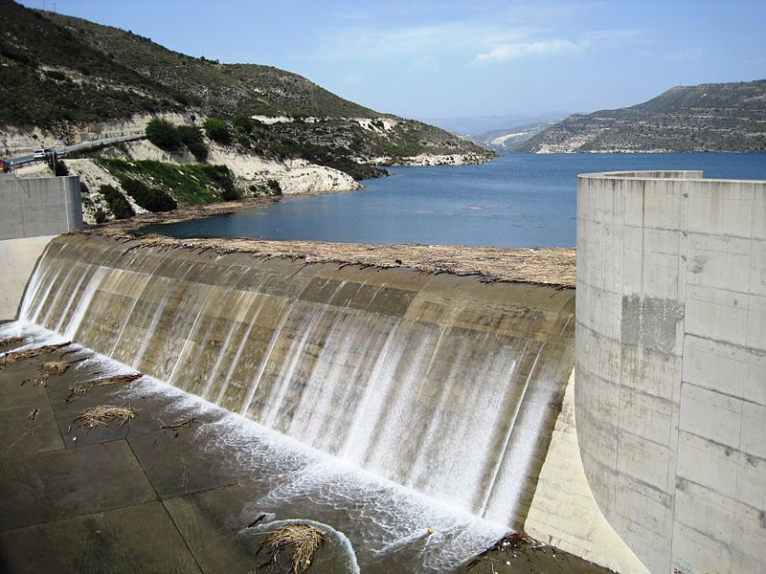
Public Goods
Infrastructure
National Defense
Education
Fire Fighters
Police Protection
Postal Service
Libraries
Notes:
Images in Public Domain: https://commons.wikimedia.org/wiki/File:Kouris_Dam_-_overflow_day_8_April_2012.jpg, By Spiegel898 (talk) (English Wikipedia) - Originally uploaded as File:GuardKandahar.jpg by Spiegel898 (talk) on English Wikipedia, Public Domain, https://commons.wikimedia.org/w/index.php?curid=5997547, https://commons.wikimedia.org/wiki/File:US_Navy_020719-N-3446M-008_Volunteer_meets_with_Philippine_children_at_a_Special_Education_Center_for_gifted_children.jpg, https://commons.wikimedia.org/wiki/File:United_States_Postal_Service_Truck.jpg
Images in Creative Commons: https://commons.wikimedia.org/wiki/File:Police-IMG_4105.jpg, https://commons.wikimedia.org/wiki/File:KU_Leuven_Library.jpg

Slide 22
Market Failures
The market distributes a good inefficiently
Free Riders—a person benefits from a public good without paying for it
Externalities

Slide 23
Externalities
Cost or benefit of a good or service that goes to someone who did not produce or consume that good or service
Positive Externality—a benefit (e.g. you renovate a run-down house and your neighbors’ property value increases)
Negative Externality—a cost (e.g. your house is foreclosed on and your neighbors’ property value decreases)

Slide 24
Goals of Government
Increase positive externalities (e.g. education benefits all of society, not just students)
Decrease negative externalities (e.g. regulations to reduce greenhouse gasses factories emit into the atmosphere)
Notes:
Film, Joseph Stiglitz: The financial crisis was a market failure: https://www.youtube.com/watch?v=g_W9SsstO9Y

Slide 25
Safety Nets
Services and assistance provided by the government to help those temporarily without income or who are at or below the poverty line

Slide 26
Poverty
Poverty Threshold—income level too low to support a household
Relative figure—the U.S. Census reports on and adjusts the level each year
Show up to 3:23.
Notes:
Film, The Line: Poverty in America - Officially Licensed Version (show the first 3 min. and 23 sec. clip from the film): https://www.youtube.com/watch?v=rHyNBGIFYl8

Slide 27
Redistribution
Taxes are directed into welfare programs to help those living in poverty
Welfare programs—government aid for the poor
Notes:
Image in Public Domain (1939 Food Stamp): https://commons.wikimedia.org/wiki/File:Orange-US-Food-Stamp-1939.jpg

Slide 28
Redistribution
Program
Possible Alternative
TANF “The Temporary Assistance for Needy Families (TANF) program is designed to help needy families achieve self-sufficiency. States receive block grants to design and operate programs that accomplish one of the purposes of the TANF program.”
Medicaid “Authorized by Title XIX of the Social Security Act, Medicaid was signed into law in 1965 alongside Medicare. All states, the District of Columbia, and the U.S. territories have Medicaid programs designed to provide health coverage for low-income people.”
Supplemental Assistance Nutrition Program (SNAP) “SNAP offers nutrition assistance to millions of eligible, low-income individuals and families and provides economic benefits to communities. SNAP is the largest program in the domestic hunger safety net.”
Notes:
TANF: https://www.acf.hhs.gov/ofa/programs/tanf
Medicaid: https://www.medicaid.gov/about-us/program-history/index.html
SNAP: https://www.fns.usda.gov/snap/supplemental-nutrition-assistance-program-snap

