Slide 1
Price Controls
Who likes the idea of having a price ceiling on gas so prices will never go over $2 per gallon?
1
Notes:
https://www.youtube.com/watch?v=1EzY4Vl460U&t=1s

Slide 2
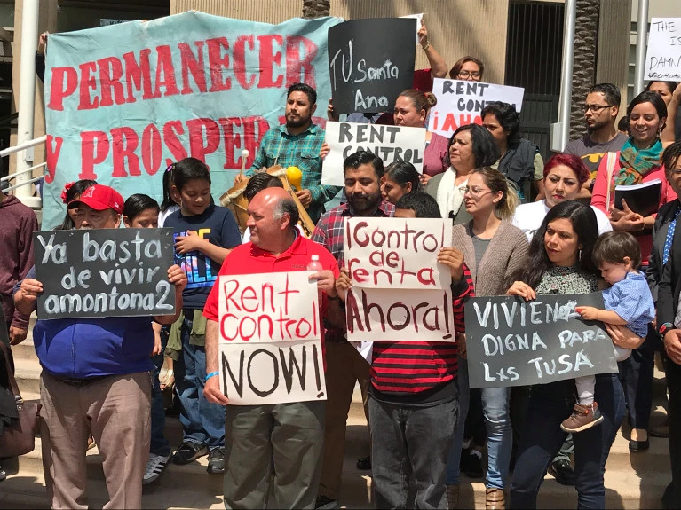
In the News: Debate over Rent Control Rages in California
Read the article on California’s current debate over rent control and consider the following questions in your weekly summary:
-Who benefits from rent control policies?
-Who is harmed?
-What unintended consequences do you anticipate could occur as a result of implementing rent control?
- Include a Supply and Demand Graph illustrating this situation
Notes:
https://www.ocregister.com/2018/05/18/santa-ana-rent-control-petition-drive-underway/

Slide 3
Can the government “fix” prices?
What if people think that prices for some basic good are too high? What if sellers of some other goods say prices are so low they’re going to go out of business?
Discussion Question: Should the government intervene in the market to make sure that prices aren’t too high or too low?
3

Slide 4
Price Ceiling
Maximum legal price a seller can charge for a product.
Goal: Make affordable by keeping price from reaching Eq.
$8
6
4
2
1
Price
Gasoline
S
Does this policy help consumers?
Result: BLACK MARKETS
Price Ceiling
Shortage
(Qd>Qs)
D
10 20 30 40 50 60 70 80
Q
4

Slide 5
Price Floor
Minimum legal price a seller can sell a product.
Goal: Keep price high by keeping price from falling to Eq.
P
Corn
S
$
4
3
2
1
Surplus
(Qd<Qs)
Price Floor
Does this policy help corn producers?
D
10 20 30 40 50 60 70 80
Q
5

Slide 6
Notes:
https://www.youtube.com/watch?v=YUA8i5S0YMU

