Slide 1
Mesopotamia
“Land Between the Rivers”
VIDEO

Slide 2
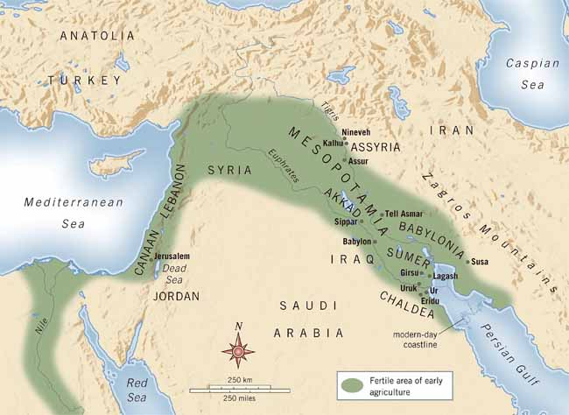

Slide 3
FERTILE CRESENT
Mesopotamia
Fertile land between the Tigris and Euphrates Rivers
20 to 150 miles wide

Slide 4
SUMER
First Civilization
Collection of City-States
Each city-state centered around a temple called a Ziggurat

Slide 5
Vocabulary
What is an independent government made up of a city and its surrounding lands?
City-State

Slide 7
SUMERIAN INVENTIONS
Wheel, sail, plow
Sewer, arch
Number system
Geometry
Algebra
Cuneiform

Slide 8
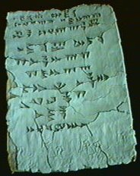
Cuneiform Oldest written language

Slide 9
From The Epic of Gilgamesh
.You know the city Shurrupak, it stands on the banks of Euphrates? That city grew old and the gods that were in it
were old. There was Anu,-lord of the firmament, their father, and warrior Enlil their counsellor, Ninurta the helper, and
Ennugi watcher over canals; and with them also was Ea. In those days the world teemed, the people multiplied, the world
bellowed like a wild bull, and the great god was aroused by the clamour. Enlil heard the clamour and he said to the gods in
council, "The uproar of mankind is intolerable and sleep is no longer possible by reason of the babel." So the gods agreed
to exterminate mankind. Enlil did this, but Ea because of his oath warned me in a dream. He whispered their words to my
house of reeds, "Reed-house, reed-house! Wall, O wall, hearken reed-house, wall reflect; O man of Shurrupak, son of
Ubara-Tutu; tear down your house and build a boat, abandon possessions and look for life, despise worldly goods and save
your soul alive. Tear down your house, I say, and build a boat. These are the measurements of the barque as you shall
build her: let hex beam equal her length, let her deck be roofed like the vault that covers the abyss; then take up into the
boat the seed of all living creatures."

Slide 10
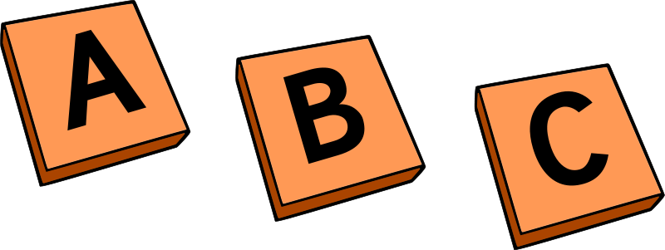
Vocabulary
What is the oldest written language?
Cuneiform
What civilization invented it?
Sumerians

Slide 11
THE BIRTH OF EMPIRE
Sargon of Akkad ca. 2350 B.C.
Created world’s first empire by controlling northern and southern Mesopotamia
Spread Sumerian culture beyond Tigris-Euphrates Valley

Slide 12
Vocabulary
What do we call it when ideas are spread from one place to another?
Cultural Diffusion

Slide 14
Ishtar

Slide 16
The story of Mesopotamia is the story of the
&
of Empires
RISE
FALL

Slide 17
Babylonian Empire
1st
Ca. 2000 BCE Amorites invade
Establish capital at Babylon, on the Euphrates River

Slide 18
BABYLONIAN EMPIRE
The Assyrians conquered the 1st Babylonian Empire, ca. 1700-612 BCE
The Chaldeans conquered the Assyrians, ca. 612-539 BCE
They became the Neo-Babylonians, or the 2nd Babylonian Empire
The PERSIANS conquered them, 539 BCE

Slide 19
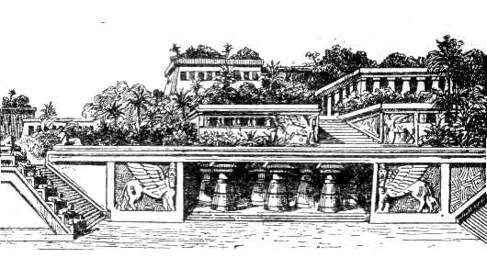
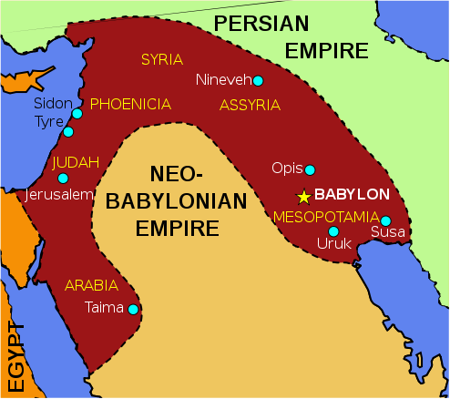
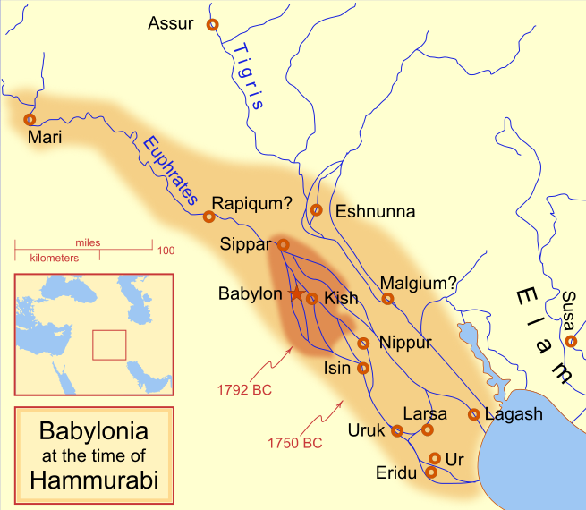
BABYLONIANS
1st Empire
First Written Laws:
HAMMURABI’S CODE
- Tower of Babylon
--Hanging Gardens
2nd Empire

Slide 21
Phoenicians
VIDEO

Slide 22
Traders
Collection of city-states
About 1100 B.C. dominated Mediterranean trade
Shipbuilders and seafarers
First Mediterranean people to voyage beyond the Strait of Gibraltar

Slide 24
Merchandise
Red-purple dye
- Made from rotten snails
Papyrus
Wine
Weapons
Precious metals
Ivory
Slaves

Slide 25
Alphabet
Needed to record transactions
Created a phonetic alphabet
22 letters
Same phonetically as the Hebrew
First two letters: aleph, beth

Slide 26
Phoenician Alphabet

Slide 27
Vocabulary
What do we call the Phoenician writing system?
The Phoenician Alphabet

Slide 28
Hebrews

Slide 29
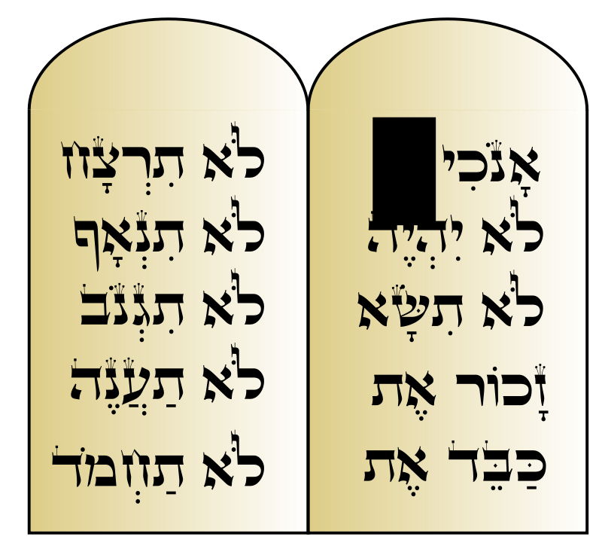
Canaan “the Promised-Land:” faced drought, famine, starvation
Abraham’s Covenant with God:
A nation out of one
Father of all three major world religions
Isaac and Ishmael
Judaism and Islam

Slide 30
Enslaved in Egypt
Led by Moses out of Egypt
40 years wandering in the desert
-10 Commandments
-The Torah
Back in Canaan (Israel), war over land with Philistines

Slide 32
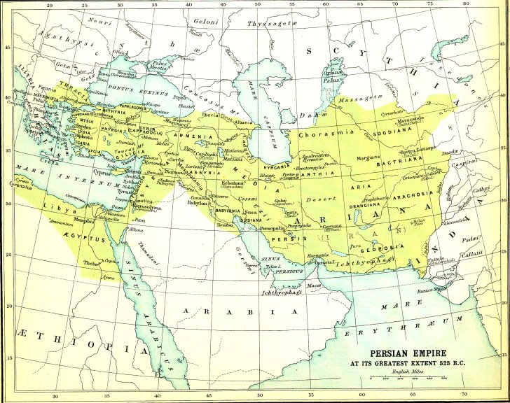
AND FINALLY, THE PERSIANS…
Came from present-day Iran
Cyrus the Great seized Babylon.
- Freed the Jewish people
- Allowed them to return to Israel
- Allowed them to rebuild the Temple of Solomon

Slide 33
Tolerant rulers
Darius the Great built the city of Persepolis
Zoroastrianism
- Monotheistic
- Good vs. Evil
- Afterlife=a good place & a bad place!

Slide 34
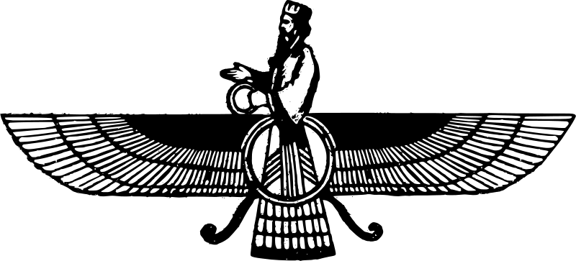
Vocabulary
What is the monotheistic Persian religion that believes in a struggle between good and evil?
Zoroastrianism

Slide 36
Fertile Crescent
Sumerians
Akkadians
Amorites (1st Babylonian Empire)
Hittites (IRON WEAPONS)
Assyrians (IRON WEAPONS, FIERCE ARMY)
Neo-Babylonians (Chaldeans [related to the Amorites]), 2nd Babylonian Empire
Persians
VIDEO 1
VIDEO 2

