Slide 1
Macroeconomics
Measurements of Economic Activity
©Leah Cleary 2018

Slide 2
Macroeconomics
The study of the economy as a whole, including inflation, unemployment, and economic growth
Notes:
Image in creative commons, https://pixabay.com/en/money-euro-arrows-circuit-965063/

Slide 3
Macroeconomic Goals
Steady Economic Growth
Price Stability
Full Employment

Slide 4
Macroeconomic Goals
Steady Economic Growth:
New businesses created
Existing businesses adding capital and technology
Increased knowledge and skills of workers
Increased productive resources

Slide 5
Macroeconomic Goals
Price Stability:
Minimize price level increase
Money’s purchasing power should be stable
People, businesses, and governments can make predictions

Slide 6
Macroeconomic Goals
Full Employment (between 4 and 6% unemployment):
Most who are willing and able to work can
If people work, they can purchase
Contribute to the economy
Businesses flourish and hire

Slide 7
Final Goods
A good made for consumers.
Capital Goods
A good used in the production of other goods.

Slide 8
Gross Domestic Product
Nominal GDP (Y) Measures Economic Growth
Sum of:
Consumer spending (C)
Investment spending (I)
Government spending (G)
Net exports (X-M)
Y=C+I+G+(X-M)

Slide 9
Nominal GDP
A.K.A. Output Expenditure Model
How a country’s GDP is calculated
Return to Real GDP
Y=C+I+G+(X-M)
Investment
Exports
GDP
Consumer Spending
Government Spending
Imports
Notes:
Film, What is GDP? | CNBC Explains: https://www.youtube.com/watch?v=iLom1WlqwS0

Slide 10
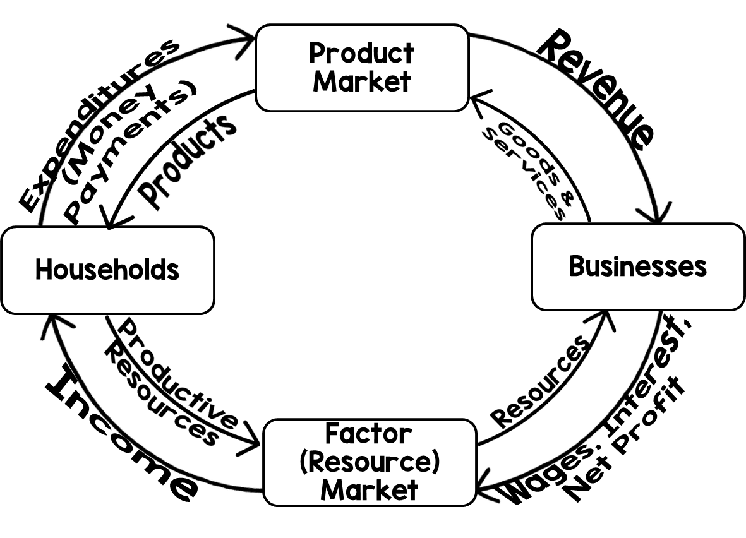

Slide 11
Gross Domestic Product
Consumer spending: Value of what households spend on final goods and services in the product market at a given time

Slide 12
Gross Domestic Product
Investment:
Value of capital goods purchased by businesses in a specific period
Value of currently unsold products of businesses in a specific period
Value of new homes constructed in a specific period

Slide 13
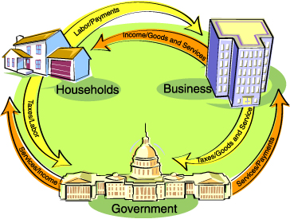
Gross Domestic Product
Government spending: Value of any spending on final goods and services by a government in a given period

Slide 14
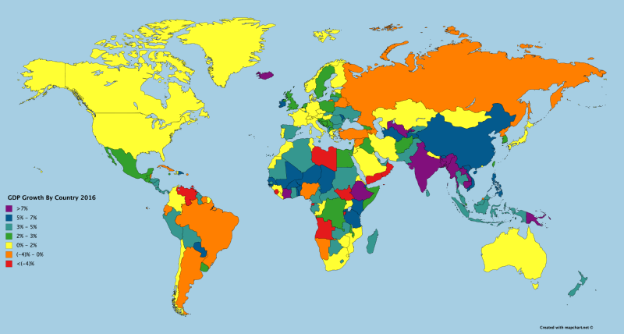
Gross Domestic Product
Net exports: Value of a country’s exports minus the value of its imports
Notes:
Image in Creative Commons by RanilAbeyasinghe, https://en.wikipedia.org/wiki/File:GDP_Growth_By_Country_2016.png

Slide 15
Unemployment Rate
Reported by the Department of Labor’s Bureau of Labor Statistics (BLS) each month
Gathered from a 60,000 household sample
4% to 6% unemployment rate=full employment
Notes:
Film, What Is the Real Unemployment Rate?: https://www.youtube.com/watch?v=Hn6JWzoKv14

Slide 16
Unemployment Rate
Criteria to be counted unemployed:
16 years or older
Not incarcerated
No paid jobs in the measurement period
Seeking employment
Labor Force = all employed people + all unemployed people

Slide 17
Unemployment Rate
This is how you calculate the UNEMPLOYMENT RATE:
4% to 6% unemployment is considered full employment.
Number of Unemployed People
X 100 = Unemployment Rate
Number of People in Labor Force
unemployment rate = all unemployed people
Notes:
Film, Defining the Unemployment Rate: https://www.youtube.com/watch?v=uPRQnQxsL3E

Slide 18
Consumer Price Index
CPI=Measures change in value of basket of goods and services purchased by the average urban consumer
To calculate CPI:
Year | Gobstoppers | Junior Mints | Skittles | Lemonheads
1 | $0.75 | $1.00 | $1.50 | $1.00
2 | $1.00 | $1.75 | $2.00 | $1.25
3 | $1.50 | $2.00 | $2.75 | $1.75
Current Value of Market Basket
X 100 = Index Number
Value of Market Basket in Base Year

Slide 19
Consumer Price Index
Year | Gobstoppers | Junior Mints | Skittles | Lemonheads
1 | $0.75 | $1.00 | $1.50 | $1.00
2 | $1.00 | $1.75 | $2.00 | $1.25
3 | $1.50 | $2.00 | $2.75 | $1.75
$6.00
X 100 = 141.18
$4.25

Slide 20
Inflation
CPI Number calculates country’s inflation rate
Inflation=sustained increase in the price level of the economy over time
If the result is positive, then the price level is rising
Only a problem if price levels increase too quickly
inflation rate = % change in CPI
New CPI – Old CPI
X 100 = % Change in CPI
Old CPI

Slide 21
Inflation
inflation rate = % change in CPI
New CPI – Old CPI
X 100 = % Change in CPI
Old CPI
Year | Gobstoppers | Junior Mints | Skittles | Lemonheads
1 | $0.75 | $1.00 | $1.50 | $1.00
2 | $1.00 | $1.75 | $2.00 | $1.25
3 | $1.50 | $2.00 | $2.75 | $1.75
188.24
– 141.18
X 100 = 33.33%
141.18
When calculating from the base year, the CPI Value for the base year always = 100

Slide 22
Real GDP
Value of current GDP adjusted for inflation
Most accurate view of a nation’s productivity
Nations measure economic growth by calculating the Percentage Change of Real GDP and comparing it from one period to the next.
Click Here to Jog Your Memory
Nominal GDP
X 100 = GDP adjusted for changes in price level
CPI
CPI/100
GDP Deflator
Notes:
The link goes back to the nominal GDP Slide. There is a link on that slide leading back to this one. Film, Macro: Unit 1.3 -- Real and Nominal GDP: https://www.youtube.com/watch?v=p6lkDjq8-tw

Slide 23
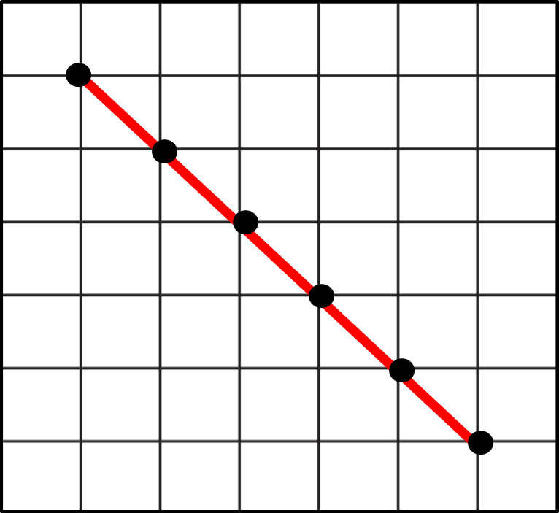
Aggregate Demand
Total quantity of all goods and services consumers are willing and able to purchase at each price level over a given period of time
Three Reasons for The Downward Slope:
Inverse relationship between Price Level and Real GDP
Price Level
1. Interest Rate Effect: As interest rates rise consumers and businesses spend less
3. Net Exports Effect: Inflation in a nation increases the cost of exports from that nation, reducing demand in other nations.
2. Wealth Effect: As interest rates rise, purchasing power decreases.
Real GDP

Slide 24
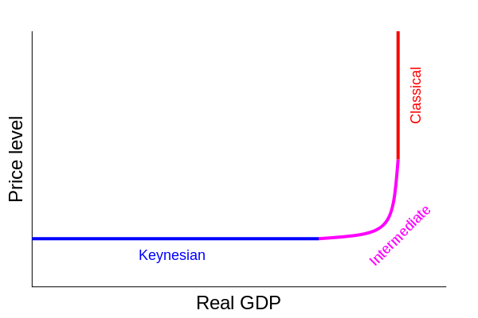
Aggregate Supply
Total quantity of final goods and services producers in an economy are willing and able to produce
Has both a short-run and long-run curve
Notes:
Image in Creative Commons by King of Hearts, https://commons.wikimedia.org/wiki/File:Aggregate_supply.svg

Slide 25
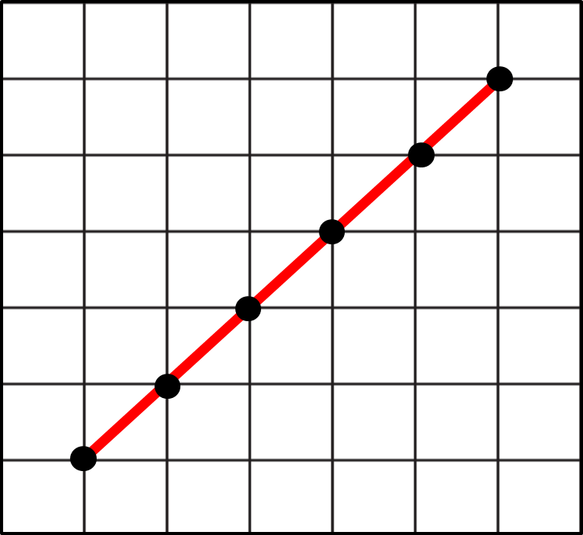
Short-Run Aggregate Supply
Why It Is Upward Sloping in The Short-Run:
Price Level
Sticky Wages and Prices: Wages and prices are slow to change because of contracts.
Real GDP

Slide 26
Long-Run Aggregate Supply
Price Level
Why It Is Vertical in The Long-Run:
Prices and Wages are flexible in the long-run.
Real GDP
In the long-run, price-level change has no effect on long-run quantity of goods and services.
Vertical at the full employment level of real GDP.

Slide 27
Increases in Aggregate Demand
Short-Run Aggregate Supply
Price Level
Real GDP Increases:
Indicates growth if % change in GDP is greater than % change in price level
PL2
PL1
Aggregate Demand 2
Aggregate Demand 1
Y1
Y2
Real GDP

Slide 28
Increases in Aggregate Demand
Price Level Increases:
Indicates increase in inflation rate. Amount of increase determines how well price stability goals are being met.
Short-Run Aggregate Supply
Price Level
PL2
PL1
Aggregate Demand 2
Aggregate Demand 1
Y1
Y2
Real GDP

Slide 29
Decreases in Aggregate Demand
Short-Run Aggregate Supply
Price Level
Real GDP Decreases:
Indicates less short-run employment. Means the economy is contracting.
PL2
PL1
Aggregate Demand 2
Aggregate Demand 1
Y1
Y2
Real GDP
Notes:
Film, Macro 3.1- Aggregate Demand Practice: https://www.youtube.com/watch?v=l6Udc6uDX8o

Slide 30
Increases in Aggregate Supply
Aggregate Supply 1
Price Level
Aggregate Supply 2
Real GDP Increases:
Change from Y1 to Y2 means more short-run employment
PL1
PL2
Aggregate Demand
Short-Run economic growth because of lower price level.
Y1
Y2
Real GDP

Slide 31
Decreases in Aggregate Supply
Aggregate Supply 1
Price Level
Aggregate Supply 2
Real GDP Decreases:
Change from Y1 to Y2 means less short-run employment
PL1
PL2
Aggregate Demand
Economic contraction because of higher price level.
Y1
Y2
Real GDP
Stagflation
Notes:
Film, Macro 3.2- Aggregate Supply Practice: https://www.youtube.com/watch?v=UwAQRnpVMzI

Slide 32
Unanticipated Inflation
Sectors= Households, Businesses, Financial Institutions, and Governments
Sectors act as BOTH borrowers and lenders
Lenders are hurt by fixed rate loans when unanticipated inflation occurs.
Borrowers of fixed rate loans benefit from unanticipated inflation.
Notes:
Film, What is Inflation?: https://www.youtube.com/watch?v=UMAELCrJxt0

Slide 33
Types of Unemployment
Cyclical (short-run) = Occurs as a result of a downturn in overall economic activity. When economic expansion happens, jobs will return.
Example: During an economic down-turn, people are buying fewer new cars. Car factories lay off non-essential employees until the economy turns around.

Slide 34
Types of Unemployment
Frictional (long-run) = Occurs as a result of graduates seeking jobs or workers seeking better jobs.
Example: Employees attain higher degrees and quit their jobs to find higher paying ones.

Slide 35
Types of Unemployment
Structural (long-run) = Occurs as a result of workers not having the skills employers are looking for.
Example: Many high school graduates do not have the problem-solving skills employers are looking for.

Slide 36
Types of Unemployment
Seasonal (long-run) = Occurs as a result of employers needing a skill set only part of the year.
Example: Retail stores hire extra employees during the Christmas season.
Notes:
Film, GDP, Unemployment, Inflation- EconMovies #6: Back to the Future: https://www.youtube.com/watch?v=3GTgniuxA50

Slide 37
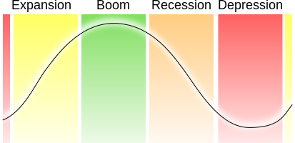
The Business Cycle
Peak
Real GDP
Contraction
Recovery/ Expansion
Trough
Time
Notes:
Image in Public Domain: https://commons.wikimedia.org/wiki/File:Economic_cycle.svg
Film, Macro 2.7- Business Cycle Unit Summary: https://www.youtube.com/watch?v=O-M6ZK93LnM

