Slide 1
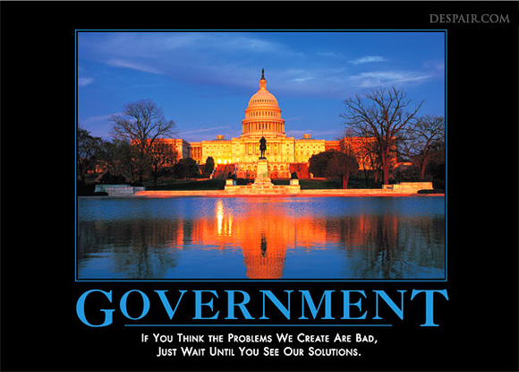
1

Slide 2
Review: The Invisible Hand
of the free market:
If society wants computers and people are willing to pay high prices then…
Businesses have the INCENTIVE to start making computers to earn PROFIT.
This leads to more COMPETITION….
Which means lower prices, better quality, and more product variety.
To maintain profits, firms find most efficient way to produce goods and services.
The government doesn’t need to get involved since the needs of society are automatically met.
2

Slide 3
Does the Free Market ever FAIL to meet society’s needs?
3

Slide 4
What is a Market Failure?
Market Failure- A situation in which the free-market system fails to satisfy society’s wants.
(When the invisible hand doesn’t work.)
Private markets do not efficiently bring about the allocation of resources.
What’s the result…
The government might be called upon to attempt to satisfy society’s wants.
4

Slide 5
How does the free market FAIL?
5

Slide 6
The Four Market Failures
We will focus on four different market failures:
Public Goods
2. Externalities (third person side effects)
3. Monopolies
4. Unequal distribution of income
In each of the above situations,
the government may step in to attempt to
allocate resources efficiently.
6

Slide 7
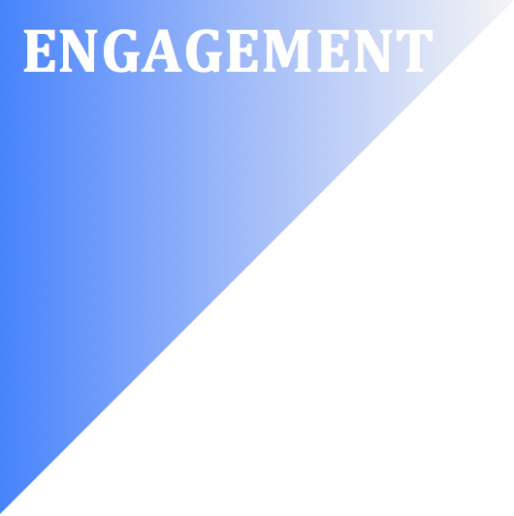
Notes:
https://www.youtube.com/watch?v=13JOGWzY8kE&list=PL1oDmcs0xTD-dJN1PL2N1urX0EKupBJCQ&index=22

Slide 8
Market Failure #1: Public Goods

Slide 9
Public Goods
If there was no government, how would schools, parks, and freeways be different?
Would there be enough to meet our needs?
Public Sector- The part of the economy that is primarily controlled by the government
Private Sector- The part of the economy that is run by private individuals and companies that seek profit.
Video: Fire Department Auction
9
Notes:
https://www.youtube.com/watch?v=oGudMA9RJuU

Slide 10
Public Goods
Why must the government provide public goods and services?
It is impractical for the free-market to provide these goods because there is little opportunity to earn profit.
This is due to the Free-Rider Problem
Free Riders are individuals that benefit without paying.
Notes:
https://www.youtube.com/watch?v=PwJrPa8Ps7A&t=139s

Slide 11
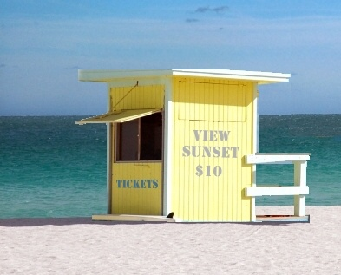
What’s wrong with this picture?
11

Slide 12
The Free Rider Problem
Examples:
People who download music illegally
People who watch a street performer and don’t pay
Teenagers that live at home and don’t have a job

Slide 13
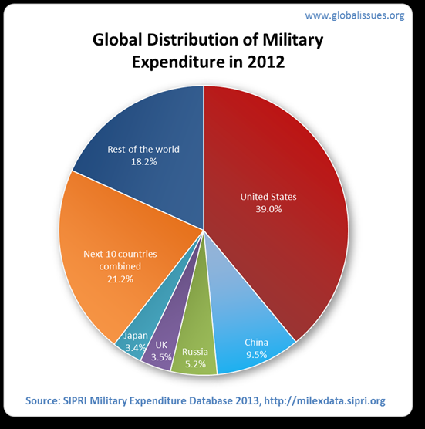
Does anyone free ride off you?
Canadian Military Spending: $21.8 Billion
US Military Spending: $660 Billion
Why doesn’t Canada spend more on their military?
13

Slide 14
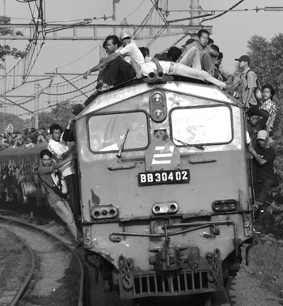
What’s wrong with Free Riders?
Free-Riders keep firms from making profits.
If left to the free market, essential services would be under produced.
To solve the problem, the government can:
1. Find new ways to punish free-riders.
2. Use tax dollars to provide the service to everyone.
14

Slide 15
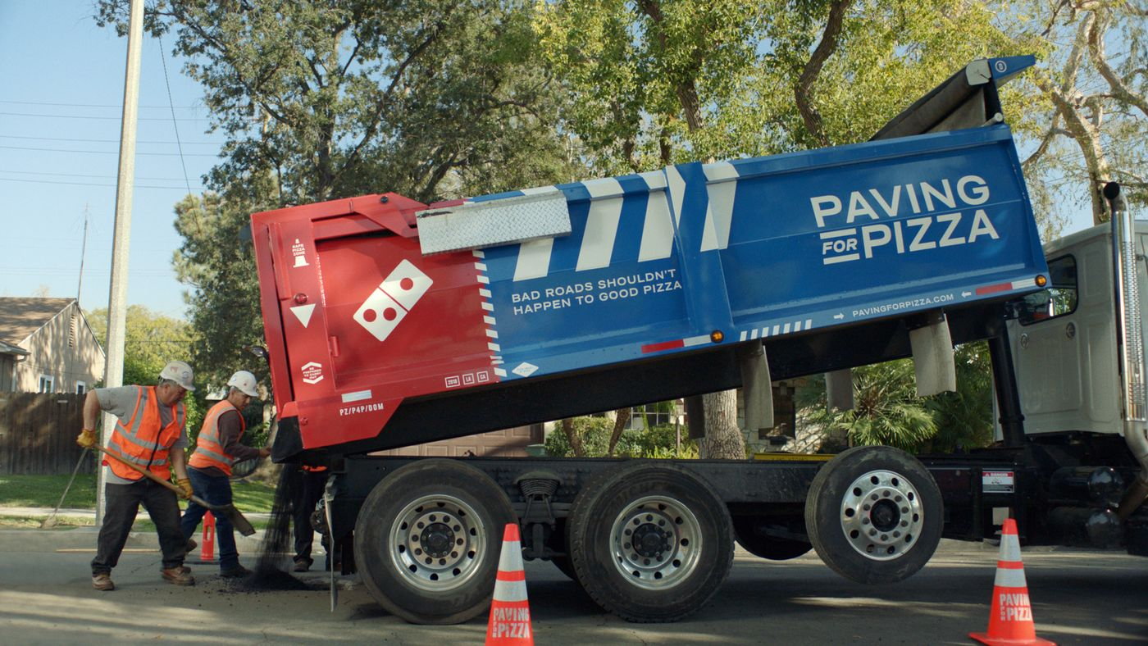
Think About It:
Why is Domino’s providing this public good?
Notes:
https://www.youtube.com/watch?v=JDd-HP3FA4s

Slide 16
Notes:
https://www.youtube.com/watch?v=nsWuzS_dEM8&list=PL71234D006E682C13&index=4

Slide 17
Definition of Public Goods
17

Slide 18
Definition of Public Goods
Public goods have two criteria:
1. Non-exclusionary
Cannot exclude people from enjoying the benefits (even if they don’t pay).
Ex: National Defense
2. Shared Consumption (Non-rival)
One person’s consumption of a good does not reduce the usefulness to others.
Ex: City Park
18

Slide 19
Identify which of the following are
TRUE public goods
(are non-exclusionary and non-rival in consumption):
1. Hamburgers
2. Satellite TV
3. Free Public Education
4. Homes
5. Street lights
6. Highways
19

Slide 20
Review
List the characteristics of the Free Market.
Define Market Failure.
What is the “invisible hand”?
Why must the government provide public goods?
Define Free Rider.
What is wrong with having free riders?
List 10 streets in this city.
20

Slide 21
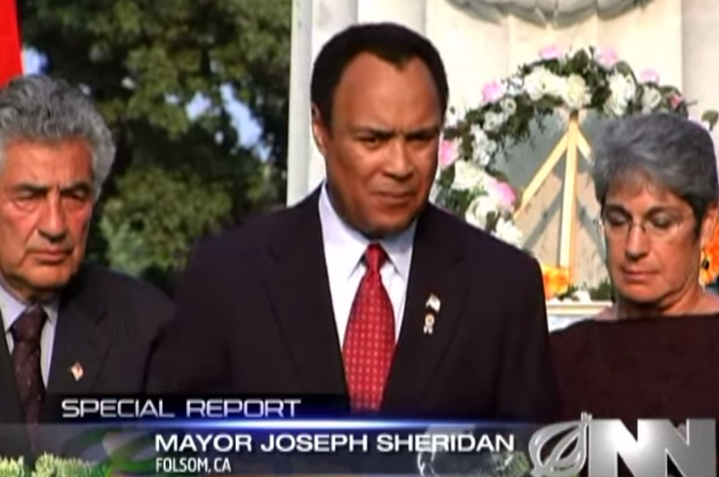
How do we decide how many public goods we need?
21
Notes:
https://www.youtube.com/watch?v=yjfrJzdx7DA

Slide 22
Can the government…
Prevent wildfires in San Diego forever?
Ensure that no one ever speeds on the freeway?
Create a research station on Mars?
Stop pollution from fossil fuels?
Completely stop illegal immigration?
Make sure everyone in the US has a job?
YES! But the costs outweigh the benefits.
How does the government decide how many public goods to provide?

Slide 23
How does the government determine what quantity of public goods to produce?
They use Supply and Demand
Demand for Public Goods-
The Marginal Social Benefit of the good is its usefulness to society add is determined by citizens willingness to pay.
Supply of Public Goods-
The Marginal Social Cost of providing each additional quantity.
Produce where MSB = MSC

Slide 24
Demand for a New Park
Marginal willingness to pay higher taxes
Assume:
There are only two people in society.
Each additional park costs $5
How many parks should be made?
# of Parks | Adam is willing to pay | Jill is willing to pay | Society’s Demand for Parks | Marginal Cost
1 | $4 | $5 | $9 | $5
2 | $3 | $4 | $7 | $5
3 | $2 | $3 | $5 | $5
4 | $1 | $2 | $3 | $5
5 | $0 | $1 | $1 | $5

Slide 25
Demand for a New Park
Marginal willingness to pay higher taxes
# of Parks | Adam is willing to pay | Jill is willing to pay | Society’s Demand (MSB) | Marginal Cost per Park
1 | $4 | $5 | $9 | $5
2 | $3 | $4 | $7 | $5
3 | $2 | $3 | $5 | $5
4 | $1 | $2 | $3 | $5
5 | $0 | $1 | $1 | $5
Copyright
ACDC Leadership 2018

Slide 26
Demand for a New Park
Marginal willingness to pay higher taxes
# of Parks | Adam is willing to pay | Jill is willing to pay | Society’s Demand (MSB) | Marginal Social Cost
1 | $4 | $5 | $9 | $5
2 | $3 | $4 | $7 | $5
3 | $2 | $3 | $5 | $5
4 | $1 | $2 | $3 | $5
5 | $0 | $1 | $1 | $5
Copyright
ACDC Leadership 2018

