Slide 1
The Late Middle Ages
The Rise of Nations

Slide 2
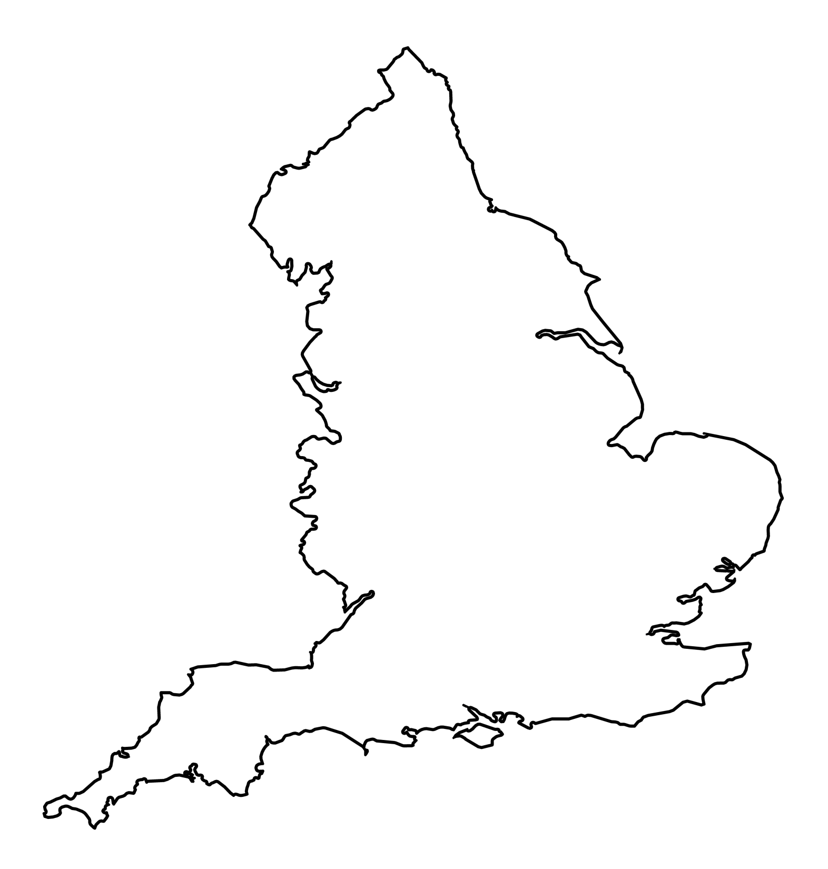
England
Anglo-Saxon culture
Alfred the Great, ruled 871-899
- turned back Vikings
Successors united England, “land of Angles”

Slide 3
England
1016, Danish king, Canute
- Anglo-Saxon and Viking blend
1042 Edward the Confessor (descendant of Alfred)
1066 Edward died, no heir

Slide 4
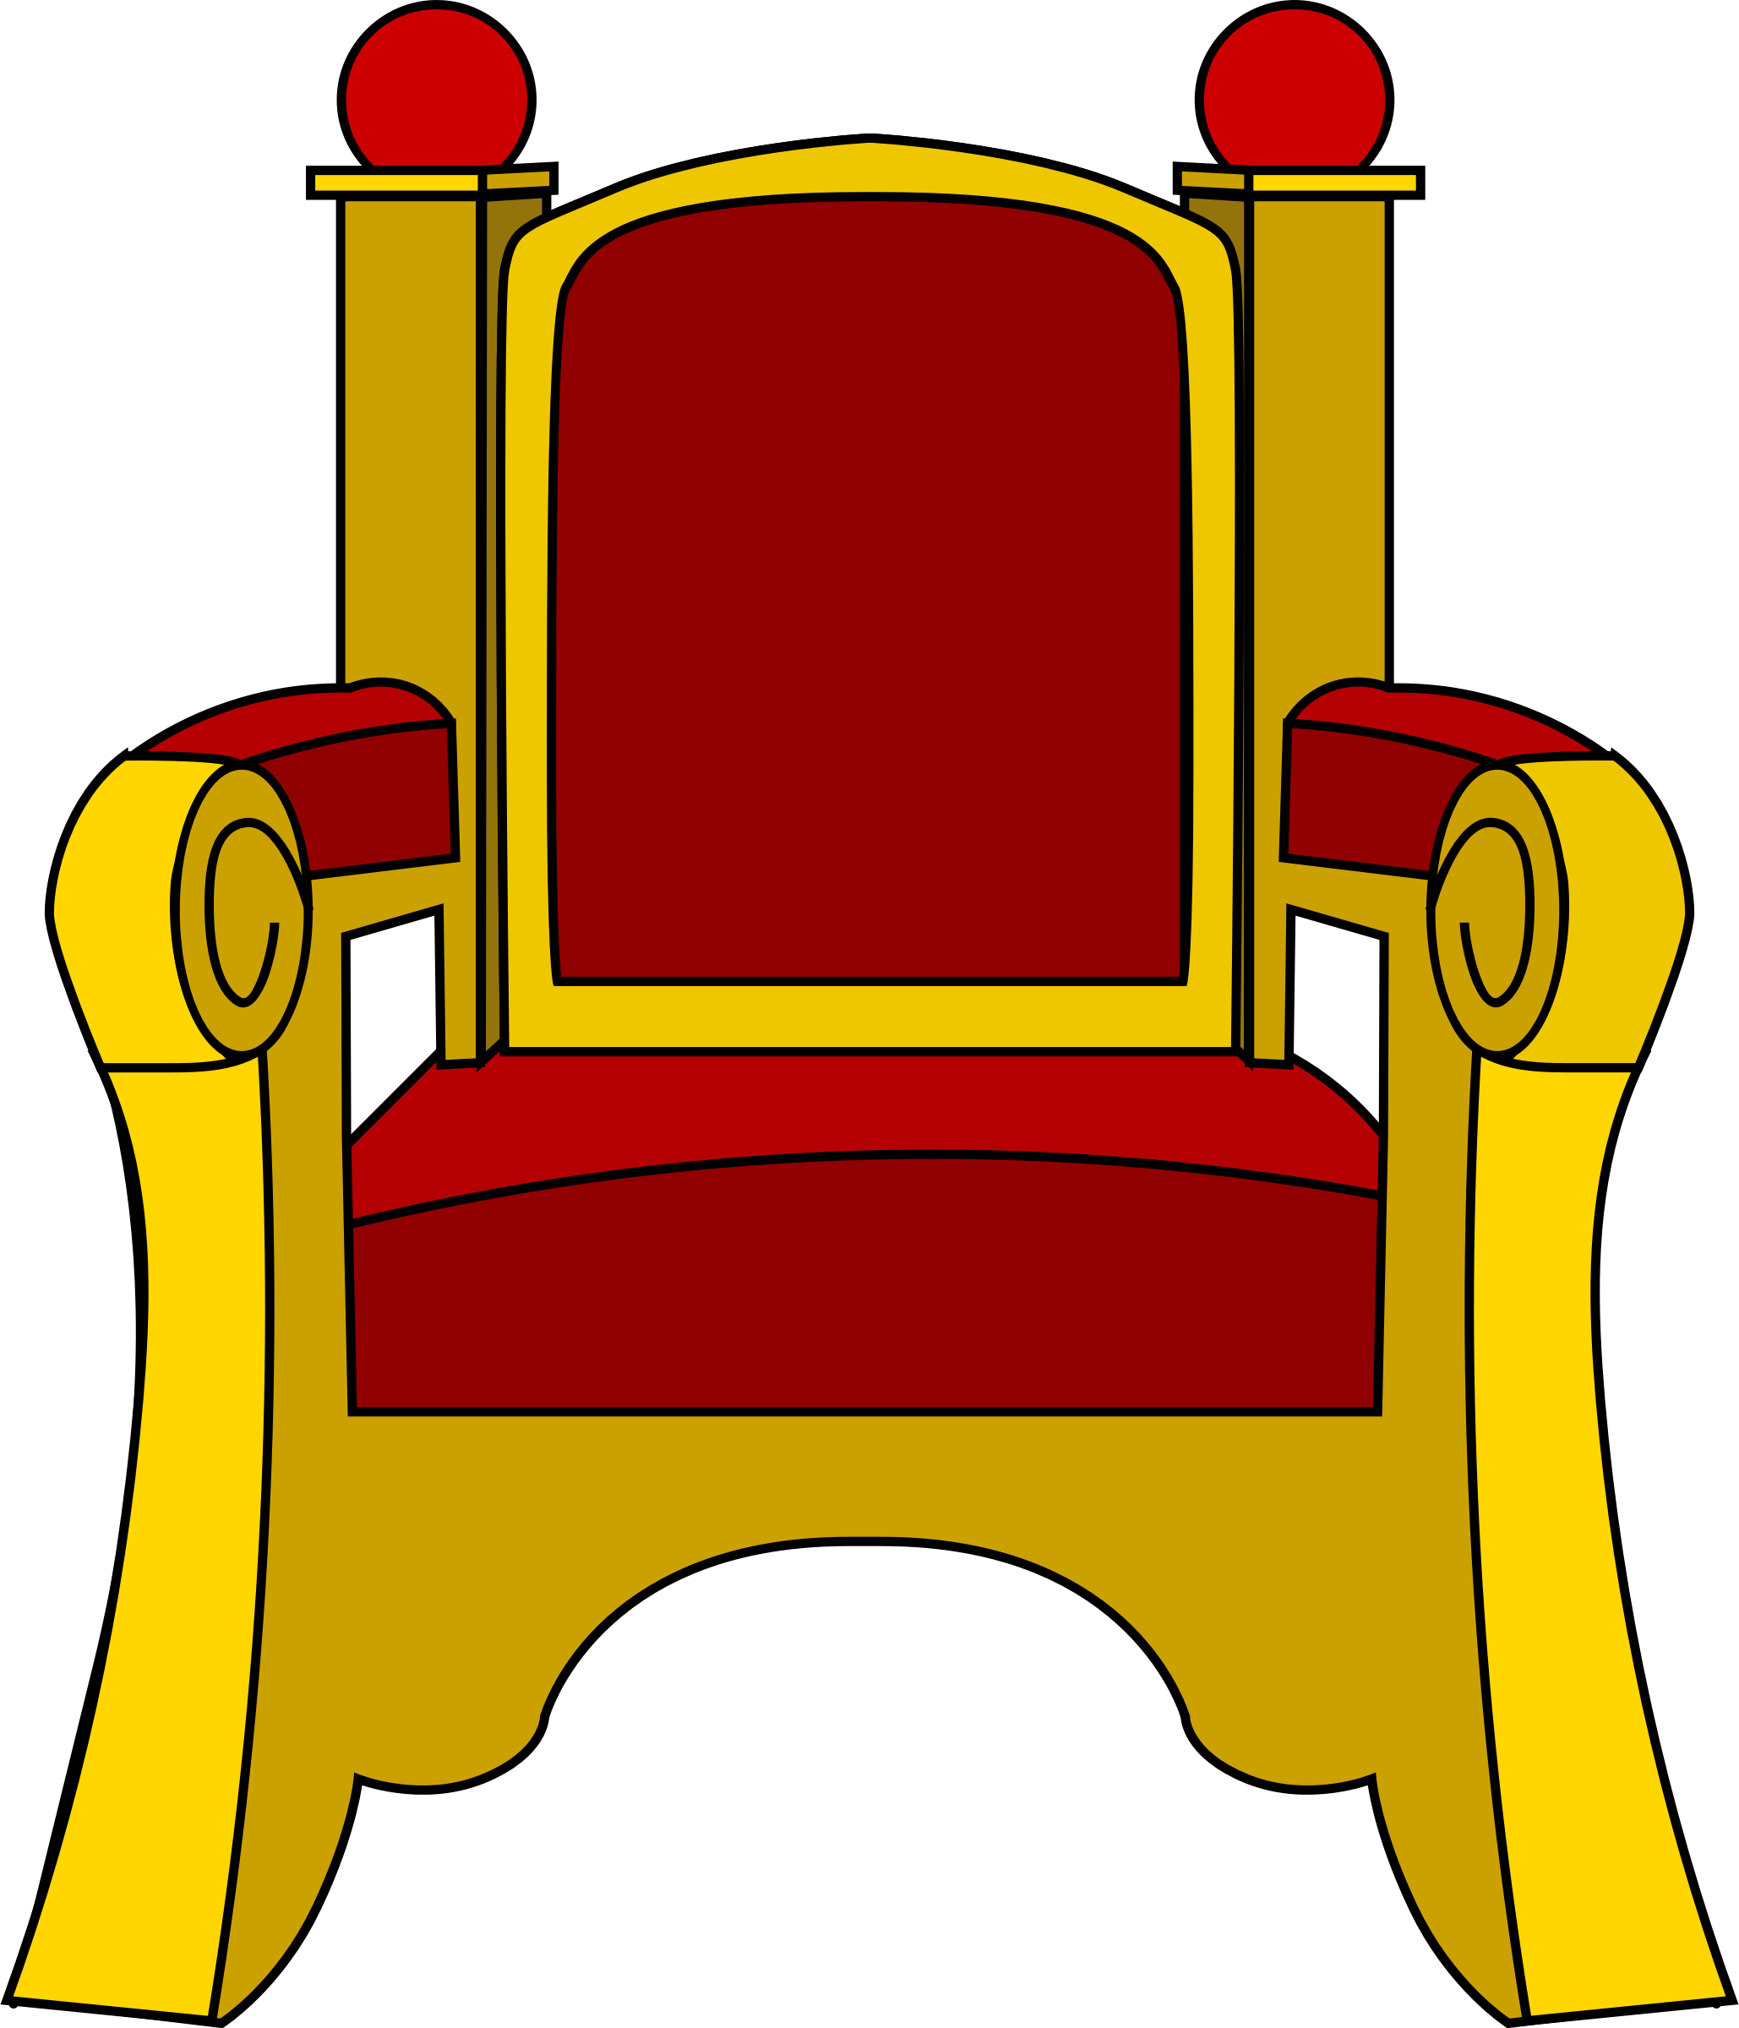
Struggle for the Throne
Two Claimants:
- Harold Godwinson, Anglo-Saxon
- William the Conqueror, French
- Edward’s cousin
- Invaded England

Slide 5
WILLIAM THE CONQUEROR
Notes:
Image in public domain: https://commons.wikimedia.org/wiki/File:William_the_conqueror.jpg

Slide 6
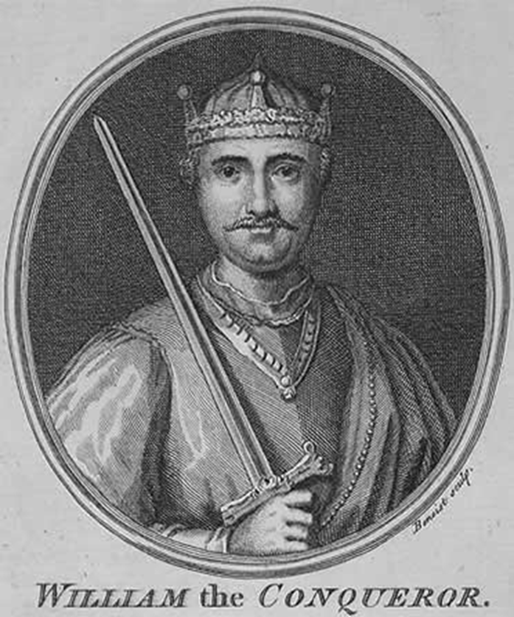
1066
October 14, 1066 Battle of Hastings
- William won
- Declared England his
- Gave land to 200 French lords
- United England
VIDEO
Notes:
Video, “William the Conqueror,” to the tune of “Sexyback,” 3:56: https://www.youtube.com/watch?v=bQ8A5gRe_Dw

Slide 7
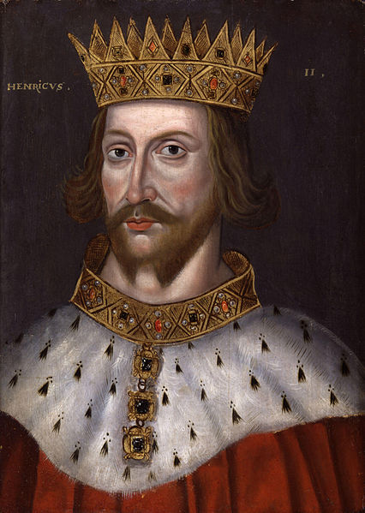
Henry II
English king, French vassal
Married Eleanor of Aquitaine
Annual court of justice
- Trial by Jury
- Common Law

Slide 8
Henry’s Sons
Richard the Lionhearted
John Softsword, ruled 1199-1216
- lost Normandy
- Resulted in Magna Carta, 1215
- No taxation without rep.
- Trial by Jury
- Protection of Law
VIDEO

Slide 9
Model Parliament
1295, Edward I wanted to fight French Welsh, and Scots
Needed money
Needed wide support
Two burgesses (wealthy property owners) from every borough
Two knights from every county

Slide 10
Model Parliament
Basis of current parliament:
- House of Commons
- House of Lords
Parliament and Magna Carta checked King and Lord’s power

Slide 11
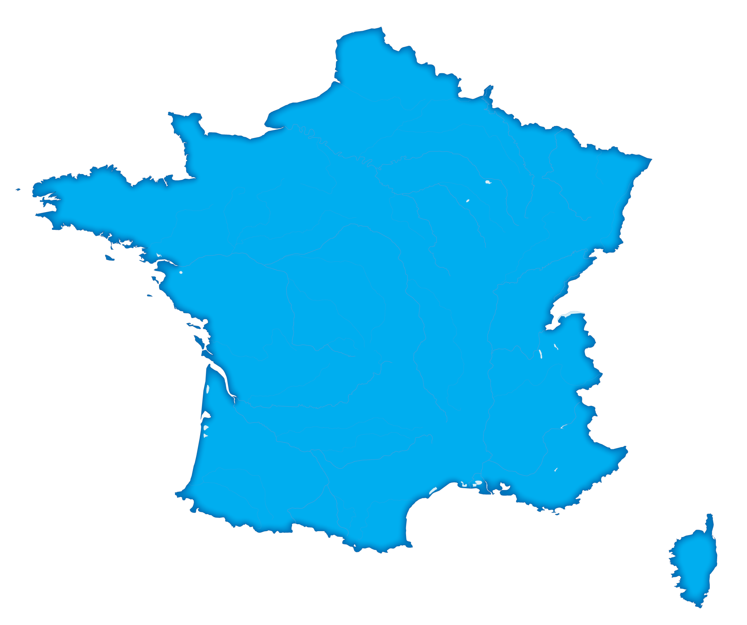
France
1000, 47 Feudal territories
987, Last Carolingian died
987-1328, Hugh Capet began Capetian Dynasty
Notes:
1000 feudal territories meant that there was a power struggle between the king and the lords.

Slide 12
Philip IV
1285-1314
1302, pope said priests didn’t have to pay the king taxes
Wanted wider support against the pope
- allowed commoners into estates-
general

Slide 13
Estates-General
1st Estate=Church Leaders
2nd Estate=Great Lords
3rd Estate=Commoners (merchants and wealthy landowners)

Slide 14
100 YEARS WAR
England vs. France
from 1337-1453 (112 years)
Over the throne of France
Joan of arc, peasant French girl said she had spoken to God
Helped to build French morale
English longbow makes knight’s armor obsolete
France won!!!
VIDEO

Slide 15
WAR OF THE ROSES
THE WAR OF THE ROSES: 1455-1487
-England
-Also called the cousins’ war
-Lancaster (red rose) Vs.
-York (white rose)
-A lot of back and forth for a long time
-The Lancasters ruled, then the Yorks, and back again
-Finally, Lancaster wins
-Henry VII takes the throne
-TUDOR DYNASTY
-The legacy of the Yorks is seen through Tudor PROPOGANDA
-Richard III
-Princes in the tower

Slide 16
Important Dates of the Middle Ages
800: Charlemagne crowned emperor
1066: Battle of Hastings
1099: capture of Jerusalem by Crusaders
1198: Fall of Jerusalem to Saladin
1215: Magna Carta
1348-1350: Worst of Black Death
1337-1453: 100 Years War (between England and France)
1455-1485: English War of the Roses (Lancaster’s win; Tudor dynasty begins )
1492: The Reconquista of Spain
VIDEO
VIDEO

