Slide 1
Classical Greece

Slide 2
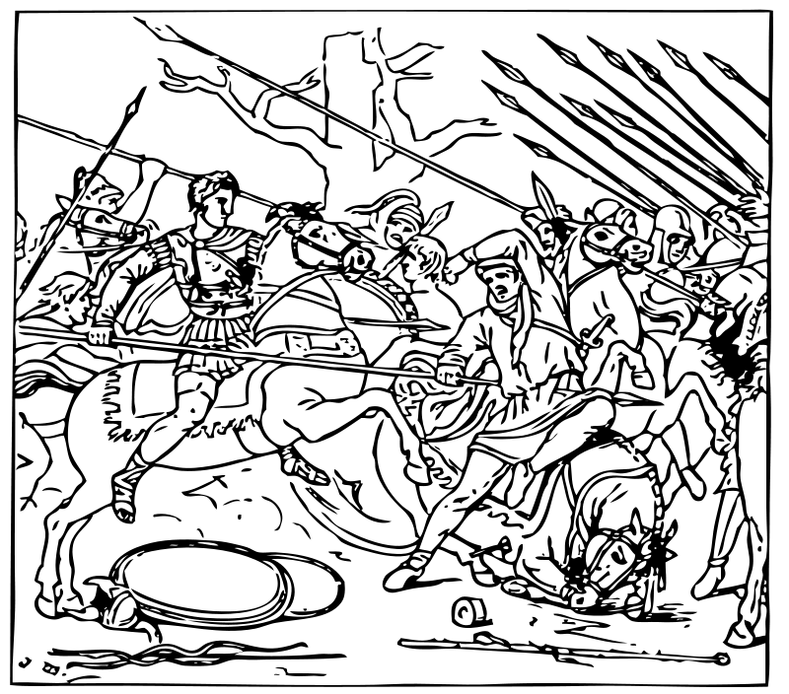
Focus: Classical Greece
Ca. 510 BCE – 323 BCE
The Persian Wars – The Death of Alexander the Great

Slide 3
Topics
Contributions
Religion
Persian Wars
Peloponnesian War
Culture
Macedonian Conquest
Alexander=Empire to Death

Slide 4
The Polis
Shaped by geography
- Rocky
- Mountainous
- Watery
***Hard to get from one place to another***
No central government
Collection of city-states

Slide 5
Vocabulary
What is the name for a Greek City-State?
POLIS

Slide 6
Greek Contributions
Democracy
Olympics
Trial by Jury
Theatre- comedy, tragedy, history
Medicine
Mythology

Slide 7
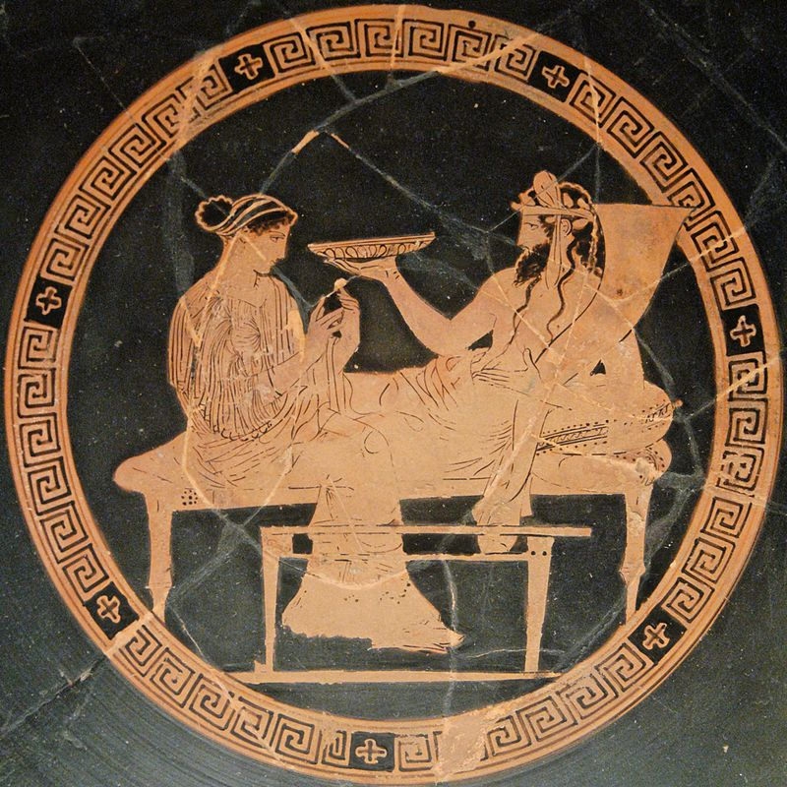
Greek Religion
Polytheistic
Main gods lived on Mt. Olympus
Eg.: Zeus, Hera, Apollo, Athena, Aphrodite, Ares, Poseidon, and Hades.
After death, everyone went to Hades

Slide 8
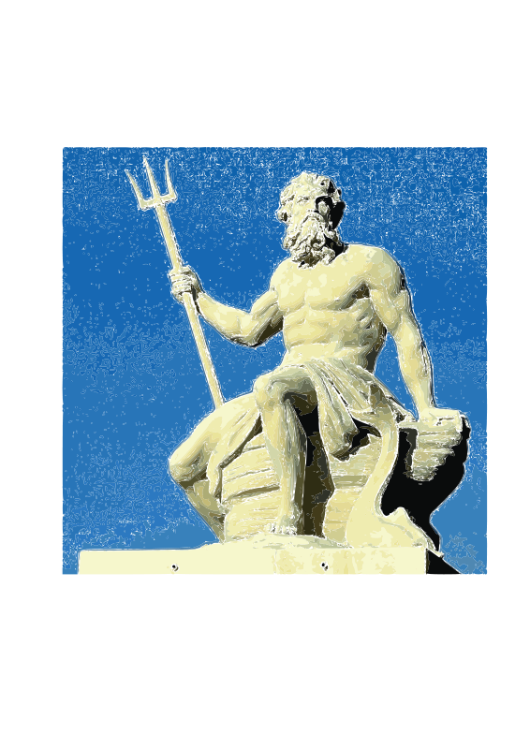
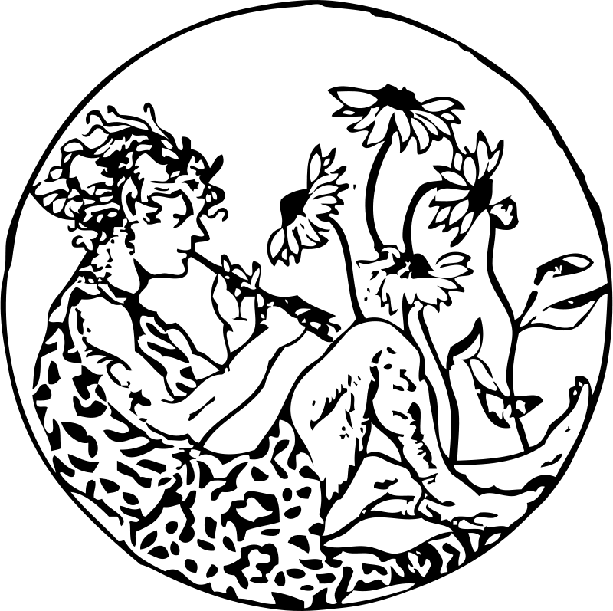
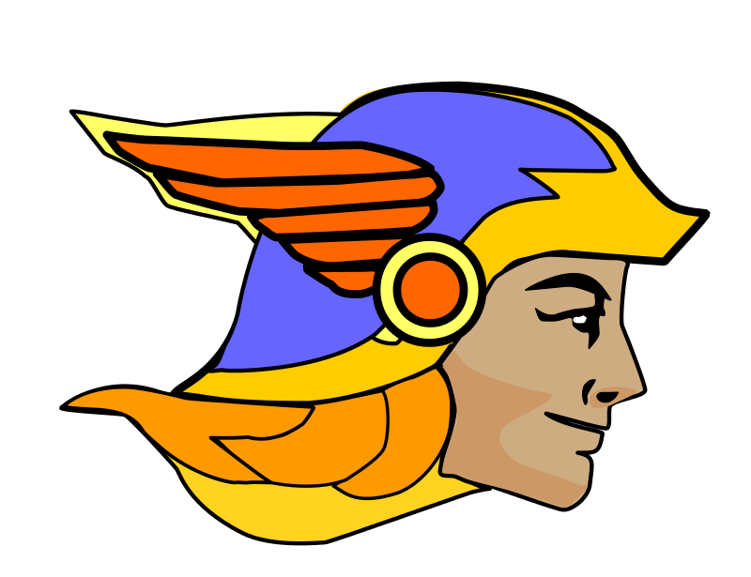
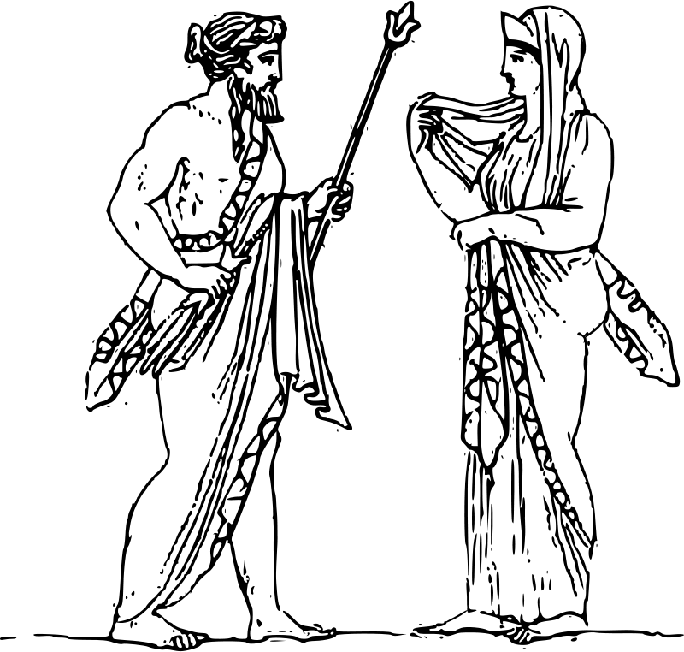
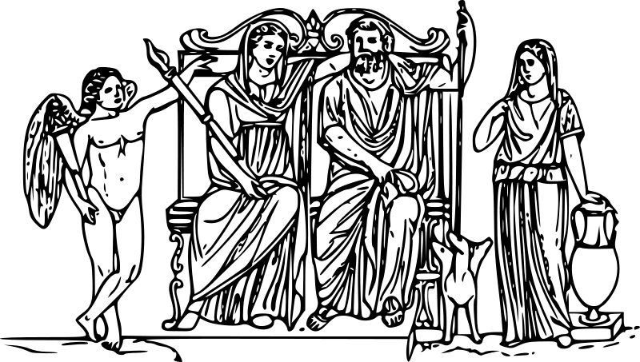

Slide 9
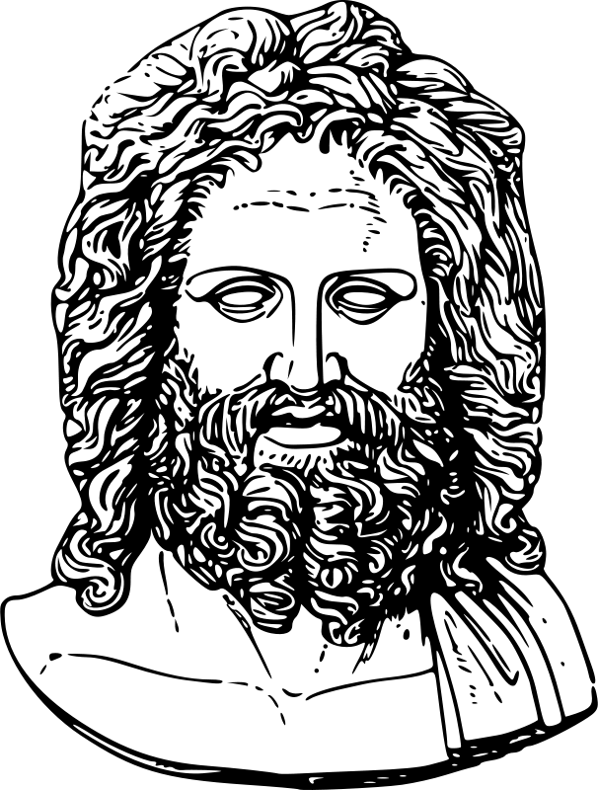
Religion
Some Greeks prayed to local gods rather than Mt. Olympus.
Remember, historians don’t always agree

Slide 10
Some say:
Greeks were not really united by religion
Some say:
They were
-Dionysia
-Olympics

Slide 11
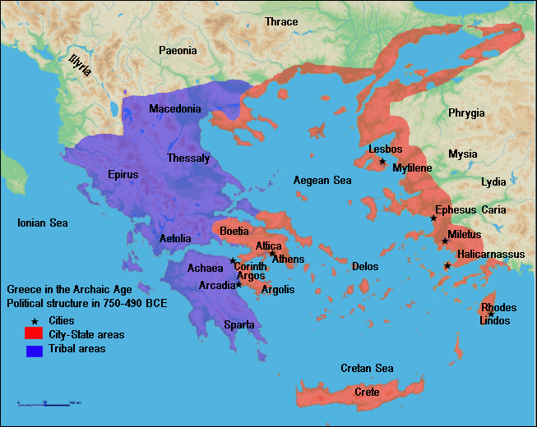
Ionia

Slide 12
Persian Wars
3 Different Wars over…
LAND

Slide 13
Fighting Styles
Persian tactics = barrage of arrows
Athenians and Spartans = close fighting with long, heavy spears, swords, and shields

Slide 14
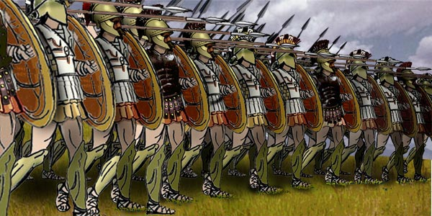

Slide 15
1st Persian War
492 BCE
Persian fleet went to attack Athens
Bad storm forced them to go back

Slide 16
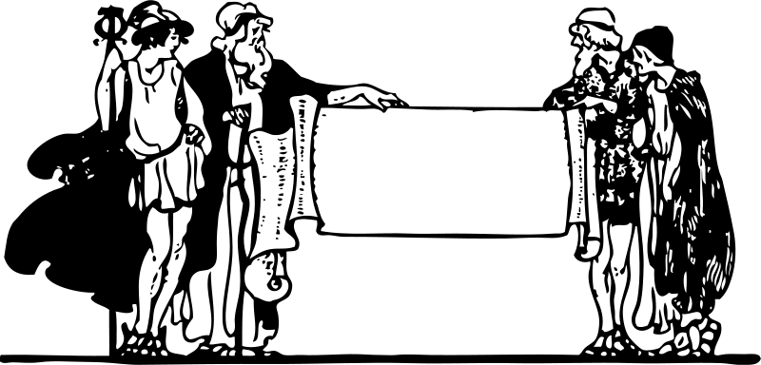
1st Persian War
King Darius of Persia sent messengers to Greek city-states.
Demanded “dirt and water” (subjugation)
Only Athens and Sparta refused.
Um…No

Slide 17
2nd Persian War
490 BCE Darius sent his fleet to attack Greece
8 days of fighting
Plains of Marathon = 10,000 Athenians vs. 20,000 Persians
Athenians won in 5 hours
6400 Dead Persians, only 192 Athenian deaths…
According to Herodotus

Slide 18
2nd Persian War
Sent Pheidippides the greatest runner in Greece to run and tell Athens they’d won. He fell dead at 26 miles from heat exhaustion and fighting after delivering the message.

Slide 19
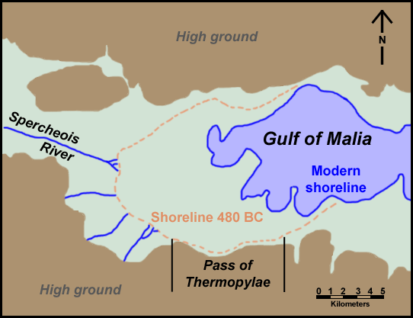
3rd Persian War
3rd Persian War 480 BC
Xerxes, son of Darius, led a massive invasion
Thermopylae the Persian passage to Athens

Slide 20
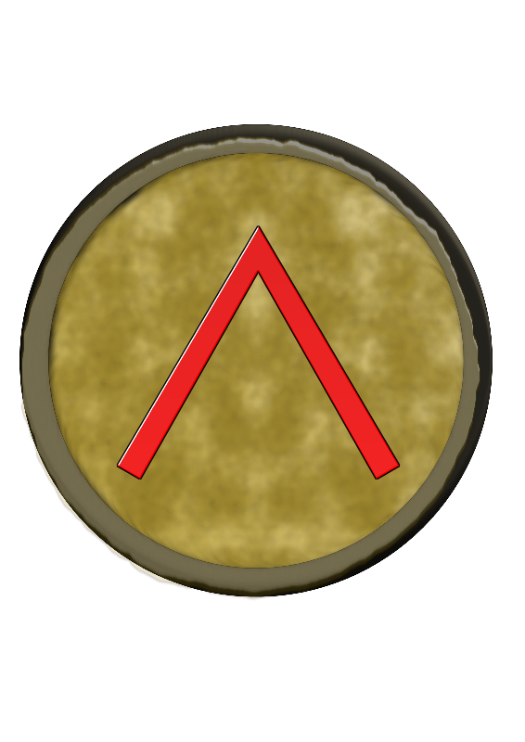
3rd Persian War
King Leonidas led 300 Spartans.
King Leonidas sent the other Greeks away when he realized they couldn’t win.
The Spartans held the Persians off for three days.

Slide 21
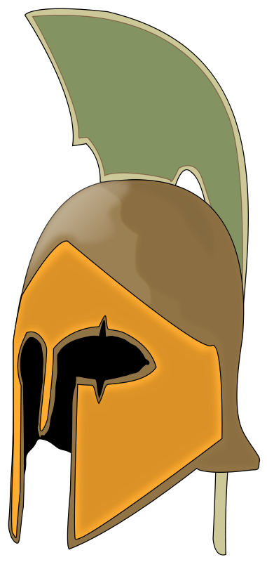
3rd Persian War
Xerxes sent his troops through a secret pass to surround the Spartans.
All 300 died.

Slide 22
3rd Persian War
The Persians destroyed Athens.
But Athens had been evacuated.
Athens’ navy defeated the Persians at sea.

Slide 23
So….
The Greeks were the winners…
And who is history told by?
The winners, of course

Slide 24
Legacy
We face the West instead of the East
Democracy
Prejudice
eleftheria (ελευθερια)
FREEDOM
We Win!

Slide 25
Vocabulary
What are three wars fought between Persia and Greece between 492 and 480 B.C.E.?
PERSIAN WARS

Slide 26
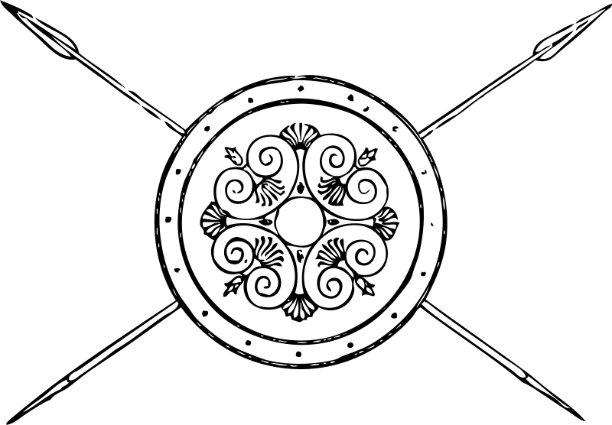
From City-States to…
EMPIRES
The Delian League
VS.
The Spartan Confederation

Slide 27
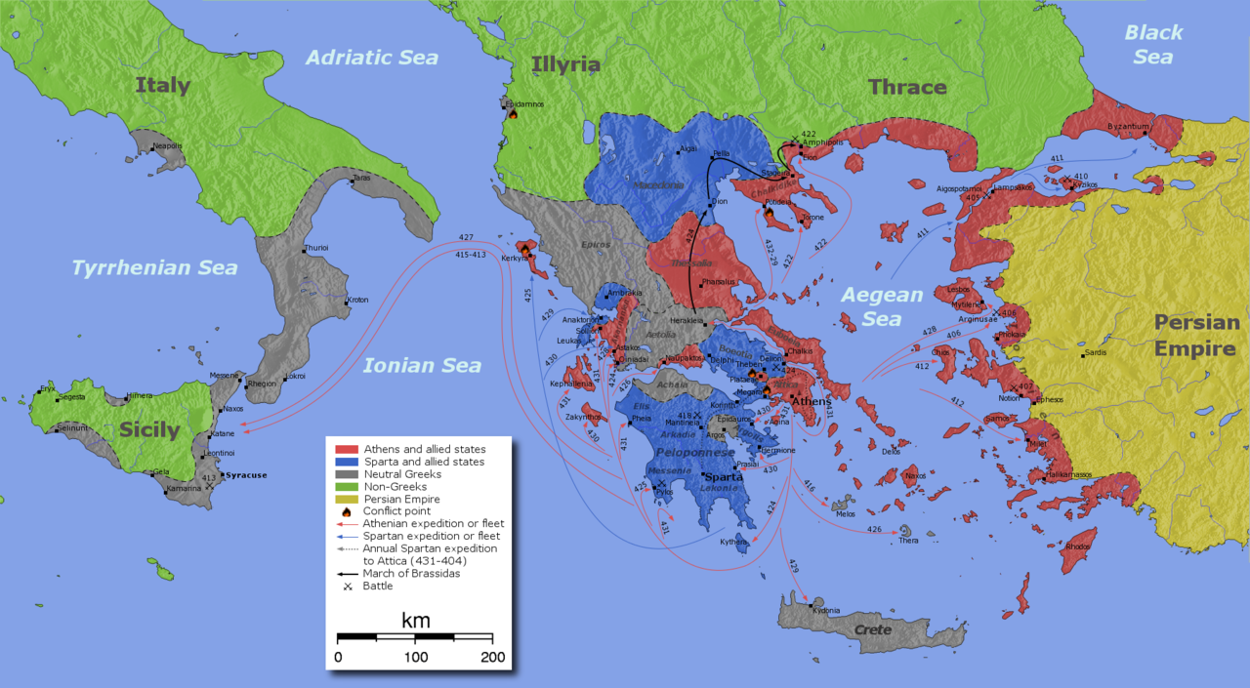
Delian League

Slide 28
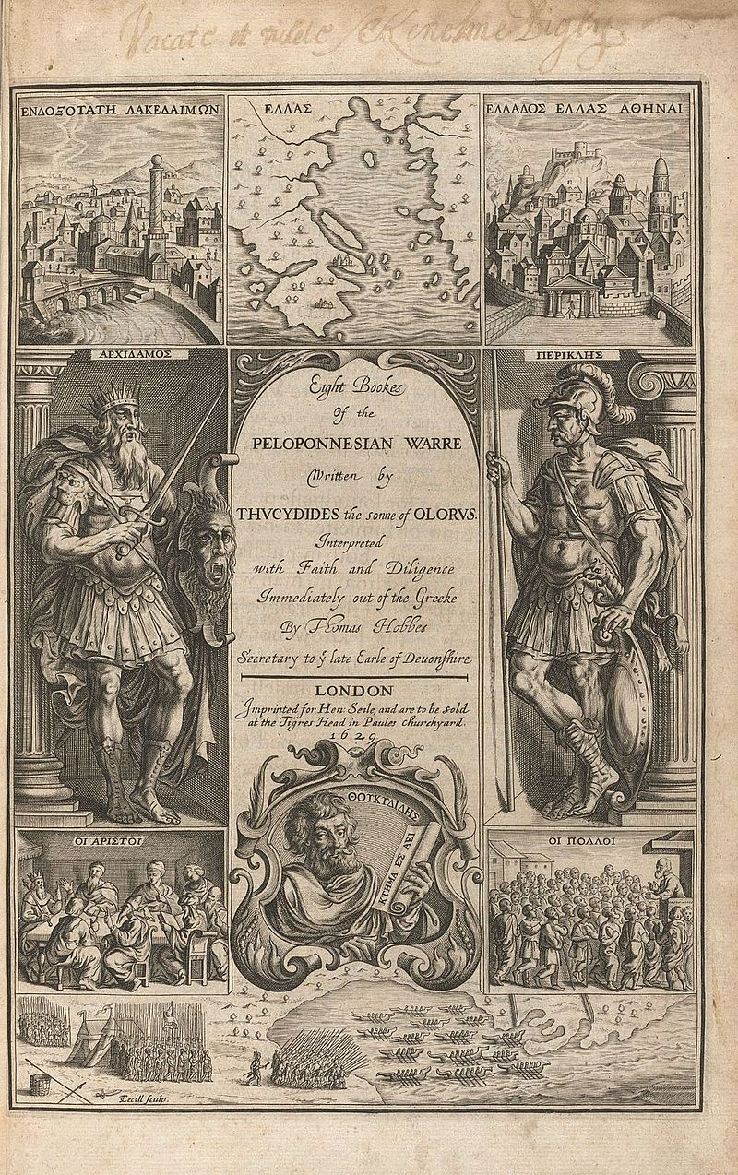
Peloponnesian War 431-404 B.C.
Sparta vs. Athens
27 years
Best Warriors=Sparta
Great Navy and BIG Population= Athens
Plague killed 60% of Athens’ population
Sparta won
No more Empire
City-states once more

Slide 29
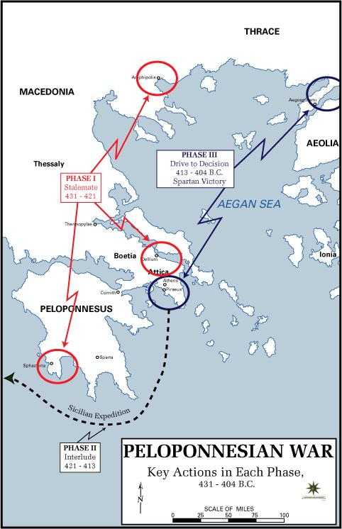

Slide 30
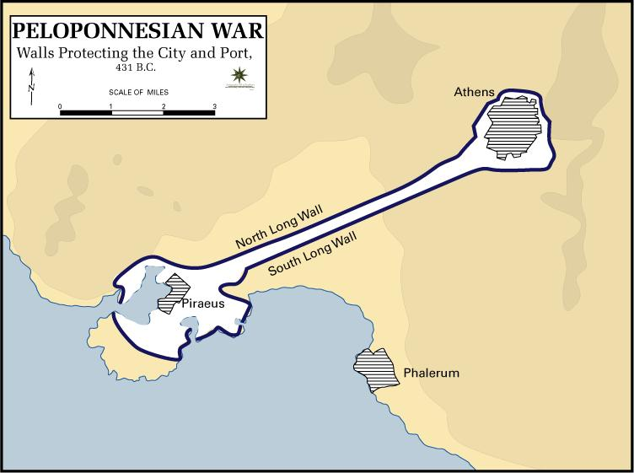

Slide 31
Vocabulary
What is the REALLY long war fought between Athens and Sparta called?
Peloponnesian War

Slide 32
Greek Philosophers
Socrates
469-399 B.C. Athens
Teacher and philosopher
Method of teachings was to ask questions (Socratic Method)

Slide 33
Put on trial for corrupting the youth:
- Questioned religion
- Criticized Peloponnesian War
Trial of Socrates 501 men on jury Found guilty of treason and gave him three choices:
1 Apologize
2 Move
3 Death by Hemlock
**he chose this**

Slide 34
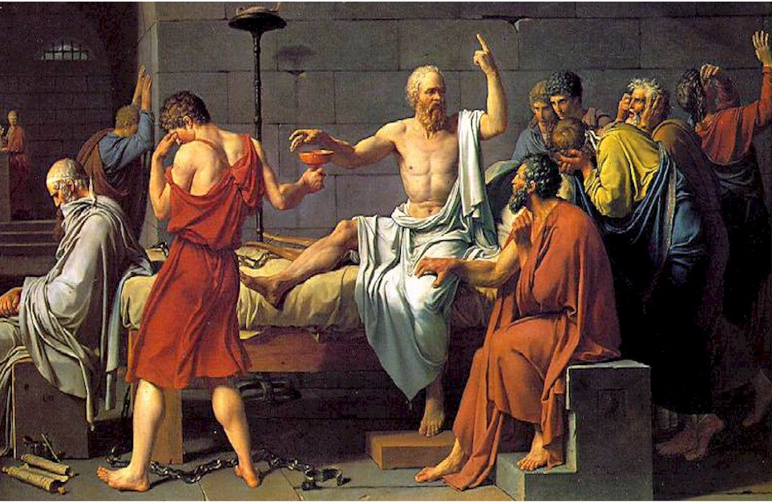
Video

Slide 35
Greek Philosophers
Plato
Socrates’ most famous student
Wrote The Republic
Wrote about Socrates
One of first written works to argue for equal rights for women

Slide 36
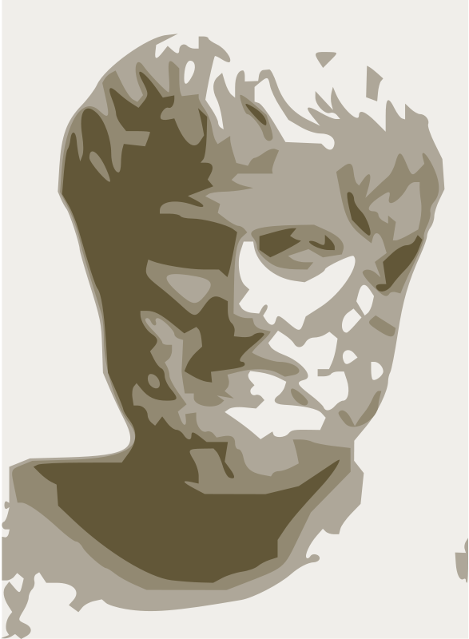
Greek Philosophers
Aristotle
Studied under Plato
Father of Biology

Slide 37
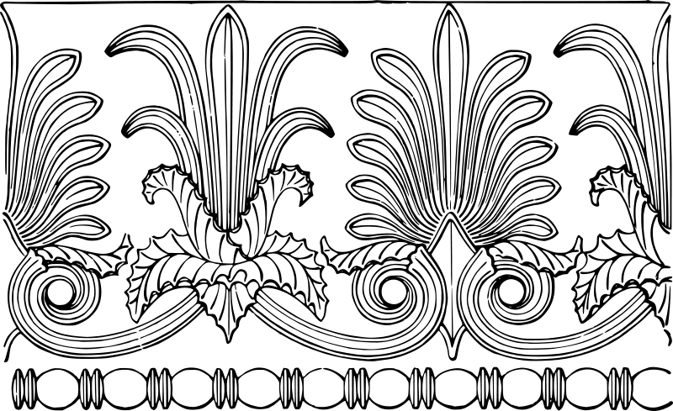
Wrote Politics
Taught Alexander the Great
“Patience is virtue”
“Moderation”

Slide 38
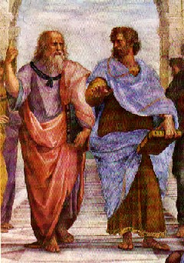

Slide 39
Vocabulary
Which Greek philosopher taught by questioning?
Socrates
Which one wrote The Republic?
Plato
Which one taught Alexander the Great?
Aristotle

Slide 40
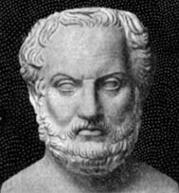
Greek Writers
Homer
Blind
Wrote Iliad and The Odyssey
Herodotus
Father of History
Wrote about 3 Persian Wars
Thucydides
Wrote about the Peloponnesian War

Slide 41
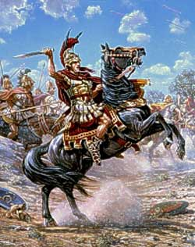
Famous Greeks
Pericles
Leader of Athens for 31 years between 460-429 BC
“Golden Age” of Athens
Philip II of Macedonia 350 BC
Attacked Persia
Brought 1/3 of Greek city-states under his control
Alexander the Great
356-323 BC*Macedonian*
Finished father’s job and conquered Greece, Persia, Egypt, and part of India
Died at age of 32 from malaria?

Slide 42
Alexander

Slide 43
Vocabulary
Who conquered most of the known world?
Alexander the Great
What is the name of the culture that is a result of his conquests?
Hellenistic Culture

