Slide 1

GLOBALIZATION

Slide 2
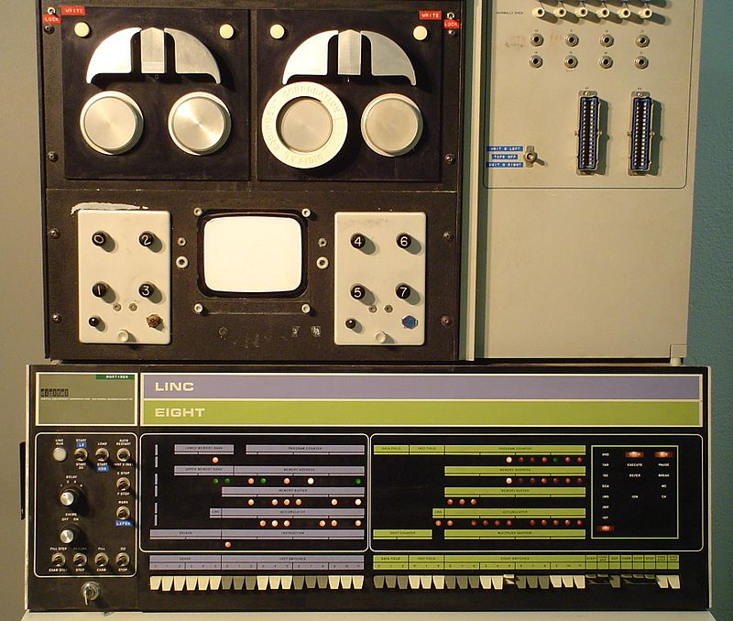
1966-69

Slide 3
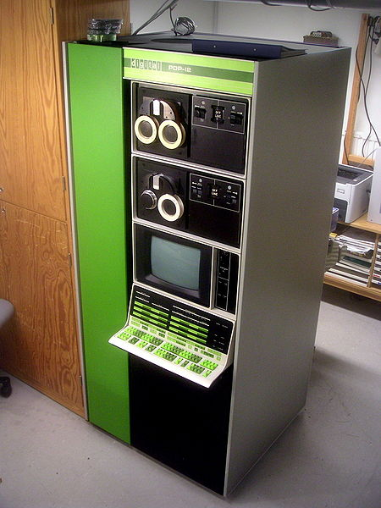
1969-72

Slide 4
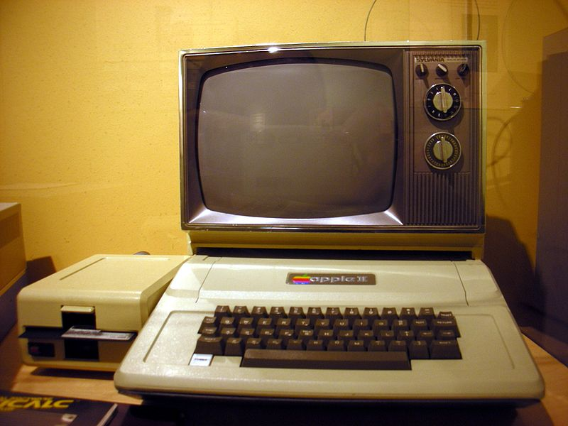
1977

Slide 5
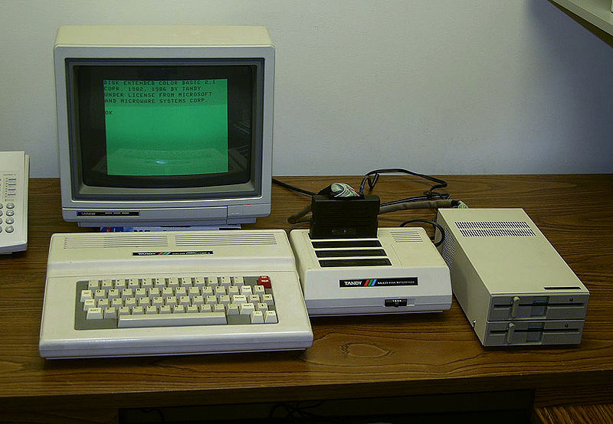
1986-1991

Slide 6
1994, The WorldWideWeb made the internet accessible to non-techies with web browsers like Netscape and Mosaic
Popular web browsers today are Google Chrome, Firefox, Microsoft Explorer, and Safari
VIDEO

Slide 7
Pair-Share
Discuss with your partner:
How does technology of the 1990s compare to the technology of today?
How do you think technology may change in the near future?

Slide 8
Globalization
Increased interaction and interdependence among various nations of the world
Driven by trade and enabled by technology
VIDEO

Slide 9
International Security
International Alliances such as NATO, SEATO, and the Warsaw Pact
United Nations Peacekeeping Forces
North Atlantic Treaty Organization
Southeast Asia Treaty Organization

Slide 10
International Pacts
Signed among nations for international security
1968, Nuclear Non-Proliferation Treaty
1970s, SALT Treaties
Treaties to prevent the manufacture of chemical or biological weapons

Slide 11
Persian Gulf War
1st Post Cold War Crisis
42 Days in 1991
VIDEO

Slide 12
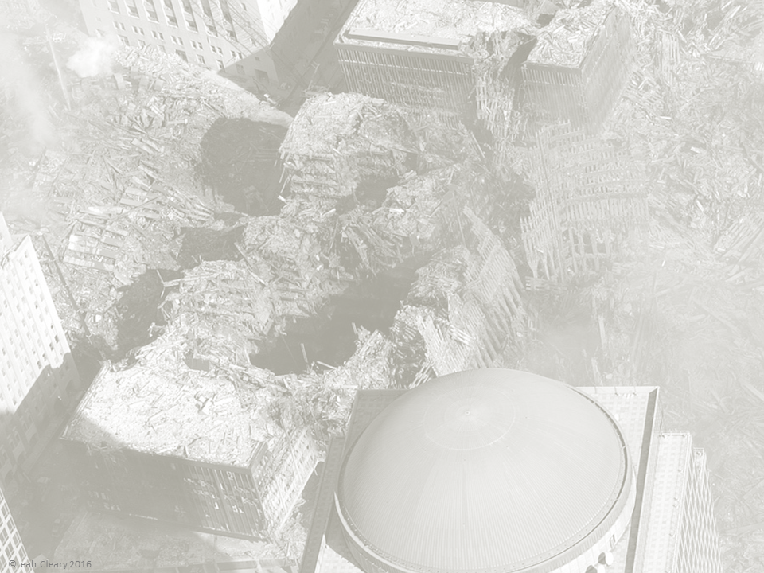
Terrorism
Violence to Force Change
Motives:
Political
National
Cultural
Religious

Slide 13
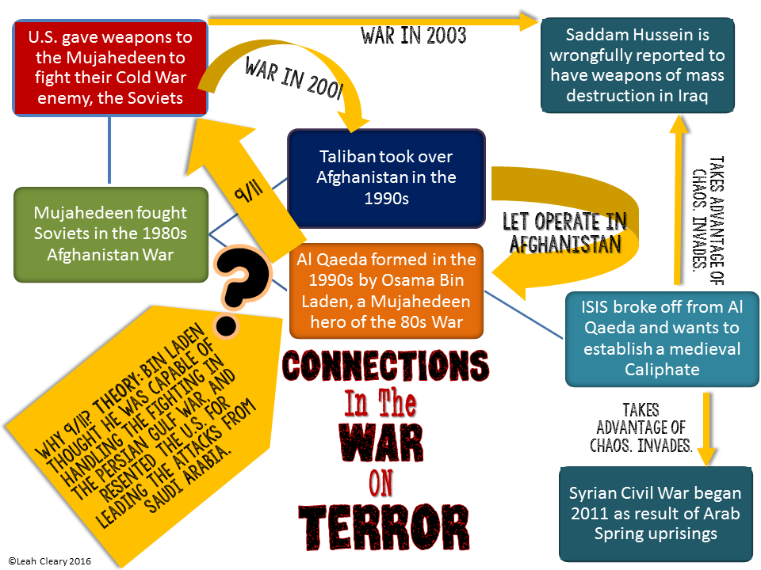

Slide 14
London Bombings
9/11 Attacks
War in Iraq
MAR.20
JUL.7
2001
2003
2004
2005
2008
OCT.7
MAR.11
JUN.2
Madrid Train Bombings
War in Afghanistan
Danish Embassy Bombing

Slide 15
Boko Haram Insurgency Begins in Nigeria
Benghazi Attack
Osama Bin Laden is Killed
Boston Marathon Bombing
SEPT.11
JUL.26
May2
APRIL15
2009
2011
2012
2013
NOV.5
DEC.18
SEPT.21-24
Iraq War Ends
Fort Hood Shooting
Westgate Shopping Mall Attack in Kenya

Slide 16
Back in Iraq to Fight ISIS
Paris Attacks
Charlie Hebdo Shootings in France
Afghan War Ends?
NOV.13
JUN.13
DEC.28
JAN.7
2014
2015
2016
APRIL14
SEPT.22
JUN.26
JAN.1
MAR.22
Boko Haram Kidnaps Schoolgirls
Ramadan Hotel Attacks
Fighting ISIS in Syria
Afghan War Continues
Brussels Bombings

