Slide 1
Macroeconomics
Fiscal and Monetary Policy
©Leah Cleary 2018

Slide 2
Role/ Function of Money
Fiat Money = Official currency of a government
It has value if people accept it

Slide 3
Role/ Function of Money
Three Functions of Money:
1. Medium of Exchange
2. Store of Value
3. Standard of Value (Unit of Account)

Slide 4
Medium of Exchange
Facilitates transactions:
Cash, credit, or debit used to make transactions between people and businesses

Slide 5
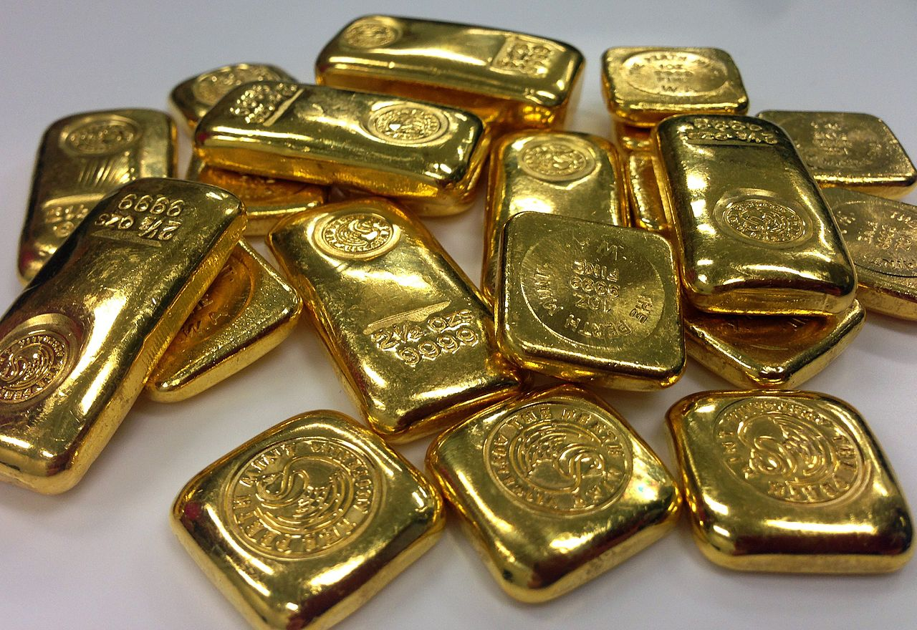
Store of Value
Saving Money for the Future:
Assumption that money saved today will retain its purchasing power

Slide 6
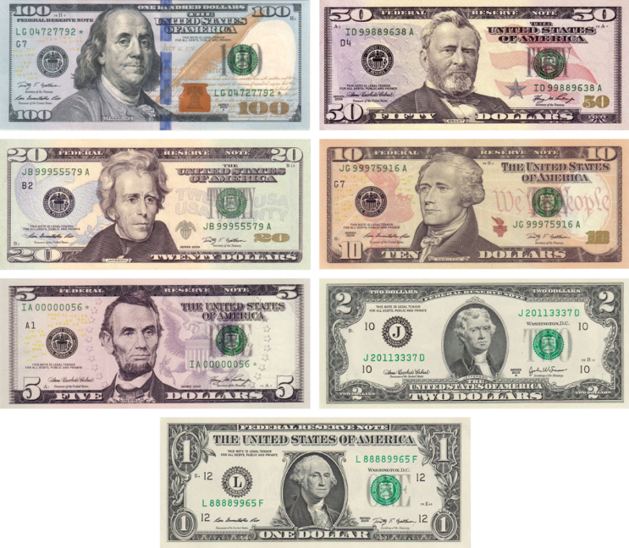
Standard of Value/ Unit of Account
Money as a Guide:
The dollar is our standard
Allows us to compare prices and value our savings

Slide 7
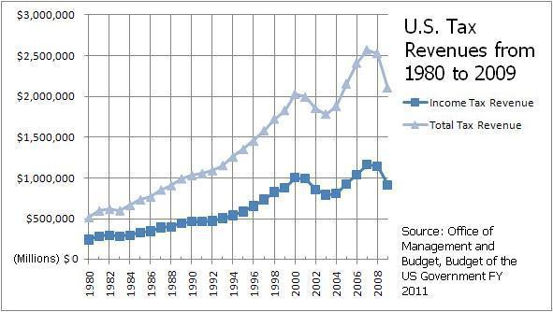
Fiscal Policy
Actions taken by Congress and the President to stabilize the economy
Tools of Fiscal Policy:
1. Taxes
2. Government Spending

Slide 8
Expansionary Fiscal
Contractionary Fiscal
Policies
Policies
1.
Lowering Taxes
1.
Raising Taxes
2.
Increasing Government Spending
2.
Cutting Government Spending
Effects:
Effects:
-
Encourage consumer spending and
-
Slow consumer spending and
investment
investment
-
Increase Real GDP
-
Decrease Real GDP
-
Increase Price Level
-
Decrease Price Level
-
Increase Employment
-
Decrease Employment

Slide 9
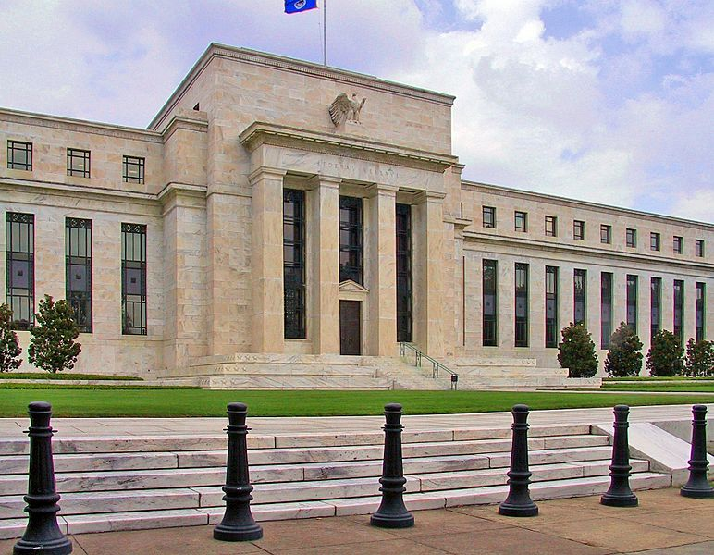
Organization of the Fed
Federal Reserve Act of 1913:
Both public and private
12 district banks around the U.S. (private)
Board of Governors (public)

Slide 10
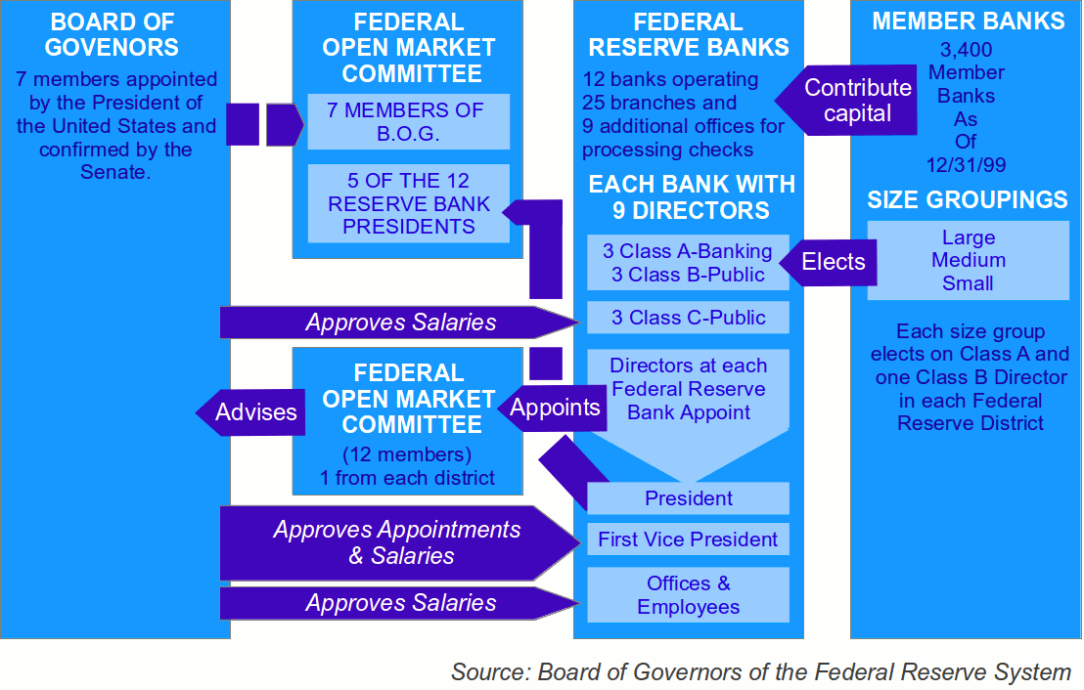

Slide 11
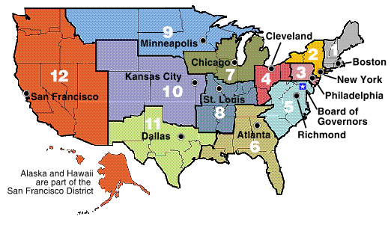

Slide 12
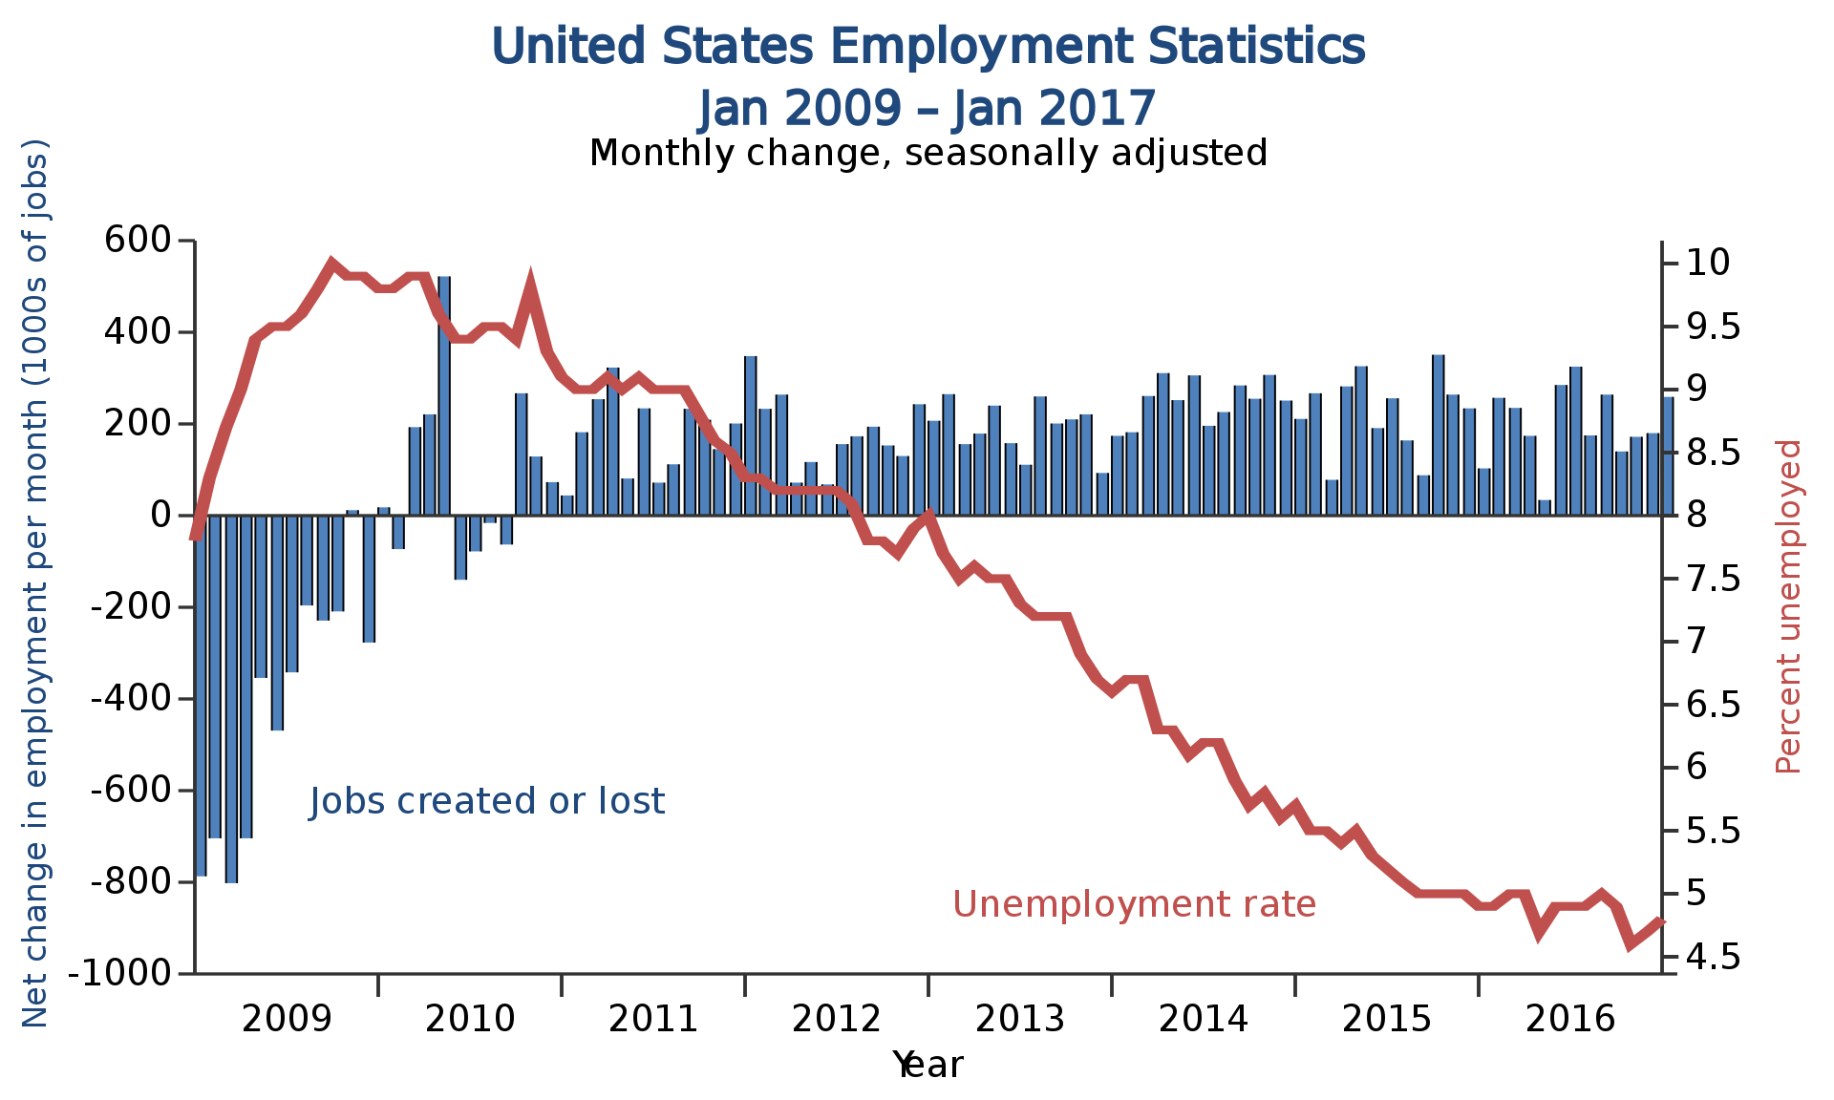
Feds’ Dual Mandate
1. Price Stability: The price level (inflation) should not change too much over time
2. Full Employment: Keep the unemployment rate between 4% and 6%

Slide 13
The Federal Reserve
 | Board of Governors | Reserve Banks | FOMC
Organization
Responsibilities

Slide 14
Monetary Policy
“the Federal Reserve’s actions, as a central bank, to achieve three goals specified by Congress: maximum employment, stable prices, and moderate long-term interest rates in the United States.”
Tools of Monetary Policy:
1. Reserve Requirement
2. Interest on Required and Excess Reserves
3. Discount Rate
4. Open Market Operations

Slide 15
Monetary Policy Tools
Reserve Requirement
Banks must keep a percentage of deposits on hand
Raising and lowering the reserve requirement changes the money supply in the economy

Slide 16
Expansionary
Contractionary
Monetary Policies
Monetary Policies
Reserve
1.
Lower Reserve
1.
Raise Reserve
Requirements
Requirement
Requirement
Effects:
Effects:
-
Encourage consumer
-
Slow consumer
spending and
spending and
investment
investment
-
Increase Real GDP
-
Decrease Real GDP
-
Increase Price Level
-
Decrease Price Level
-
Increase Employment
-
Decrease
Employment

Slide 17
Monetary Policy Tools
Interest on Required and Excess Reserves
Beginning Oct. 1, 2008, the Federal Reserve began paying interest on bank reserves
If the Fed either raises or lowers interest rates, banks will be compelled to either hold excess reserves or lend them to customers
Increases or decreases the money supply

Slide 18
Expansionary
Contractionary
Monetary Policies
Monetary Policies
Interest on
1.
Lowering The
1.
Raising The Interest
Required and
Interest on Required
on Required and
and Excess Reserves
Excess Reserves
Excess
Effects:
Effects:
-
Encourage consumer
-
Slow consumer
Reserves
spending and
spending and
investment
investment
-
Increase Real GDP
-
Decrease Real GDP
-
Increase Price Level
-
Decrease Price Level
-
Increase Employment
-
Decrease
Employment

Slide 19
Monetary Policy Tools
Discount Rate
Fed=Lender of last resort
When banks can’t borrow from one another, they borrow from the Federal Reserve
Discount Rate=Interest the Fed charges on loans
Changing the discount rate signals banks to change their lending activity
Impacts the money supply

Slide 20
Expansionary
Contractionary
Monetary Policies
Monetary Policies
Discount Rate
1.
Lowering The
1.
Raising The Discount
Discount Rate
Rate Effects:
Effects:
-
Slow consumer
-
Encourage consumer
spending and
spending and
investment
investment
-
Decrease Real GDP
-
Increase Real GDP
-
Decrease Price Level
-
Increase Price Level
-
Decrease
-
Increase Employment
Employment

Slide 21
Monetary Policy Tools
Market Operations
Fed votes to raise, lower, or keep the target for the interest rate, The Federal Funds Rate (FFR)
FFR=“The federal funds rate is the interest rate banks charge each other for overnight loans to meet reserve requirements.”
The Fed aims at their FFR target through buying and selling bonds
Impacts money supply

Slide 22
Expansionary
Contractionary
Monetary Policies
Monetary Policies
Market
1.
Buying Government
1.
Selling Government
Operations
Bonds Effects:
Bonds Effects:
-
Encourage consumer
-
Slow consumer
spending and
spending and
investment
investment
-
Increase Real GDP
-
Decrease Real GDP
-
Increase Price Level
-
Decrease Price Level
-
Increase Employment
-
Decrease
Employment

