Slide 1
What is Economics?
Economics is the science of scarcity.
Scarcity- we have unlimited wants but limited resources.
Since we are unable to have everything we desire, we must make choices on how we will use our resources.
Economics is the study of ______ .
choices
In economics we will study the choices of individuals, firms, and governments.
1

Slide 2
Examples:
You must choose between buying jeans or buying shoes.
Businesses must choose how many people to hire.
Governments must choose how much to spend on welfare.
Textbook Definition
Economics- Social science concerned with the efficient use of scarce resources to achieve maximum satisfaction of economic wants.
(Study of how individuals and societies deal with ________).
scarcity
2

Slide 3
Microeconomics vs. Macroeconomics

Slide 4
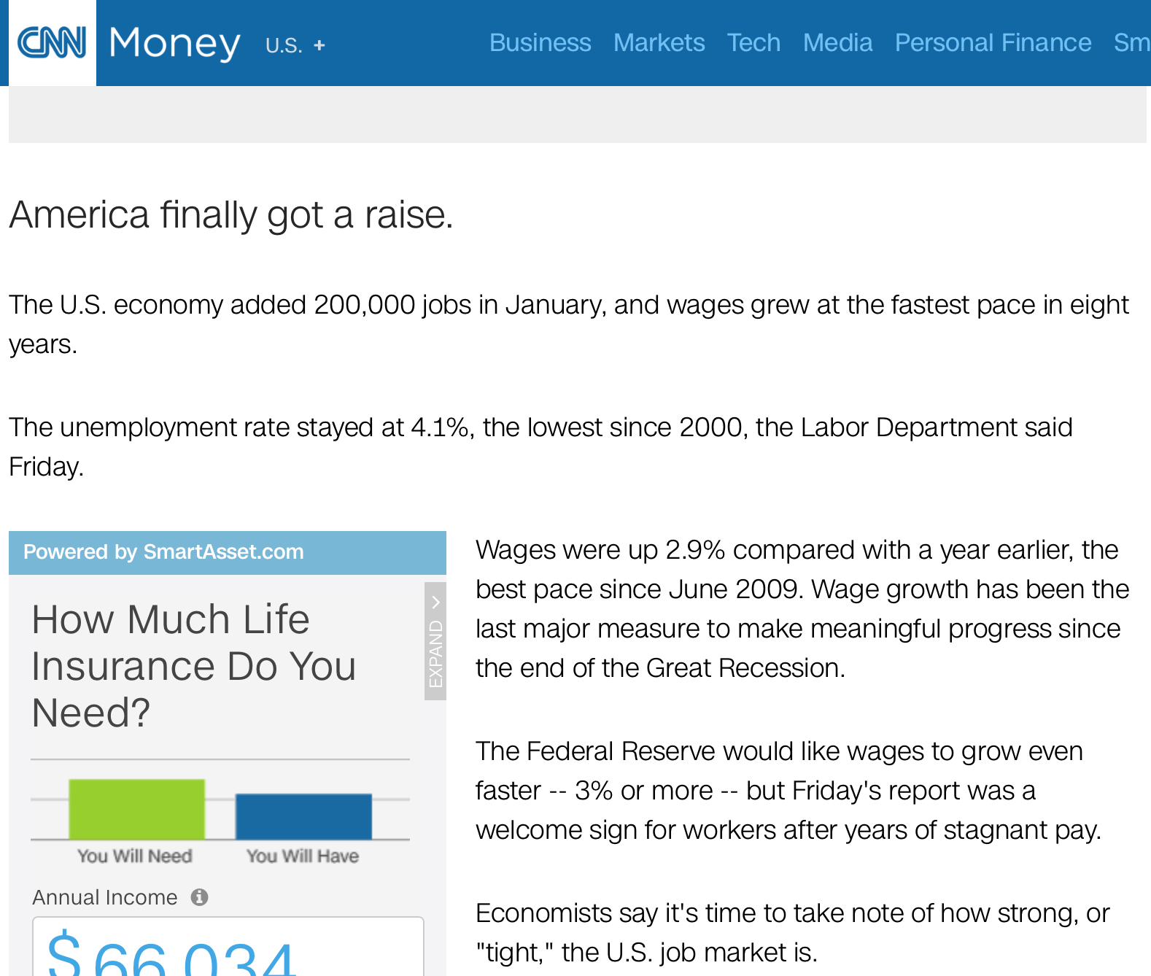
Macro or Micro?

Slide 5
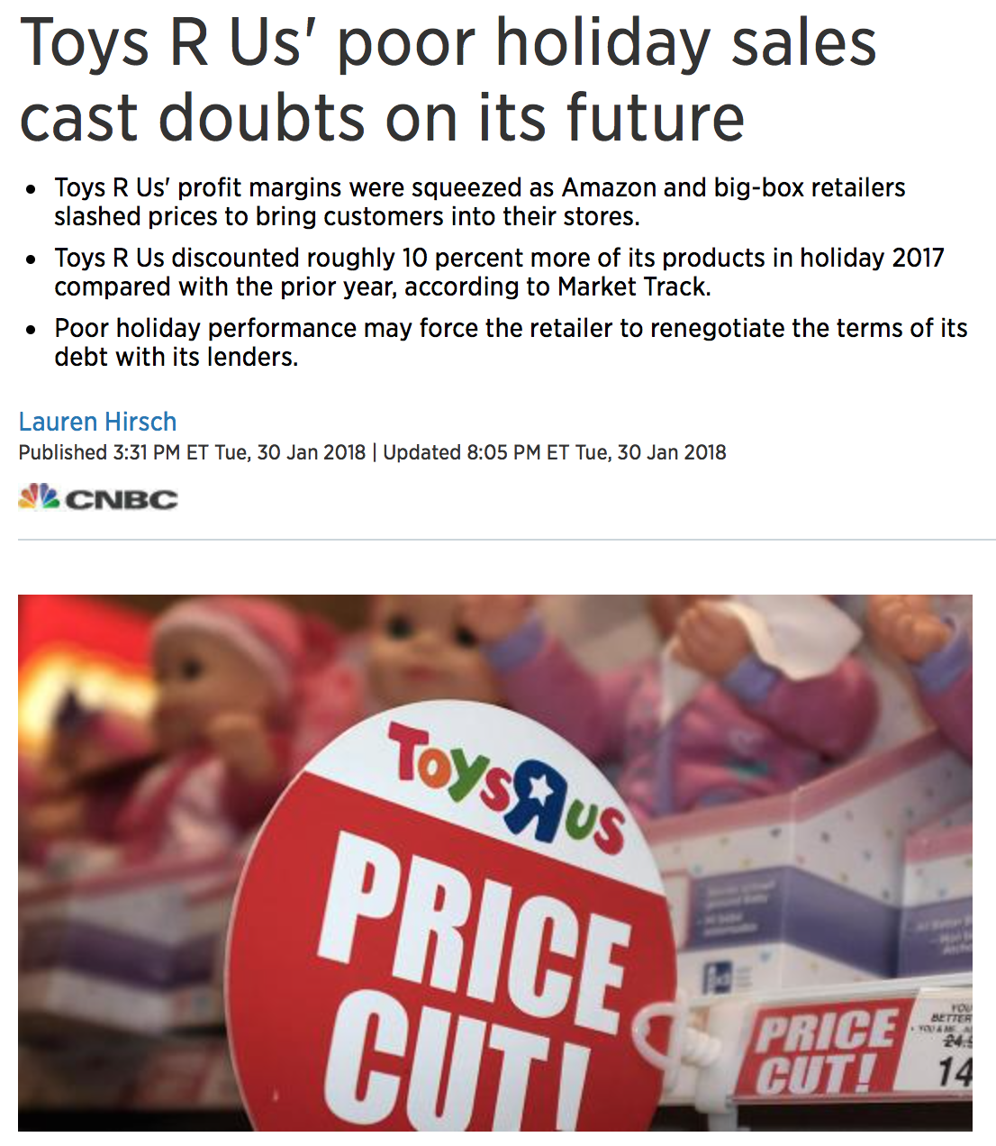
Macro or Micro?

Slide 6
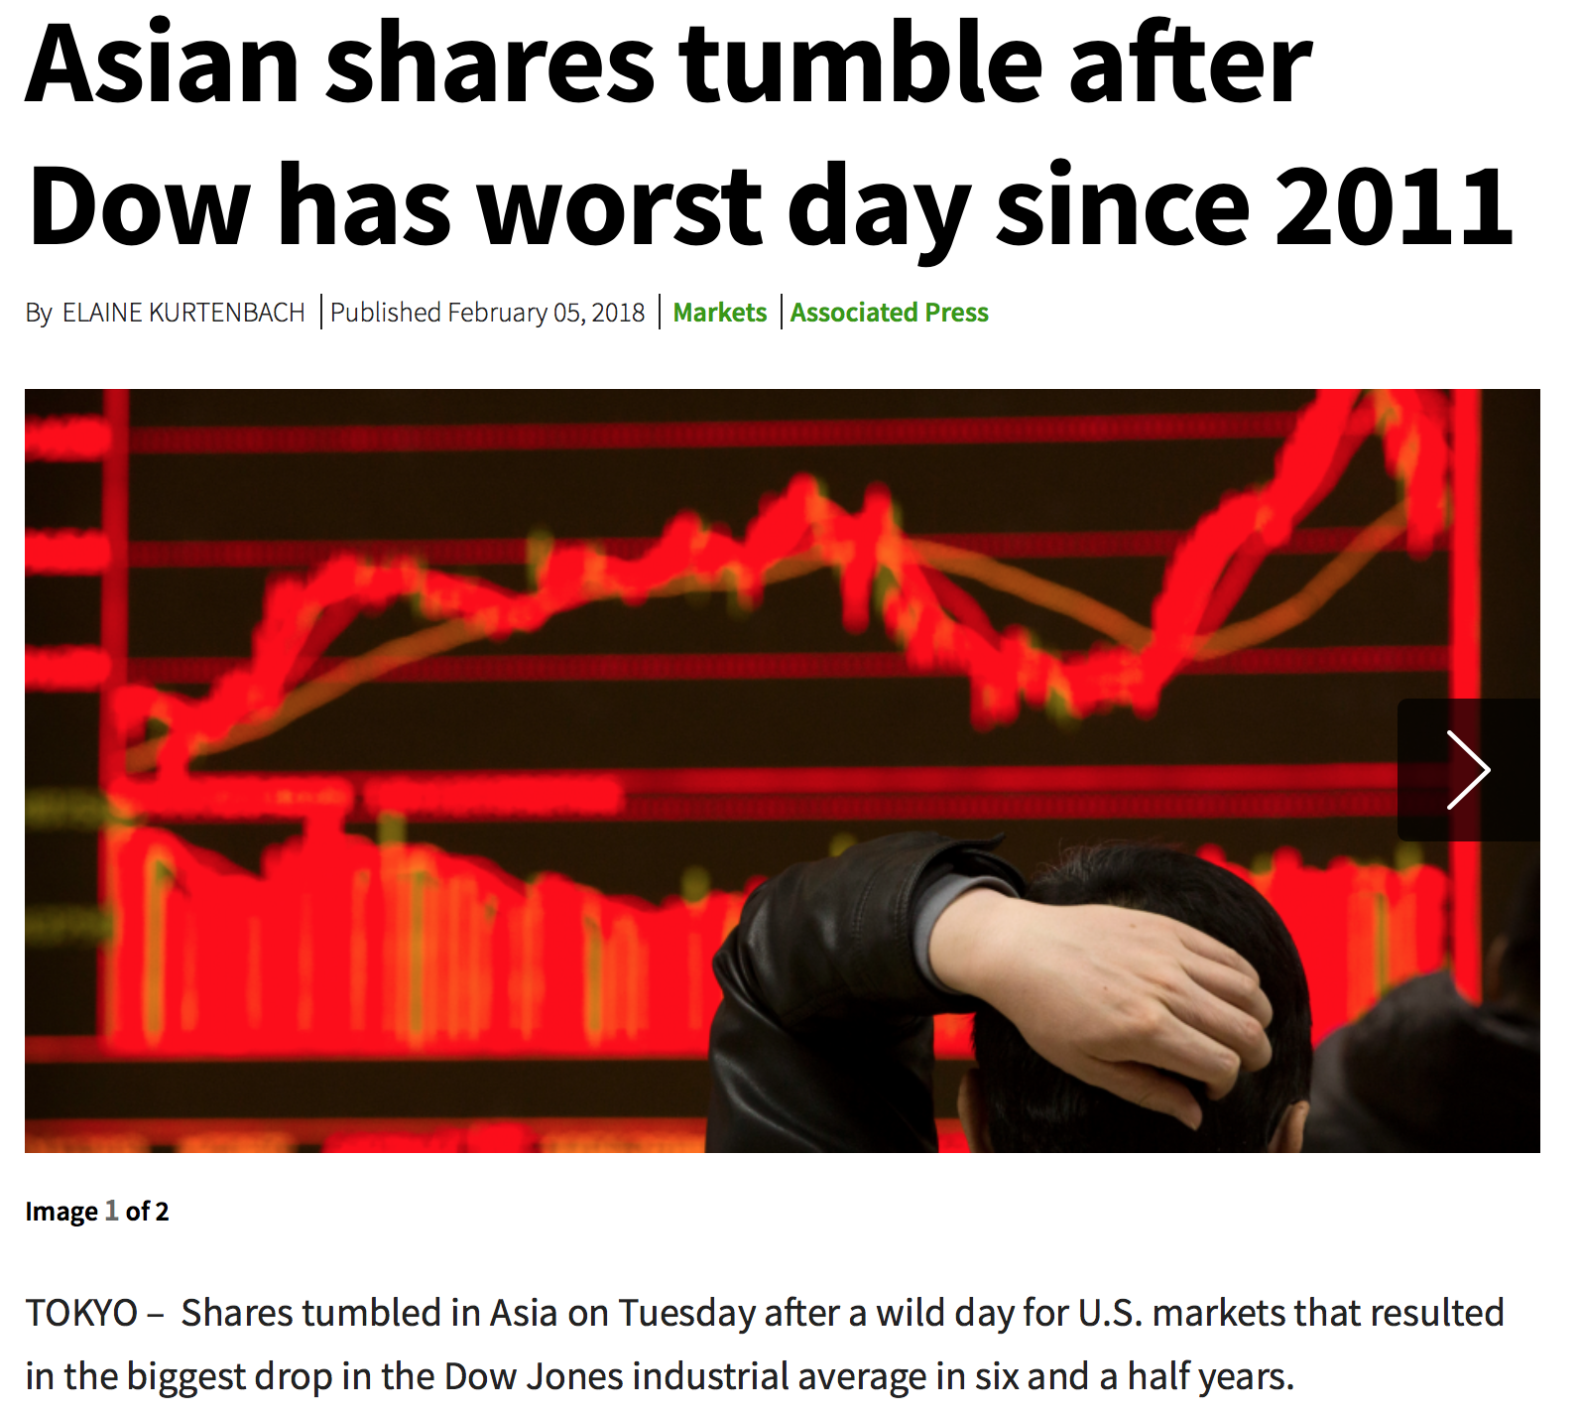
Macro or Micro?

Slide 7
Micro vs. Macro
MICROeconomics-
Study of small economic units such as individuals, firms, and markets.
Examples- Supply and demand in specific industries, production costs, labor markets
MACROeconomics-
Study of the large economy as a whole or economic aggregates.
Examples- economic growth, government spending, inflation, unemployment, international trade
7

Slide 8
5 Key Economic Assumptions
Society has unlimited wants and limited resources (scarcity).
Due to scarcity, choices must be made. Every choice has a cost (a trade-off).
Everyone’s goal is to make choices that maximize their satisfaction. Everyone acts in their own “self-interest.”
Everyone makes decisions by comparing the marginal costs and marginal benefits of every choice.
Real-life situations can be explained and analyzed through simplified models and graphs.
8

Slide 9
Thinking at the Margin
# Times Watching Movie | Benefit | Cost
1st | $30 | $10
2nd | $15 | $10
3rd | $5 | $10
Total | $50 | $30
Would you see the movie three times?
Notice that the total benefit is more than the total cost, but you would NOT watch the movie the 3rd time.
9

Slide 10
Marginal Analysis
In economics, the term marginal = additional
Marginal analysis (aka: thinking on the margin) making decisions based on increments.
Example:
When you decide to go to the mall, you consider the additional benefit and the additional cost (your opportunity cost).
Once you get to the mall, you continue to use marginal analysis when you shop, buy food, and talk to friends.
Since your marginal benefits and costs can quickly change, you’re analyzing them every second.
What if your ex-girlfriend shows up?
The Point: You will continue to do something as long as the marginal benefit is greater than the marginal cost.
10

Slide 11
Review with your partner…
Define scarcity.
Define Economics.
Identify the relationship between scarcity and choices.
Explain how Macroeconomics is different than Micro.
Give an example of marginal analysis.
11

Slide 12
Given the following assumptions, make a rational choice in your own self-interest (hold everything else constant)…
1. You want to visit your friend for a week. You will return Sunday night.
2. You work every weekday earning $100 per day.
3. You have three flights to choose from:
Thursday Night Flight = $275
Friday Early Morning Flight = $300
Friday Night Flight = $325
Which flight should you choose? Why?
12

Slide 13
Trade-offs vs. Opportunity Cost
ALL decisions involve trade-offs.
Trade-offs - ALL the alternatives that we give up when we make a choice.
(Examples: going to the movies)
Opportunity cost- most desirable alternative given up when you make a choice.
What are trade-offs of deciding to go to college?
What is the opportunity cost of going to college?
13

Slide 14
What decisions did you make yesterday?
To snooze or not to snooze?
Breakfast at home or fast food or none at all?
Buy or bring a lunch?
Who to sit with at lunch?
Study or hang out with friends after school?
Go to bed on time or watch Netflix?
Why do you have to choose to do some things and not others?
All of your choices involve a cost of some kind, even if it is not money...what are the costs?

Slide 15
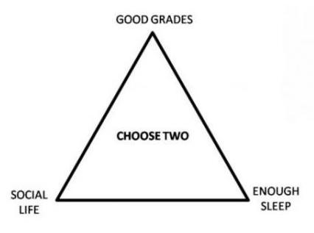
Economics of College
15

Slide 16
Economic Terminology
Utility =
Satisfaction!
Marginal =
Additional!
Allocate =
Distribute!
16

Slide 17
Price vs. Cost
What’s the price? vs. How much does that cost?
Price= Amount buyer (or consumer) pays.
Cost= Amount seller pays to produce a good.
Investment
Investment= The money spent by BUSINESSES to improve their production.
Ex: $1 Million new factory
Consumer Goods- created for direct consumption. (example: pizza)
Capital Goods- created for indirect consumption. (oven, blenders, knives, etc.)
Goods used to make consumer goods.
17

Slide 18
The 4 Factors of Production

Slide 19
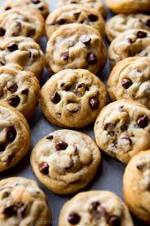
Want to Start a Cookie Business?
What materials will you need?
What skills do your workers they need?
What does the owner need to do?
THESE ARE YOUR FACTORS OF PRODUCTION!!!

Slide 20
The Four Factors of Production
ALL resources can be classified as one of the following four factors of production:
1. Land -All natural resources that are used to produce goods and services. (Ex: water, sun, plants, animals)
2. Labor -Any effort a person devotes to a task for which that person is paid. (Ex: manual laborers, lawyers, doctors, teachers, waiters, etc.)
3. Capital -
Physical Capital- Any human-made resource that is used to create other goods and services. ( Ex: tools, tractors, machinery, buildings, factories, etc.)
Human Capital- Any skills or knowledge gained by a worker through education and experience.
20

Slide 21
The Four Factors of Production
4. Entrepreneurship - Ambitious leaders that combine the other factors of production to create goods and services.
Examples-Henry Ford, Bill Gates, Inventors, Store Owners, etc.
Entrepreneurs:
Take The Initiative
Innovate
Act as the Risk Bearers
So they can obtain _________.
PROFIT
Profit = Revenue - Costs
21

Slide 22
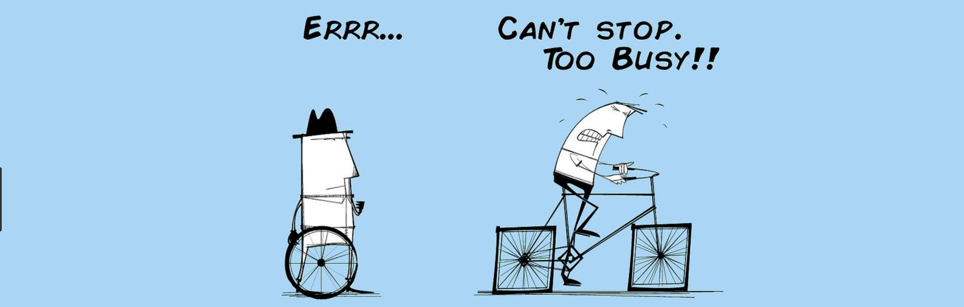
Are you PRODUCTIVE?
What does a “productive school day” look like?
What increases your productivity?
What decreases your productivity?
In most cases, what is the relationship between your productivity and your income? Why?

Slide 23
Productivity
Productivity = A measure of efficiency that shows the number of outputs per unit of input.
Ex: Bob can make 10 pizzas in 1 hour.
Stan can make 5 pizzas in 1 hour.
Bob is more productive.
Why do businesses and countries want to improve their productivity?
Since all resources are scarce, improving productivity allows us to produce more stuff with fewer resources.

Slide 24
REVIEW
Explain relationship between scarcity and choices.
Differentiate between price and cost.
Differentiate between consumer and capital goods.
Differentiate between command economies and free market economies.
Give examples of each of the 4 Factors of Production.
Define human capital.
Define tradeoffs.
Define opportunity cost.
24

Slide 25
The Production Possibilities Curve (PPC)
Using Economic Models…
Step 1: Explain concept in words
Step 2: Use numbers as examples
Step 3: Generate graphs from numbers
Step 4: Make generalizations using graph

Slide 26
What is the Production Possibilities Curve?
A production possibilities curve (or frontier) is a model that shows alternative ways that an economy can use its scarce resources.
This model graphically demonstrates scarcity, trade-offs, opportunity costs, and efficiency.
4 Key Assumptions
Only two goods can be produced
Full employment of resources
Fixed Resources (Ceteris Paribus)
Fixed Technology
26

Slide 27
Production “Possibilities” Table
A
B
C
D
E
f
Bikes
14
12
9
5
0
0
Computers
0
2
4
6
8
10
Each point represents a specific combination of goods that can be produced given full employment of resources.
NOW GRAPH IT: Put bikes on y-axis and computers on x-axis
27

Slide 28
Production Possibilities
How does the PPC graphically demonstrate scarcity, trade-offs, opportunity costs, and efficiency?
14
12
10
8
6
4
2
0
Impossible/Unattainable
(given current resources)
A
B
G
C
Bikes
Efficient
D
Inefficient/ Unemployment
E
0 2 4 6 8 10
Computers
28
Notes:
Scarcity- Any point outside the curve is impossible
Trade-offs- You can’t produce more computers without giving up some bikes
Opportunity Cost- The opportunity cost of moving from combination A to B is 2 bikes
Efficicency- Any point on the curve is efficient (you are using all your resources to the fullest)

Slide 29
Opportunity Cost
Example:
1. The opportunity cost of moving from a to b is…
2 Bikes
2.The opportunity cost of moving from b to d is…
7 Bikes
3.The opportunity cost of moving from d to b is…
4 Computer
4.The opportunity cost of moving from f to c is…
0 Computers
5.What can you say about point G?
Unattainable
29

Slide 30
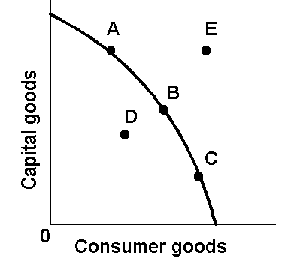
The Production Possibilities Curve (or Frontier)
30

Slide 31
The Production Possibilities Curve and Efficiency
31

Slide 32
Two Types of Efficiency
Productive Efficiency-
Products are being produced in the least costly way.
This is any point ON the Production Possibilities Curve
Allocative Efficiency-
The products being produced are the ones most desired by society.
This optimal point on the PPC depends on the desires of society.
32

Slide 33
Productive and Allocative Efficiency
Which points are productively efficient?
Which are allocatively efficient?
14
12
10
8
6
4
2
0
Productively Efficient combinations are A through D
A
B
G
Allocative Efficient combinations depend on the wants of society
(What if this represents a country with no electricity?)
Bikes
C
E
F
D
0 2 4 6 8 10
Computers
33

Slide 34
Shifting the Production Possibilities Curve
34

Slide 35
Production Possibilities
4 Key Assumptions Revisited
Only two goods can be produced
Full employment of resources
Fixed Resources (4 Factors)
Fixed Technology
What if there is a change?
3 Shifters of the PPC
1. Change in resource quantity or quality
2. Change in Technology
3. Change in Trade
35

Slide 36
Production Possibilities
What happens if there is an increase in population?
Computers
Pizzas
36

Slide 37
Production Possibilities
What happens if there is an increase in population?
Computers
Pizzas
37

Slide 38
Production Possibilities
What if there is a technology improvement in pizza ovens?
Computers
Pizzas
38

Slide 39
Production Possibilities
What if there is a technology improvement in pizza ovens?
Computers
Pizzas
39

Slide 40
Capital Goods and Future Growth
Countries that produce more capital goods will have more growth in the future.
Panama – Favors Consumer Goods
Mexico – Favors Capital Goods
Current
PPC
Future
PPC
Future
PPC
Capital Goods
Capital Goods
Current
PPC
Consumer goods
Consumer goods
Panama
Mexico
40

Slide 41
PPC Practice
Draw a PPC showing changes for each of the following:
Pizza and Computers (3)
1. New computer making technology
2. Decrease in the demand for pizza
3. Mad cow disease kills 85% of cows
Consumer goods and Capital Goods (4)
4. Destruction of power plants leads to severe electricity shortage
5. Faster computer hardware
6. Many workers unemployed
7. Significant increases in education
41

Slide 42
The Circular Flow Model
The Product Market-
The “place” where goods and services produced by businesses are sold to households.
The Resource (Factor) Market-
The “place” where resources (land, labor, capital, and entrepreneurship) are sold to businesses.
42

Slide 43
43
Notes:
https://www.youtube.com/watch?v=mN5HPJYJzus&list=PLD5BC727C84E254E5&index=15

Slide 44
Resource Market
DEMAND
SUPPLY
$$$ Income $$$
(Factor payments)
$$$ Costs $$$
Resources
Resources
(Factors of
Production)
$$$
Taxes
Taxes
Subsidies
Transfer Payments
Public Goods
Public Goods
Individuals
Businesses
Government
$$$
Goods and
Services
Goods and
Services
$$$ Revenue $$$
SUPPLY
$$$ Spending $$$
DEMAND
Product Market
44

Slide 45
Circular Flow Model Vocab
Private Sector- Part of the economy that is run by individuals and businesses.
Public Sector- Part of the economy that is controlled by the government.
Factor Payments- Payment for the factors of production, namely rent, wages, interest, and profit.
Transfer Payments- When the government redistributes income (ex: welfare, social security).
Subsidies- Government payments to businesses.
Copyright
ACDC Leadership 2018
45

Slide 46
DEMAND DEFINED
What is Demand?
Demand is the different quantities of goods that consumers are willing and able to buy at different prices.
(Ex: You are able to purchase diapers, but if you aren’t willing to buy then there is NO demand).
What is the Law of Demand?
There is an INVERSE relationship between price and quantity demanded.
46

Slide 47
Example of Demand
I am willing to sell several A’s in this Economics class. How much will you pay?
Price | Quantity Demanded
Demand Schedule
47

Slide 48
Graphing Demand
48

Slide 49
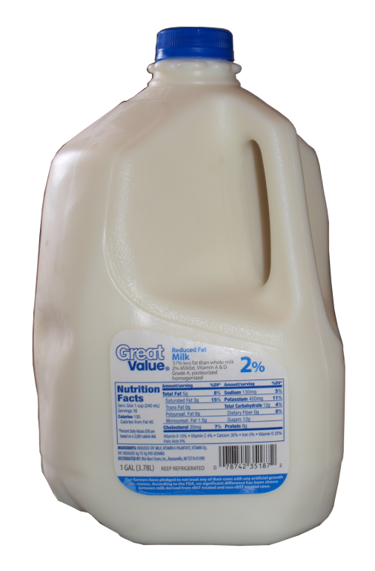
GRAPHING DEMAND
Demand Schedule
Price of Milk
Draw this large in your notes
$5
4
3
2
1
Price | Quantity Demanded
$5 | 10
$4 | 20
$3 | 30
$2 | 50
$1 | 80
10 20 30 40 50 60 70 80
Q
Quantity of Milk
49

Slide 50
GRAPHING DEMAND
Demand Schedule
Price of Milk
$5
4
3
2
1
Price | Quantity Demanded
$5 | 10
$4 | 20
$3 | 30
$2 | 50
$1 | 80
Demand
10 20 30 40 50 60 70 80
Q
Quantity of Milk
50

Slide 51
Shifts in Demand
A shift means that at the same prices, more people are willing and able to purchase that good.
This is a change in demand, not a change in quantity demanded!
PRICE DOESN’T SHIFT THE CURVE
51

Slide 52
Change in Demand
Demand Schedule
Price of Milk
What if milk
makes you smarter?
$5
4
3
2
1
Price | Quantity Demanded
$5 | 10
$4 | 20
$3 | 30
$2 | 50
$1 | 80
Demand
10 20 30 40 50 60 70 80
Q
Quantity of Milk
52

Slide 53
Change in Demand
Demand Schedule
Price of Milk
What if milk
makes you smarter?
$5
4
3
2
1
Price | Quantity Demanded
$5 | 10
$4 | 20
$3 | 30
$2 | 50
$1 | 80
Demand
10 20 30 40 50 60 70 80
Q
Quantity of Milk
53

Slide 54
Change in Demand
Demand Schedule
Price of Milk
$5
4
3
2
1
Price | Quantity Demanded
$5 | 10 30
$4 | 20 40
$3 | 30 50
$2 | 50 70
$1 | 80 100
Demand
10 20 30 40 50 60 70 80
Q
Quantity of Milk
54

Slide 55
Change in Demand
Demand Schedule
Price of Milk
Increase in Demand
Prices didn’t change but people want MORE Milk
$5
4
3
2
1
Price | Quantity Demanded
$5 | 10 30
$4 | 20 40
$3 | 30 50
$2 | 50 70
$1 | 80 100
D₁
Demand
10 20 30 40 50 60 70 80
Q
Quantity of Milk
55

Slide 56
Change in Demand
Demand Schedule
Price of Milk
What if milk
causes baldness?
$5
4
3
2
1
Price | Quantity Demanded
$5 | 10
$4 | 20
$3 | 30
$2 | 50
$1 | 80
Demand
10 20 30 40 50 60 70 80
Q
Quantity of Milk
56

Slide 57
Change in Demand
Demand Schedule
Price of Milk
What if milk
causes baldness?
$5
4
3
2
1
Price | Quantity Demanded
$5 | 10
$4 | 20
$3 | 30
$2 | 50
$1 | 80
Demand
10 20 30 40 50 60 70 80
Q
Quantity of Milk
57

Slide 58
Change in Demand
Demand Schedule
Price of Milk
$5
4
3
2
1
Price | Quantity Demanded
$5 | 10 0
$4 | 20 5
$3 | 30 20
$2 | 50 30
$1 | 80 60
Demand
10 20 30 40 50 60 70 80
Q
Quantity of Milk
58

Slide 59
Change in Demand
Demand Schedule
Price of Milk
$5
4
3
2
1
Decrease in Demand
Prices didn’t change but people want LESS Milk
Price | Quantity Demanded
$5 | 10 0
$4 | 20 5
$3 | 30 20
$2 | 50 30
$1 | 80 60
D₂
Demand
10 20 30 40 50 60 70 80
Q
Quantity of Milk
59

Slide 60
Change in Qd vs. Change in Demand
There are two ways to increase quantity from 10 to 20
Price of Milk
P
A to B is a change in quantity demanded (due to a change in price)
A to C is a change in demand (shift in the curve)
A
C
$3
$2
B
D₂
D₁
10 20
Q Milk
Quantity of Milk

Slide 61
Change in Demand
Demand Schedule
Price of Milk
What happens to
the demand for milk if
the price of milk
goes up?
$5
4
3
2
1
Price | Quantity Demanded
$5 | 10
$4 | 20
$3 | 30
$2 | 50
$1 | 80
NOTHING!
The demand stays the same
Demand
10 20 30 40 50 60 70 80
Q
Quantity of Milk
61

Slide 62
What Causes a Shift in Demand?
5 Shifters (Determinants) of Demand:
Tastes and Preferences
Number of Consumers
Price of Related Goods
Income
Future Expectations
Changes in PRICE don’t shift the curve. It only causes movement along the curve.
62

Slide 63
Practice
Identify the determinant (shifter) then decide if demand will increase or decrease
Hamburgers (a normal good)
Population boom
Incomes fall due to recession
Price of tacos, a substitute, decreases
Price increases to $5 for hamburgers
New health craze- “No ground beef”
Hamburger restaurants announce that they will significantly increase prices NEXT month
Price of fries, a complement, increases
Restaurants lower price of burgers to $.50
63

Slide 64
Supply Defined
What is supply?
Supply is the different quantities of a good that sellers are willing and able to sell (produce) at different prices.
What is the Law of Supply?
There is a DIRECT relationship between price and quantity supplied.
As price increases, the quantity producers make increases.
As price falls, the quantity producers make falls.
Why? Because, at higher prices profit seeking firms have an incentive to produce more.
EXAMPLE: Mowing Lawns
64

Slide 65
Example of Supply
You own an lawn mower and you are willing to mow lawns.
How many lawns will you mow at these prices?
Price per lawn mowed | Quantity Supplied
Supply Schedule
$1
$5
$20
$50
$100
$1000
65

Slide 66
GRAPHING SUPPLY
Supply Schedule
Price of Milk
Draw this large in your notes
$5
4
3
2
1
Price | Quantity Supplied
$5 | 50
$4 | 40
$3 | 30
$2 | 20
$1 | 10
10 20 30 40 50 60 70 80
Q
Quantity of Milk
66

Slide 67
GRAPHING SUPPLY
Supply Schedule
Price of Milk
Supply
$5
4
3
2
1
Price | Quantity Supplied
$5 | 50
$4 | 40
$3 | 30
$2 | 20
$1 | 10
10 20 30 40 50 60 70 80
Q
Quantity of Milk
67

Slide 68
GRAPHING SUPPLY
Supply Schedule
Price of Milk
Supply
$5
4
3
2
1
What if there are new
and more productive
milking machines?
Price | Quantity Supplied
$5 | 50
$4 | 40
$3 | 30
$2 | 20
$1 | 10
10 20 30 40 50 60 70 80
Q
Quantity of Milk
68

Slide 69
Change in Supply
Supply Schedule
Price of Milk
Supply
$5
4
3
2
1
Price | Quantity Supplied
$5 | 50
$4 | 40
$3 | 30
$2 | 20
$1 | 10
10 20 30 40 50 60 70 80
Q
Quantity of Milk
69

Slide 70
Change in Supply
Supply Schedule
Price of Milk
Supply
$5
4
3
2
1
Price | Quantity Supplied
$5 | 50
$4 | 40
$3 | 30
$2 | 20
$1 | 10
10 20 30 40 50 60 70 80
Q
Quantity of Milk
70

Slide 71
Change in Supply
Supply Schedule
Price of Milk
Supply
$5
4
3
2
1
Price | Quantity Supplied
$5 | 50 70
$4 | 40 60
$3 | 30 50
$2 | 20 40
$1 | 10 30
10 20 30 40 50 60 70 80
Q
Quantity of Milk
71

Slide 72
Change in Supply
Supply Schedule
Price of Milk
Supply
S₂
$5
4
3
2
1
Price | Quantity Supplied
$5 | 50 70
$4 | 40 60
$3 | 30 50
$2 | 20 40
$1 | 10 30
Increase in Supply
Prices didn’t change but there is MORE milk produced
10 20 30 40 50 60 70 80
Q
Quantity of Milk
72

Slide 73
Change in Supply
Supply Schedule
Price of Milk
Supply
$5
4
3
2
1
Price | Quantity Supplied
$5 | 50
$4 | 40
$3 | 30
$2 | 20
$1 | 10
What if the price for
dairy cows increases
drastically?
10 20 30 40 50 60 70 80
Q
Quantity of Milk
73

Slide 74
Change in Supply
Supply Schedule
Price of Milk
Supply
$5
4
3
2
1
Price | Quantity Supplied
$5 | 50
$4 | 40
$3 | 30
$2 | 20
$1 | 10
10 20 30 40 50 60 70 80
Q
Quantity of Milk
74

Slide 75
Change in Supply
Supply Schedule
Price of Milk
Supply
$5
4
3
2
1
Price | Quantity Supplied
$5 | 50
$4 | 40
$3 | 30
$2 | 20
$1 | 10
10 20 30 40 50 60 70 80
Q
Quantity of Milk
75

Slide 76
Change in Supply
Supply Schedule
Price of Milk
Supply
$5
4
3
2
1
Price | Quantity Supplied
$5 | 50 30
$4 | 40 20
$3 | 30 10
$2 | 20 1
$1 | 10 0
10 20 30 40 50 60 70 80
Q
Quantity of Milk
76

Slide 77
Change in Supply
Supply Schedule
Price of Milk
Supply
$5
4
3
2
1
S₂
Price | Quantity Supplied
$5 | 50 30
$4 | 40 20
$3 | 30 10
$2 | 20 1
$1 | 10 0
Decrease in Supply
Prices didn’t change but there is LESS milk produced
10 20 30 40 50 60 70 80
Q
Quantity of Milk
77

Slide 78
5 Shifters (Determinants) of Supply
Prices/Availability of inputs (resources)
Number of Sellers
Technology
Government Action: Taxes & Subsidies
SUBSIDIES
A subsidy is a government payment to a business or market.
Subsidies cause the supply of a good to increase.
5. Expectations of Future Profit
A change in PRICE doesn’t shift the curve. It only causes a movement along the curve.
78

Slide 79
Supply Practice
Which determinant (SHIFTER)?
Increase or decrease?
Which direction will curve shift?
Analyze Hamburgers
Strange virus kills 20% of cows
Price of hamburgers increase 30%
Government taxes burger producers
New bun baking technology cuts production time in half
The government subsidizes beef producers
Minimum wage increases to $20
79

Slide 80
Putting Supply and Demand Together!!!
Copyright
ACDC Leadership 2018
80

Slide 81
Supply and Demand are put together to determine equilibrium price and equilibrium quantity
P
Supply Schedule
Demand Schedule
S
$5
4
3
2
1
P | Qd
$5 | 10
$4 | 20
$3 | 30
$2 | 50
$1 | 80
P | Qs
$5 | 50
$4 | 40
$3 | 30
$2 | 20
$1 | 10
D
10 20 30 40 50 60 70 80
Q
81

Slide 82
Supply and Demand are put together to determine equilibrium price and equilibrium quantity
P
Supply Schedule
Demand Schedule
S
$5
4
3
2
1
P | Qd
$5 | 10
$4 | 20
$3 | 30
$2 | 50
$1 | 80
P | Qs
$5 | 50
$4 | 40
$3 | 30
$2 | 20
$1 | 10
Equilibrium Price = $3 (Qd=Qs)
D
10 20 30 40 50 60 70 80
Q
Equilibrium Quantity is 30
82

Slide 83
At $4, there is disequilibrium. The quantity demanded is less than quantity supplied.
P
Supply Schedule
Demand Schedule
S
$5
4
3
2
1
Surplus
(Qd<Qs)
P | Qd
$5 | 10
$4 | 20
$3 | 30
$2 | 50
$1 | 80
P | Qs
$5 | 50
$4 | 40
$3 | 30
$2 | 20
$1 | 10
How much is the surplus at $4?
Answer: 20
D
10 20 30 40 50 60 70 80
Q
83

Slide 84
At $2, there is disequilibrium. The quantity demanded is greater than quantity supplied.
P
Supply Schedule
Demand Schedule
S
$5
4
3
2
1
P | Qd
$5 | 10
$4 | 20
$3 | 30
$2 | 50
$1 | 80
P | Qs
$5 | 50
$4 | 40
$3 | 30
$2 | 20
$1 | 10
How much is the shortage at $2?
Answer: 30
Shortage
(Qd>Qs)
D
10 20 30 40 50 60 70 80
Q
84

Slide 85
How much is the shortage if the price is $1?
P
Supply Schedule
Demand Schedule
S
$5
4
3
2
1
P | Qd
$5 | 10
$4 | 20
$3 | 30
$2 | 50
$1 | 80
P | Qs
$5 | 50
$4 | 40
$3 | 30
$2 | 20
$1 | 10
Answer: 70
D
10 20 30 40 50 60 70 80
Q
85

Slide 86
The FREE MARKET system automatically pushes the price toward equilibrium.
P
Supply Schedule
Demand Schedule
S
$5
4
3
2
1
When there is a surplus, producers lower prices
P | Qd
$5 | 10
$4 | 20
$3 | 30
$2 | 50
$1 | 80
P | Qs
$5 | 50
$4 | 40
$3 | 30
$2 | 20
$1 | 10
When there is a shortage, producers raise prices
D
10 20 30 40 50 60 70 80
Q
86

Slide 87
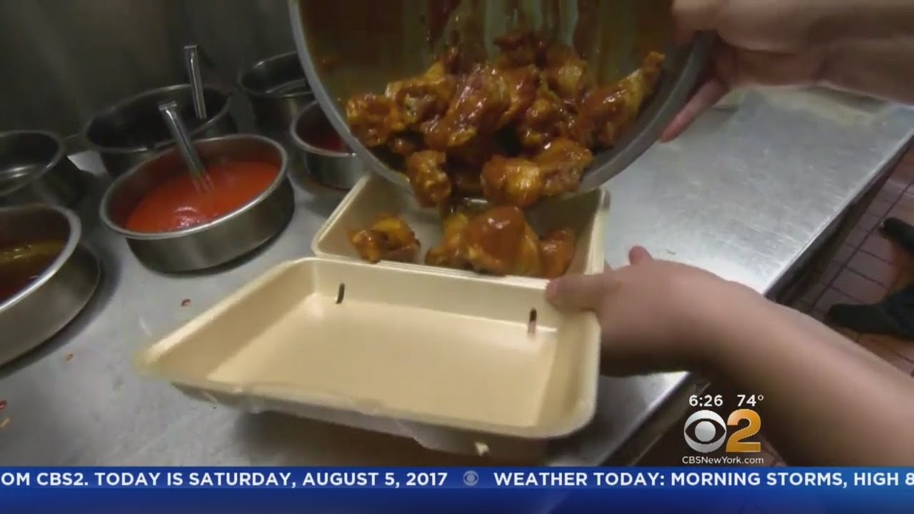
In the News: Shortage
Why is there a shortage of chicken wings?
What might cause the price to fall?
Notes:
https://www.youtube.com/watch?v=Jn_W2nDmhPI

Slide 88
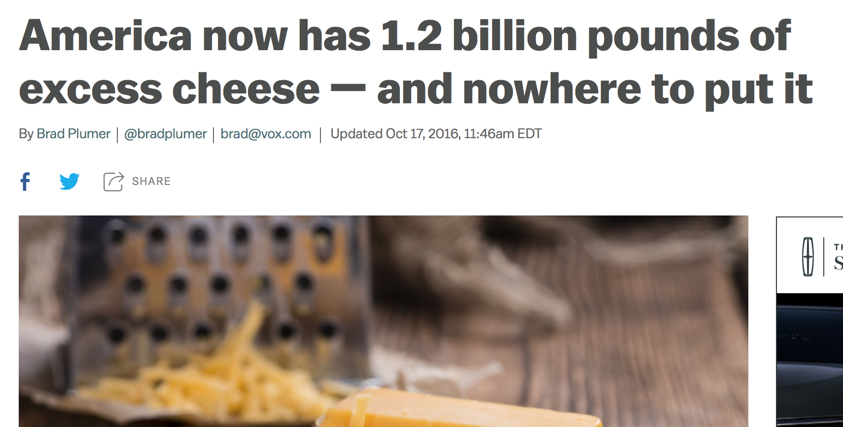
In the News: Surplus
Why is there a surplus of cheese?
What has prevented prices from falling?
Notes:
https://www.vox.com/2016/10/13/13268980/cheese-glut-united-states

Slide 89
Supply Defined
What is supply?
Supply is the different quantities of a good that sellers are willing and able to sell (produce) at different prices.
What is the Law of Supply?
There is a DIRECT relationship between price and quantity supplied.
As price increases, the quantity producers make increases.
As price falls, the quantity producers make falls.
Why? Because, at higher prices profit seeking firms have an incentive to produce more.
EXAMPLE: Mowing Lawns
89

Slide 90
Example of Supply
You own an lawn mower and you are willing to mow lawns.
How many lawns will you mow at these prices?
Price per lawn mowed | Quantity Supplied
Supply Schedule
$1
$5
$20
$50
$100
$1000
90

Slide 91
GRAPHING SUPPLY
Supply Schedule
Price of Milk
Draw this large in your notes
$5
4
3
2
1
Price | Quantity Supplied
$5 | 50
$4 | 40
$3 | 30
$2 | 20
$1 | 10
10 20 30 40 50 60 70 80
Q
Quantity of Milk
91

Slide 92
GRAPHING SUPPLY
Supply Schedule
Price of Milk
Supply
$5
4
3
2
1
Price | Quantity Supplied
$5 | 50
$4 | 40
$3 | 30
$2 | 20
$1 | 10
10 20 30 40 50 60 70 80
Q
Quantity of Milk
92

Slide 93
GRAPHING SUPPLY
Supply Schedule
Price of Milk
Supply
$5
4
3
2
1
What if there are new
and more productive
milking machines?
Price | Quantity Supplied
$5 | 50
$4 | 40
$3 | 30
$2 | 20
$1 | 10
10 20 30 40 50 60 70 80
Q
Quantity of Milk
93

Slide 94
Change in Supply
Supply Schedule
Price of Milk
Supply
$5
4
3
2
1
Price | Quantity Supplied
$5 | 50
$4 | 40
$3 | 30
$2 | 20
$1 | 10
10 20 30 40 50 60 70 80
Q
Quantity of Milk
94

Slide 95
Change in Supply
Supply Schedule
Price of Milk
Supply
$5
4
3
2
1
Price | Quantity Supplied
$5 | 50
$4 | 40
$3 | 30
$2 | 20
$1 | 10
10 20 30 40 50 60 70 80
Q
Quantity of Milk
95

Slide 96
Change in Supply
Supply Schedule
Price of Milk
Supply
$5
4
3
2
1
Price | Quantity Supplied
$5 | 50 70
$4 | 40 60
$3 | 30 50
$2 | 20 40
$1 | 10 30
10 20 30 40 50 60 70 80
Q
Quantity of Milk
96

Slide 97
Change in Supply
Supply Schedule
Price of Milk
Supply
S₂
$5
4
3
2
1
Price | Quantity Supplied
$5 | 50 70
$4 | 40 60
$3 | 30 50
$2 | 20 40
$1 | 10 30
Increase in Supply
Prices didn’t change but there is MORE milk produced
10 20 30 40 50 60 70 80
Q
Quantity of Milk
97

Slide 98
Change in Supply
Supply Schedule
Price of Milk
Supply
$5
4
3
2
1
Price | Quantity Supplied
$5 | 50
$4 | 40
$3 | 30
$2 | 20
$1 | 10
What if the price for
dairy cows increases
drastically?
10 20 30 40 50 60 70 80
Q
Quantity of Milk
98

Slide 99
Change in Supply
Supply Schedule
Price of Milk
Supply
$5
4
3
2
1
Price | Quantity Supplied
$5 | 50
$4 | 40
$3 | 30
$2 | 20
$1 | 10
10 20 30 40 50 60 70 80
Q
Quantity of Milk
99

Slide 100
Change in Supply
Supply Schedule
Price of Milk
Supply
$5
4
3
2
1
Price | Quantity Supplied
$5 | 50
$4 | 40
$3 | 30
$2 | 20
$1 | 10
10 20 30 40 50 60 70 80
Q
Quantity of Milk
100

Slide 101
Change in Supply
Supply Schedule
Price of Milk
Supply
$5
4
3
2
1
Price | Quantity Supplied
$5 | 50 30
$4 | 40 20
$3 | 30 10
$2 | 20 1
$1 | 10 0
10 20 30 40 50 60 70 80
Q
Quantity of Milk
101

Slide 102
Change in Supply
Supply Schedule
Price of Milk
Supply
$5
4
3
2
1
S₂
Price | Quantity Supplied
$5 | 50 30
$4 | 40 20
$3 | 30 10
$2 | 20 1
$1 | 10 0
Decrease in Supply
Prices didn’t change but there is LESS milk produced
10 20 30 40 50 60 70 80
Q
Quantity of Milk
102

Slide 103
5 Shifters (Determinants) of Supply
Prices/Availability of inputs (resources)
Number of Sellers
Technology
Government Action: Taxes & Subsidies
SUBSIDIES
A subsidy is a government payment to a business or market.
Subsidies cause the supply of a good to increase.
5. Expectations of Future Profit
A change in PRICE doesn’t shift the curve. It only causes a movement along the curve.
103

Slide 104
Supply Practice
Which determinant (SHIFTER)?
Increase or decrease?
Which direction will curve shift?
Analyze Hamburgers
Strange virus kills 20% of cows
Price of hamburgers increase 30%
Government taxes burger producers
New bun baking technology cuts production time in half
The government subsidizes beef producers
Minimum wage increases to $20
104

Slide 105
Putting Supply and Demand Together!!!
Copyright
ACDC Leadership 2018
105

Slide 106
Supply and Demand are put together to determine equilibrium price and equilibrium quantity
P
Supply Schedule
Demand Schedule
S
$5
4
3
2
1
P | Qd
$5 | 10
$4 | 20
$3 | 30
$2 | 50
$1 | 80
P | Qs
$5 | 50
$4 | 40
$3 | 30
$2 | 20
$1 | 10
D
10 20 30 40 50 60 70 80
Q
106

Slide 107
Supply and Demand are put together to determine equilibrium price and equilibrium quantity
P
Supply Schedule
Demand Schedule
S
$5
4
3
2
1
P | Qd
$5 | 10
$4 | 20
$3 | 30
$2 | 50
$1 | 80
P | Qs
$5 | 50
$4 | 40
$3 | 30
$2 | 20
$1 | 10
Equilibrium Price = $3 (Qd=Qs)
D
10 20 30 40 50 60 70 80
Q
Equilibrium Quantity is 30
107

Slide 108
At $4, there is disequilibrium. The quantity demanded is less than quantity supplied.
P
Supply Schedule
Demand Schedule
S
$5
4
3
2
1
Surplus
(Qd<Qs)
P | Qd
$5 | 10
$4 | 20
$3 | 30
$2 | 50
$1 | 80
P | Qs
$5 | 50
$4 | 40
$3 | 30
$2 | 20
$1 | 10
How much is the surplus at $4?
Answer: 20
D
10 20 30 40 50 60 70 80
Q
108

Slide 109
At $2, there is disequilibrium. The quantity demanded is greater than quantity supplied.
P
Supply Schedule
Demand Schedule
S
$5
4
3
2
1
P | Qd
$5 | 10
$4 | 20
$3 | 30
$2 | 50
$1 | 80
P | Qs
$5 | 50
$4 | 40
$3 | 30
$2 | 20
$1 | 10
How much is the shortage at $2?
Answer: 30
Shortage
(Qd>Qs)
D
10 20 30 40 50 60 70 80
Q
109

Slide 110
How much is the shortage if the price is $1?
P
Supply Schedule
Demand Schedule
S
$5
4
3
2
1
P | Qd
$5 | 10
$4 | 20
$3 | 30
$2 | 50
$1 | 80
P | Qs
$5 | 50
$4 | 40
$3 | 30
$2 | 20
$1 | 10
Answer: 70
D
10 20 30 40 50 60 70 80
Q
110

Slide 111
The FREE MARKET system automatically pushes the price toward equilibrium.
P
Supply Schedule
Demand Schedule
S
$5
4
3
2
1
When there is a surplus, producers lower prices
P | Qd
$5 | 10
$4 | 20
$3 | 30
$2 | 50
$1 | 80
P | Qs
$5 | 50
$4 | 40
$3 | 30
$2 | 20
$1 | 10
When there is a shortage, producers raise prices
D
10 20 30 40 50 60 70 80
Q
111

Slide 112
In the News: Shortage
Why is there a shortage of chicken wings?
What might cause the price to fall?
Notes:
https://www.youtube.com/watch?v=Jn_W2nDmhPI

Slide 113
In the News: Surplus
Why is there a surplus of cheese?
What has prevented prices from falling?
Notes:
https://www.vox.com/2016/10/13/13268980/cheese-glut-united-states

Slide 114
Supply and Demand Analysis
Easy as 1, 2, 3
Before the change:
Draw supply and demand.
Label original equilibrium price and quantity.
The change:
Did it affect supply or demand first?
Which determinant caused the shift?
Draw increase or decrease.
After change:
Label new equilibrium?
What happens to Price? (increase or decrease)
What happens to Quantity? (increase or decrease)
Let’s Practice!
114

Slide 115
S&D Analysis Practice
Before Change (Draw equilibrium)
The Change (S or D, Identify Shifter)
After Change (Price and Quantity After)
Analyze Hamburgers
New grilling technology cuts production time in half.
Price of chicken sandwiches (a substitute) increases.
Price of hamburgers falls from $3 to $1.
Price for ground beef triples.
Human fingers found in multiple burger restaurants.
115

Slide 116
New grilling technology cuts production time in half.
Price
S
S₁
P_{e}
P decrease
Q increase
P₁
D
Q_{e}
Q₁
Quantity
116
116

Slide 117
2. Price of chicken sandwiches (a substitute) increases.
Price
S
P₁
P increase
Q increase
P_{e}
D₁
D
Q_{e}
Q₁
Quantity
117

Slide 118
3. Price of hamburgers falls from $3 to $1.
Price
S
Shortage
Qd increase
Qs decrease
P_{e}
P₁
D
Q_{s}
Q_{e}
Q_{d}
Quantity
118

Slide 119
4. Price for ground beef triples.
Price
S₁
S
P₁
P_{e}
P increase
Q decrease
D
Q₁
Q_{e}
Quantity
119

Slide 120
5. Human fingers found in multiple burger restaurants.
Price
S
P decrease
Q decrease
P_{e}
P₁
D₁
D
Q₁
Q_{e}
Quantity
120

Slide 121
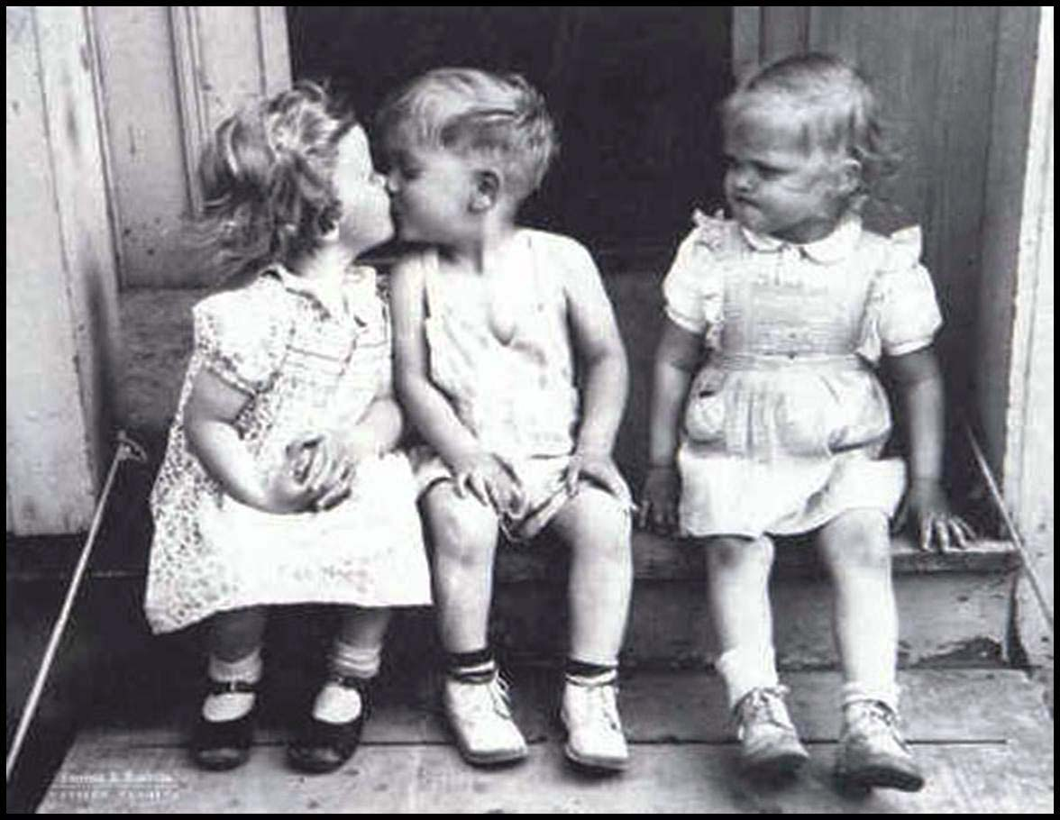
Scarcity Means There Is Not Enough For Everyone...
..So society must decide how resources will be allocated (distributed).
121

Slide 122
The Three Economic Questions
Every society must answer three questions:
What goods and services should be produced?
How should these goods and services be produced?
Who consumes these goods and services?
The way these questions are answered determines the economic system.
An economic system is the method used by a society to produce and distribute goods and services.
122

Slide 123
Economic Systems
Command Economy
Market Economy
Mixed Economy
123

Slide 124
Notes:
https://www.youtube.com/watch?v=B43YEW2FvDs

Slide 125
Command Economies
(aka Communism)
125

Slide 126
Command Economies
In a command economy (communism) the government…
owns all the resources
answers the three economic questions
Examples:
Cuba, North Korea, former Soviet Union, and China?
Why do command economies face problems of poor-quality goods, shortages, and unhappy citizens?
There is little incentive to work harder and central planners (the governments) have a hard time predicting preferences.
126

Slide 127
Advantages and Disadvantages
What is GOOD about Communism?
What is BAD about Communism?
Low unemployment - everyone has a job
Great Job Security - the government doesn’t go out of business
Less income inequality
“Free” Health Care
No incentive to work harder
No incentive to innovate or come up with good ideas
No Competition keeps quality of goods poor.
Corrupt leaders
Few individual freedoms
127

Slide 128
Free Market System
(aka Capitalism)
128

Slide 129
Characteristics of Free Market
Little government involvement in the economy. (Laissez Faire = Let it be)
Individuals OWN resources and answer the three economic questions.
The opportunity to make PROFIT gives people INCENTIVE to produce quality items efficiently.
Wide variety of goods available to consumers.
Competition and Self-Interest work together to regulate the economy (keep prices down and quality up).
129

Slide 130
Example of Free Market
Example of how the free market regulates itself:
If consumers want smartphones and only one company is making them…
Other businesses have the INCENTIVE to start making smartphones to earn PROFIT.
This leads to more COMPETITION….
Which means lower prices, better quality, and more product variety.
We produce the goods and services that society wants because “resources follow profits”.
The End Result: Most efficient production of the goods that consumers want, produced at the lowest prices and the highest quality.
130

Slide 131
Example of Command Economies
Example of why communism failed:
If consumers want smartphones and only one company is making them…
Other businesses CANNOT start making computers.
There is NO COMPETITION….
Which means higher prices, lower quality, and less product variety.
More phones will not be made until the government decides to create a new factory.
The End Result: There is a shortage of goods that consumers want, produced at the highest prices and the lowest quality.
131

Slide 132
Imagine a Farmer’s Market
The Farmer sets prices in the morning.
As customers come in, they make purchases that benefit themselves. If apples are priced too high, they don’t sell.
After a few hours of poor apple sales, the farmer may choose to lower the price.
Apples sell. The customers are happy. The farmer is happy.
Producers and consumers act in their own self-interest and make adjustments automatically.

Slide 133
The Invisible Hand
The concept that society’s goals will be met as individuals seek their own self-interest.
Example: Society wants fuel efficient cars…
Profit seeking producers will make more.
Competition between firms results in low prices, high quality, and greater efficiency.
The government doesn’t need to get involved since the needs of society are automatically met.
Competition and self-interest act as an invisible hand that regulates the free market.
133

Slide 134
Mixed Economies
A system with free markets but also some government intervention.
Almost all countries, including the US, have mixed economies.
134
Notes:
https://www.youtube.com/watch?v=KPpmAUk1olA

Slide 135
Functions of Government
Provide a Legal System
Provide Public Goods
Correct Market Failures
Maintain Competition
Redistribute Income
Stabilize the Economy

Slide 136
Provide a Legal System
To make and enforce laws and to protect private property rights

Slide 137
Provide Public Goods
Goods that individuals or private businesses wouldn’t provide

Slide 138
Correct Market Failures
Sometimes the prices and quantities of goods and services determined solely by markets are not the best for society
Example: Environmental pollution by the disposal of factory waste, imposing costs to others or a farm that sprays for pests and the area around the farm benefit from less pests

Slide 139
Maintain Competition
Competition is important in market economies because it leads to lower production costs and prices
If businesses become monopolies, the benefits of competition are lost
Example: Public Utilities

Slide 140
Redistribute Income
People, acting through their government, often decide it would be fair for the government to take income from some people and give it to others
Examples: taxes and social-welfare programs
Although many agree this is a good idea, there are many different opinions about how to do this fairly

Slide 141
Stabilize the Economy
Economists believe the government should take an active role to try to achieve steady economic growth and low levels of unemployment and inflation
The government attempts to do this through fiscal policy: taxation and spending and monetary policy: which seeks to stabilize the economy through control of the money supply

Slide 142
Pop Quiz

Slide 143
Who wrote, “In this world nothing is certain but death and taxes”?
Benjamin Franklin
Who was the author of The Wealth of Nations?
Adam Smith
Who wrote The General Theory of Employment, Interest and Money?
John Maynard Keynes
What does TNSTAAFL stand for?
There’s no such thing as a free lunch

Slide 144
Public Goods
Most goods and services produced in market economies are private goods and services.
The consumers who purchase these goods consume these goods
Example: a hamburger is a private good
National defense is an example of a public good

Slide 145
Public goods differ from private goods because they have these characteristics:
Shared consumption
When one person consumes a public good, it does not prevent others from also consuming the good
Nonexclusion
Once a public good is produced, it is difficult or impossible to exclude others from consuming the good, even if they didn’t pay for it

Slide 146
Market prices usually reflect the costs producers pay to produce goods and the benefits consumers receive from the good.
A kind of market failure occurs when market prices fail to reflect all the costs and all the benefits involved.
This market failure is called an externality problem.

Slide 147
Externalities
Exist when some of the costs or benefits associated with the production or consumption of a product spill over to third parties, who do not produce or pay to consume the product
Positive externalities are benefits enjoyed by someone who does not produce or pay to consume a product
Example: elementary education
Negative externalities are costs paid by someone who does not produce or pay to consume a product

Slide 148
148
Notes:
https://www.youtube.com/watch?v=tzXzkAs_cf0&index=6&list=PL1oDmcs0xTD9Aig5cP8_R1gzq-mQHgcAH

Slide 149
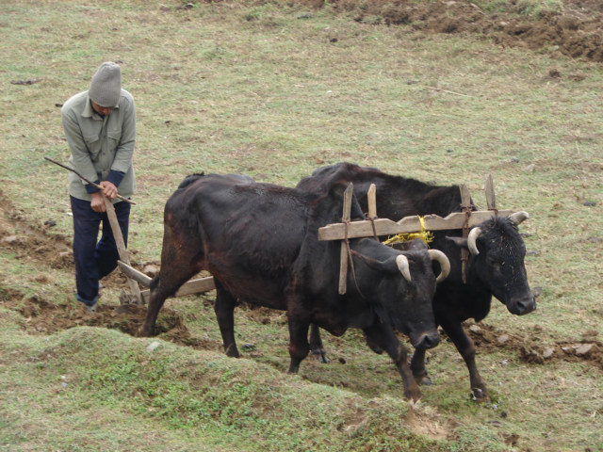
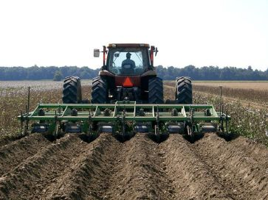
Productivity Creates Wealth
Countries with free markets, property rights, and The Rule of Law, have historically seen greater economic growth because they are more productive.
3rd World Countries
Developed Countries
149

Slide 150
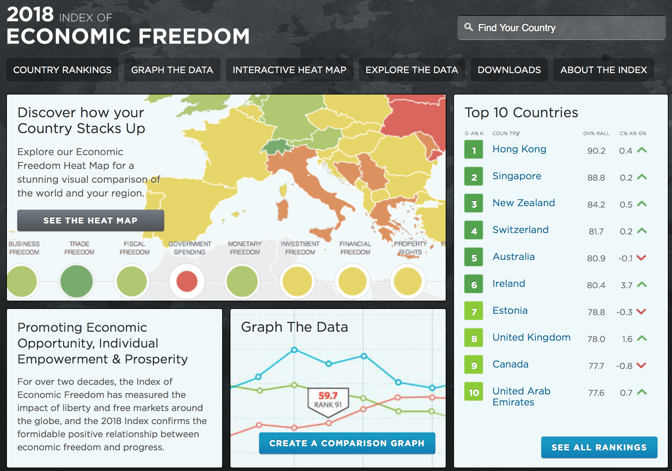
Economic Freedom
Copyright
ACDC Leadership 2018
Notes:
https://www.heritage.org/index/

Slide 151
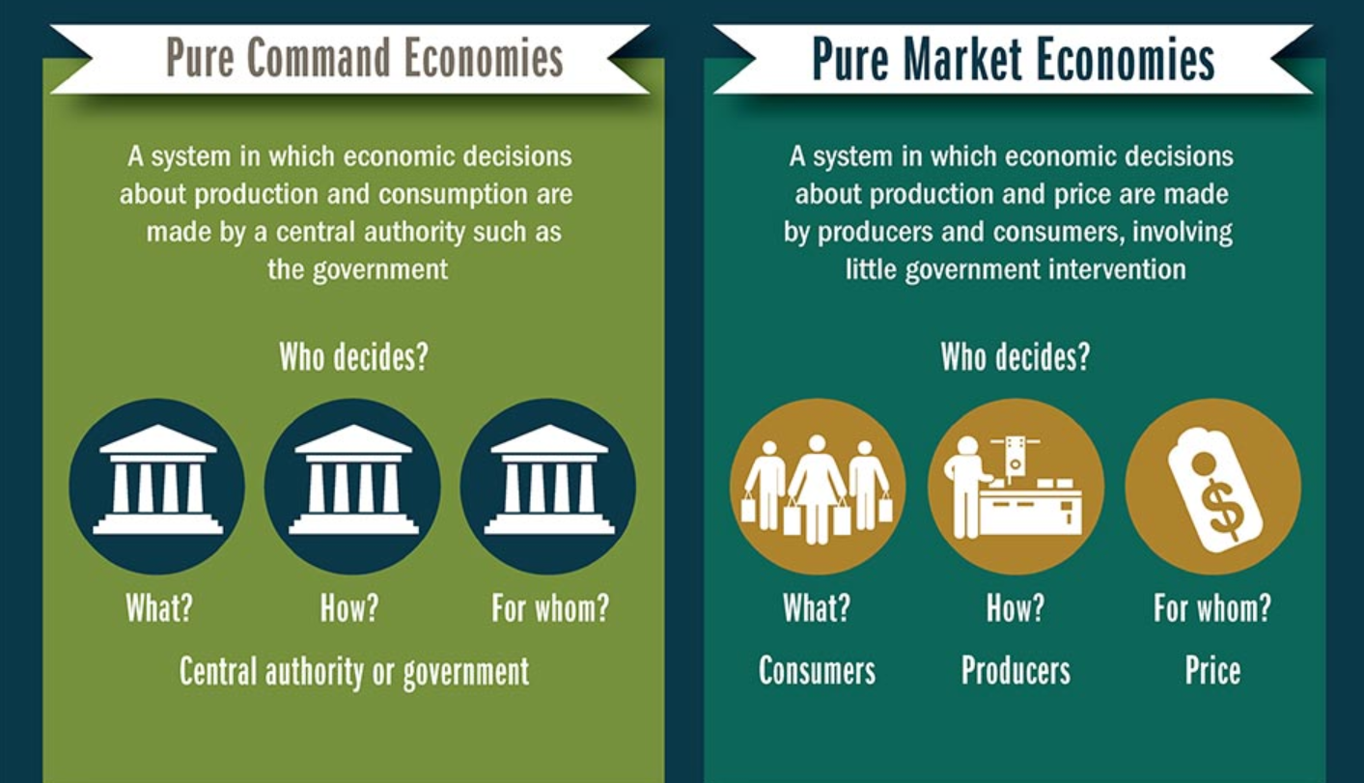
Where does the U.S. fall?

Slide 152
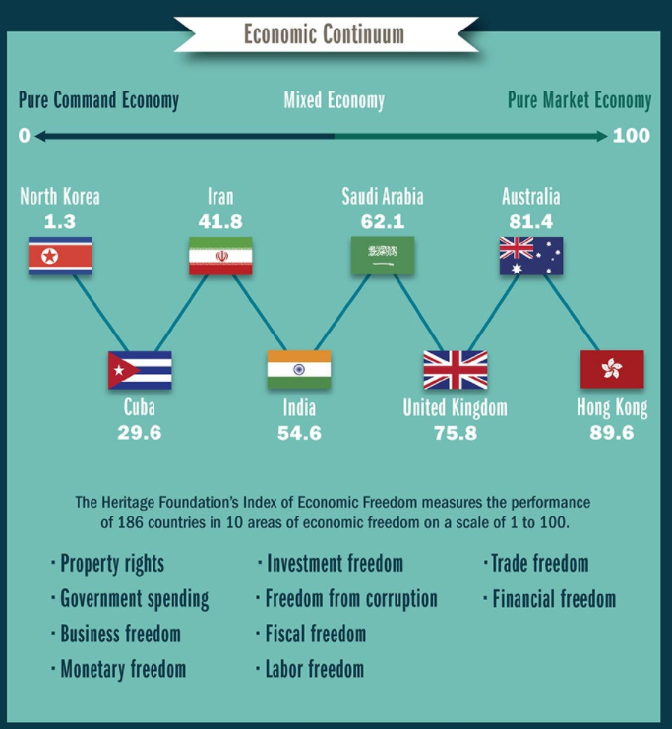

Slide 153
Scarcity Bus Ride
Notes:
https://www.youtube.com/watch?v=fBfCnRYjlRI

