Slide 1
KINGS AND QUEENS OF THE NILE
Began around 3000 BCE, Old Kingdom
Pharaohs = Kings and Queens
Gods and Goddesses

Slide 2
The Three Kingdoms
Old Kingdom
Middle Kingdom
Intermediate Periods
New Kingdom
Egypt United
Pyramids Built
One Between Each “Kingdom”
Times When Egypt Was Conquered
Osiris Important
Most Prosperous Time

Slide 3
Notes:
Images in Public Domain: http://commons.wikimedia.org/wiki/File:Anc_Egyp-Osiris.png, http://commons.wikimedia.org/wiki/File:%C3%84gyptischer_Maler_um_1360_v._Chr._001.jpg, http://commons.wikimedia.org/wiki/File:Set.svg
Isis was the great mother-goddess. Her son was Horus, the enemy of Seth. Sometimes she has the baby Horus on her lap. Sometimes she has a throne on her head. Sometimes she has a sun disk and horns. Seth (or Set) is shown with an animal's head with a long curved pointed snout, slanting eyes, and square-tipped ears. Sometimes he has a forked tail. No-one seems to know what the animal is. Aardvark, antelope, camel, donkey fennec, giraffe, greyhound, jackal, jerboa, long-snouted mouse, okapi, oryx and pig have all been suggested. Seth was the God of the desert, storm and violence, which are all enemies of the fertile, prosperous, narrow valley of the Nile.
When Horus was a baby, his father Osiris was killed by Seth. Horus and his mother Isis hid in the papyrus reeds in the delta of the Nile until Horus grew up. The he went to war with Seth to get his father's crown and kingdom. The battles raged for a long time. Once Seth managed to blind Horus by taking out his eye and tearing it to bits, but Thoth, the God of Wisdom, managed to heal the eye. Isis decided to help her son Horus. She met Seth, and asked for his help. She described someone killing a man and taking all he had away from the man's son. Seth said that killer should pay for his crimes. Isis said that Seth himself was the killer, and he had condemned himself. The other gods agreed, and Seth was driven out into the Sahara Desert.

Slide 4
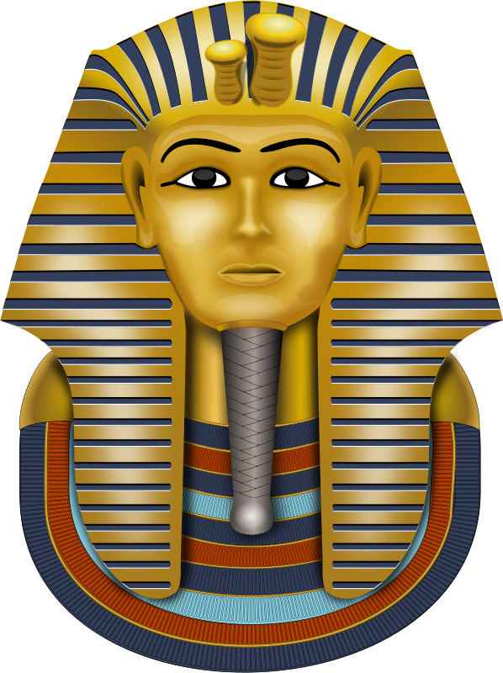
THE ALL POWERFUL PHARAOHS
Absolute Power
Their word was law
Religious and political leader

Slide 5
Vocabulary
What type of Government is that?
Theocracy

Slide 6
EGYPTIAN RELIGION
Came to believe in eternity for all souls
Your life and status determined your place
Myths explained natural phenomena
Notes:
During the day Ra had to fight a snake called Apep. He was helped by the other gods, such as Seth and Bastet. The sun disk on Ra's head often has a cobra round it. A cobra appears on the forehead of Pharaohs like Tut. Ra was the greatest of the gods and he kept his power in his secret name, which only he knew. He had started to grow old, and sometimes he dribbled. Isis collected some of his saliva and made it into a snake. She hid the snake where Ra would walk. When Ra trod on it, it bit him, and Ra screamed in pain. All the gods gathered round, but none could heal him. Isis said "If you tell me your secret name, this will give me enough magic power to heal you." Ra didn't want to do this, but eventually the pain was so bad that he had to. Isis healed him, and ever since then she has the magic powers that Ra had.

Slide 7
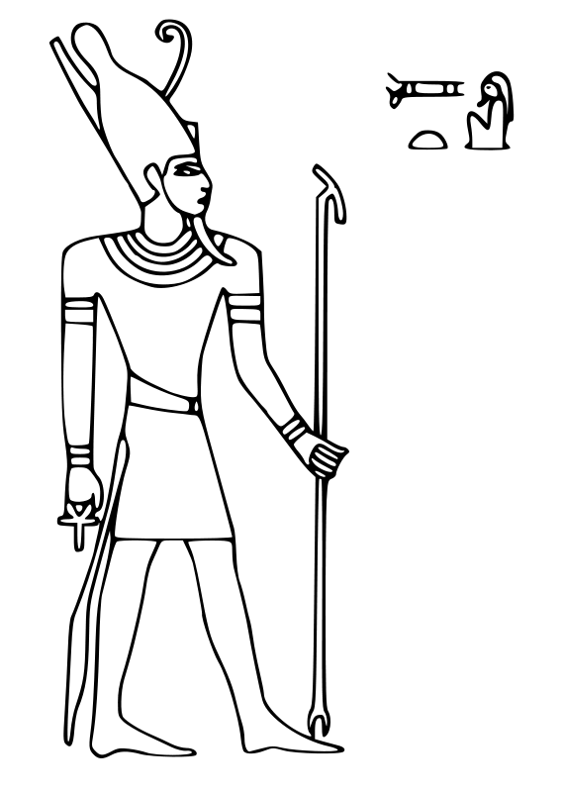
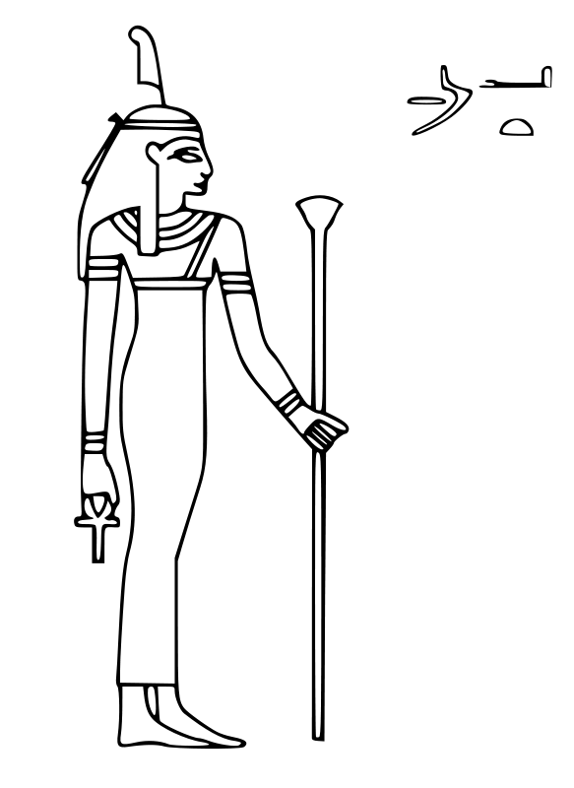
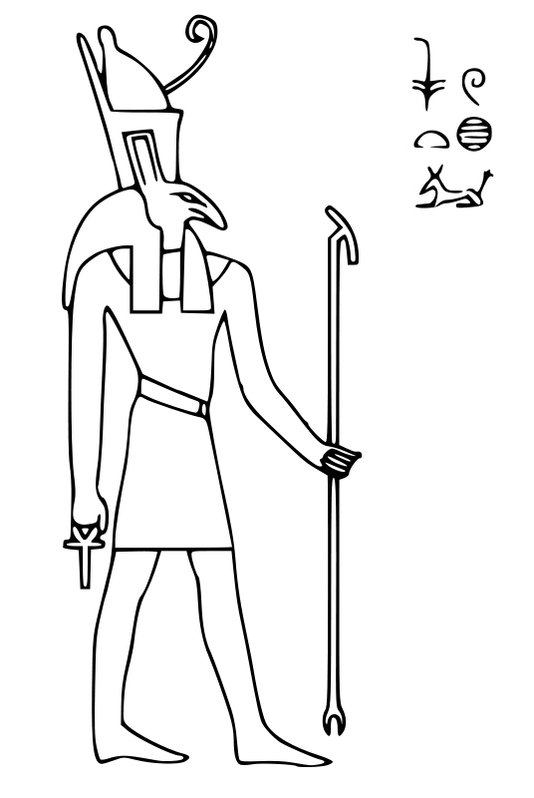
Vocabulary
What is the word for worshiping many gods?
Polytheism

Slide 8
Mummification
Burial was important
Journey to the other world
Royals were mummified

Slide 9
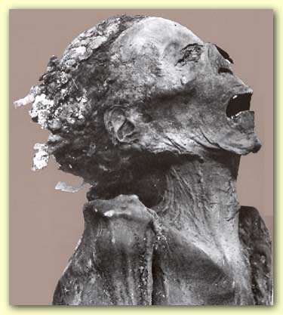
MUMMIES

Slide 10
Mummification
First, they draw out the brains through the nostrils with an iron hook…then with a sharp stone they make an incision in the side, and take out all the bowels…Then, having filled the belly with pure myrrh, cassia, and other perfumes, they sew it up again; … [then] they steep in natron, leaving it under for 70 days…[then] they wash the corpse , and wrap the whole body in bandages of waxen cloth. --Herodotus

Slide 11
MUMMIES

Slide 12
PYRAMIDS
Giant tombs for the Pharaoh
Largest at Giza

Slide 13
PYRAMIDS
May contain 2 million stones
Each stone weighs up to 5000 pounds, 2 tons!
Took around 20 years to build

Slide 16
In Your Notebook:
How can you tell burial was important to the Ancient Egyptians?
Why do you think was it so important?

Slide 17
WRITING: EGYPTIAN HIEROGLYPHICS
Pictographic
Used pictures to communicate.
The pictures represented ideas and objects.
Eventually, the pictures came to represent sounds (phonetic)

Slide 18
Rosetta Stone
1799
Key to understanding hieroglyphics

Slide 19
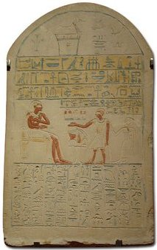

Slide 20
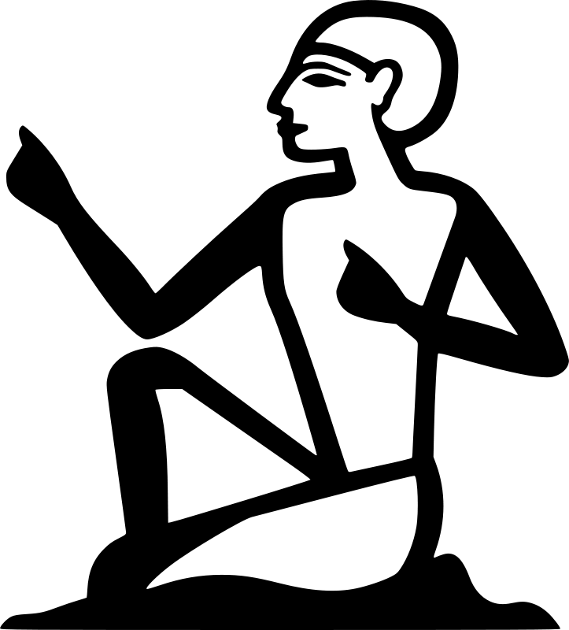
Vocabulary
What was the written language of the Egyptians?
Hieroglyphics

