Slide 1
Early Russia

Slide 2
Geography
Russia is on two continents—Europe and Asia. It is an enormous great plain with very cold winters and very little good farmland. It is landlocked, with bordering mountain ranges and icy seas. That has isolated Russia from European nations.

Slide 3
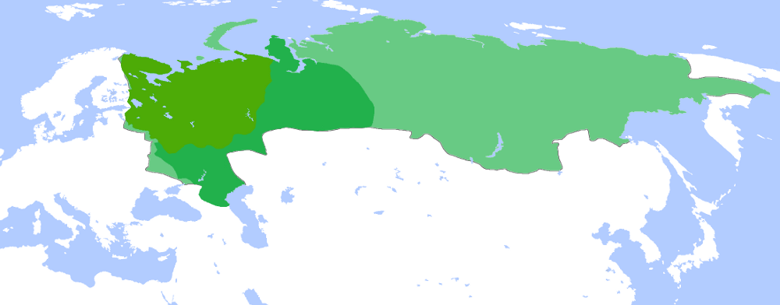
Russian Tsardom
Territory of the Tsardom of Russia in
AD 1500,
1600 and
1700.

Slide 4
Beginnings
The first people were an ethnic group known as the Slavs. Two cities, Novgorod and Kiev formed the earliest principality—Kievan Rus.
Byzantine Missionaries influenced early Russia, bringing the Russian language an alphabet—the Cyrillic Alphabet. Russia also borrowed Orthodox Christianity from the Byzantines.

Slide 5
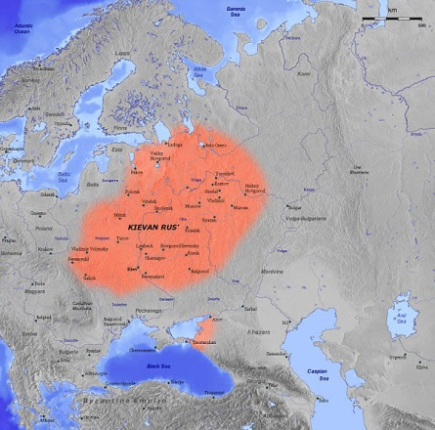
Notes:
Image in Public Domain: http://en.wikipedia.org/wiki/File:Kievan_Rus_en.jpg

Slide 6
The Mongols
The Mongols invaded Russia between 1237 and 1240, and they controlled Russia until 1480. They broke up Kievan Rus (destroyed Kiev) and are responsible for the rise of Russian Tsars. Under the Mongols, the city of Moscow (founded in 1147) grew in wealth and power.

Slide 7
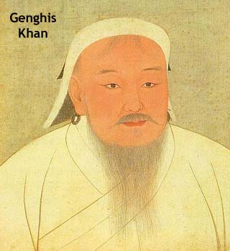
VIDEO

Slide 8
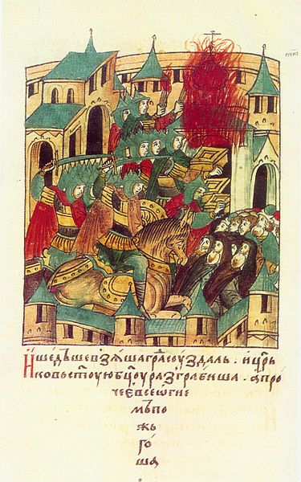

Slide 9
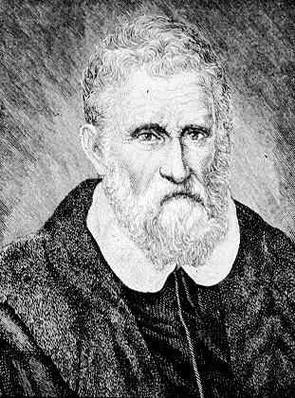
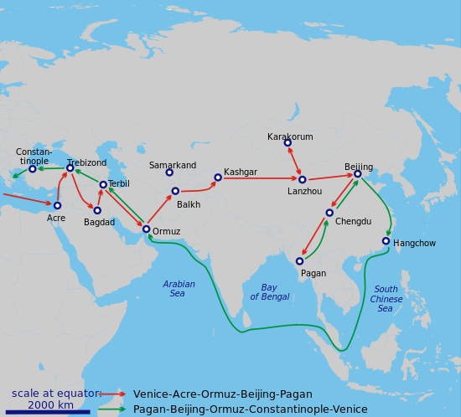
Marco Polo
VIDEO

Slide 10
Early Tsars
Tsar (also Czar) comes from Roman Caesar. It is the title for the Russian emperor.
Ivan III defeated the Mongols in 1480.
He married a Byzantine Princess.

Slide 11
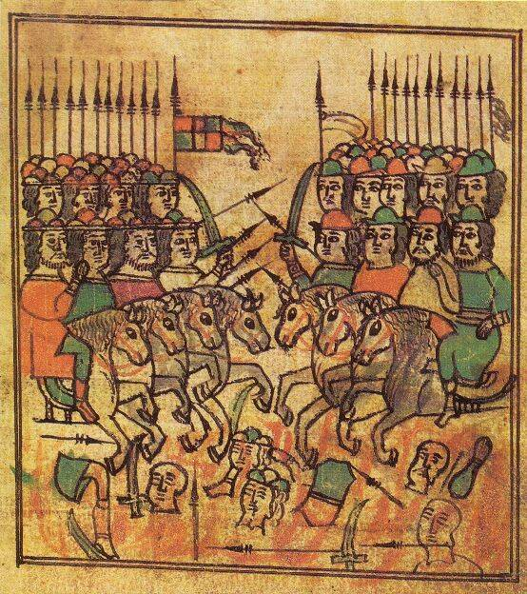

Slide 12
Early Tsars
Ivan IV was the first Russian ruler to be crowned Tsar.
He became paranoid after his wife died, and foreshadowed Stalin by killing many of his own people. He killed his son (his strongest heir), effectively ending his family’s dynasty.

Slide 13
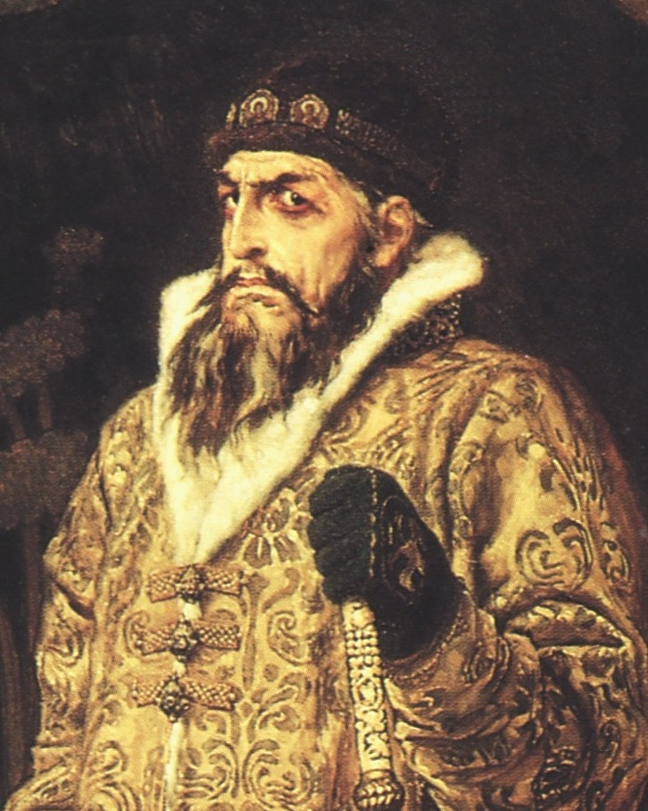

Slide 14
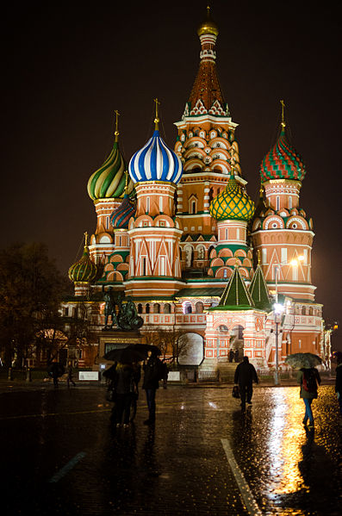
St. Basil’s Cathedral

Slide 15
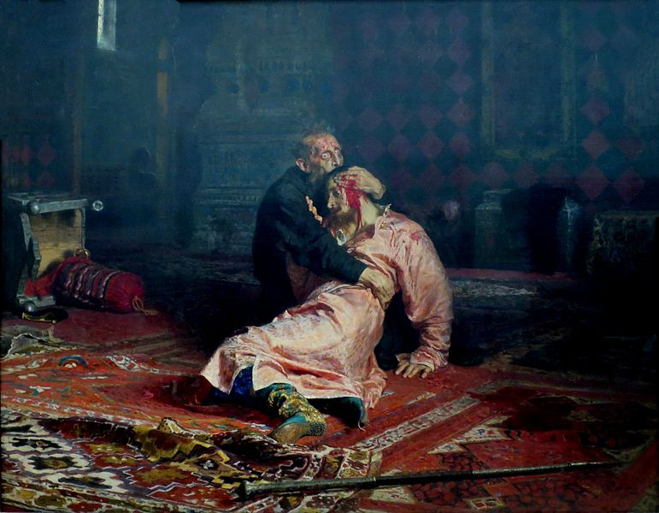
Video

