Slide 1
Rome Fell
VIDEO
What’s Next?

Slide 2
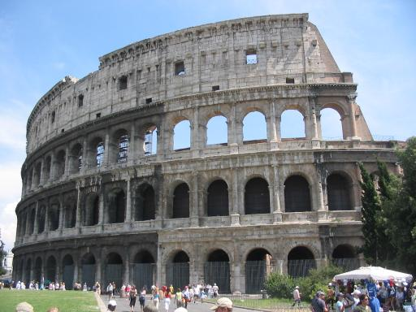
Rome Fell
Germanic Invaders
Populations become rural
- Roman trade / government collapse
- No leadership
- People flee to the country
Germanic / Latin languages blend
Notes:
Image in Public Domain: https://commons.wikimedia.org/wiki/File:Colosseum-2003-07-09.jpg

Slide 3
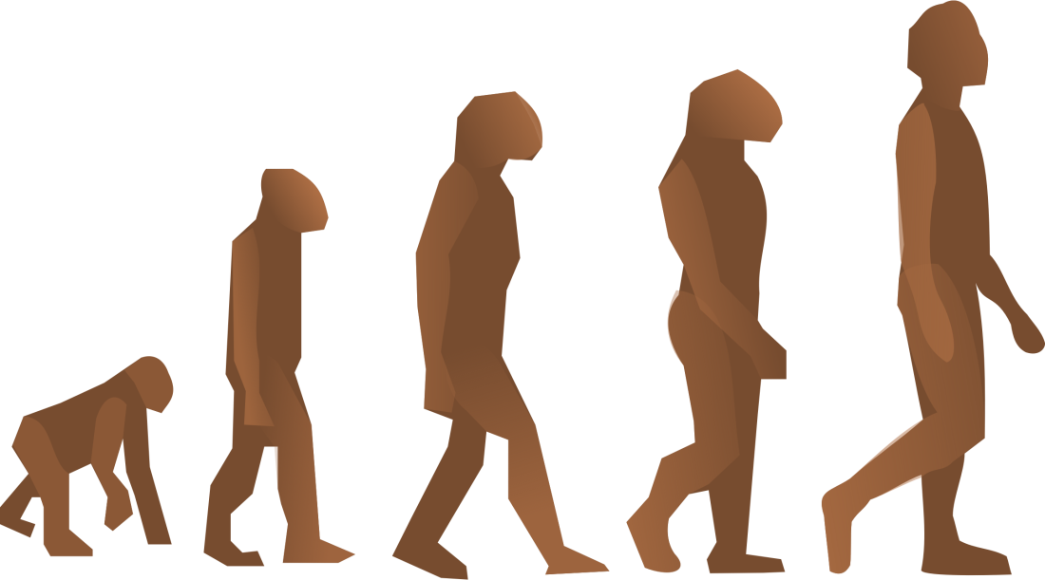
Let’s Take English as an Example
OLD ENGLISH
MIDDLE ENGLISH
MODERN ENGLISH

Slide 4
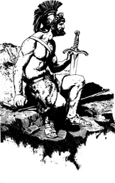
Germanic Kingdoms
Unwritten laws
Stressed personal ties
Germanic Chiefs
- band of warriors
- lived in his hall
- extreme loyalty

Slide 5
The Franks
Gaul
496, Clovis brings them to Christianity
511, Clovis unites Franks into one kingdom

Slide 6
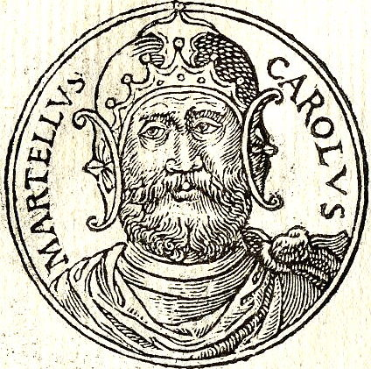
The Franks
Major Domo, “mayor of the palace”
In charge of royal household and estates
More powerful than the king
Charles Martel, “the hammer”
- extended Frank’s reign
- 732, victorious at Battle of Tours
Notes:
Image in Public Domain: https://commons.wikimedia.org/wiki/File:Carolus-Martell.jpg The Battle of Tours would seal Western Europe’s fate as Christian, rather than Muslim.

Slide 7
The Franks
Pepin the Short, Charles’s son
Pope anointed him “king by the grace of god” in exchange for his promise to fight the Lombards
Beginning of Carolingian Dynasty, 751-987

Slide 8
The Franks
771 Charlemagne, “Charles the Great,” Pepin’s son
Expanded Frankish kingdom into an empire
Spread Christianity
Christmas day, 800, Pope Leo III crowned him emperor of the Holy Roman Empire

Slide 9
The Franks
Charlemagne led a revival of learning
Died 814
Notes:
Image in Public Domain: http://archaeology.org/news/1782-140131-charlemagne-bones-sarcophagus

Slide 10
Charlemagne’s Legacy
His son, Louis the Pious, was ineffective
Louis’s three sons fought for the empire
843, Treaty of Verdun, divided empire into three kingdoms: Lothair (Italy), Charles the Bald (France), and Louis the German (Germany)

Slide 12
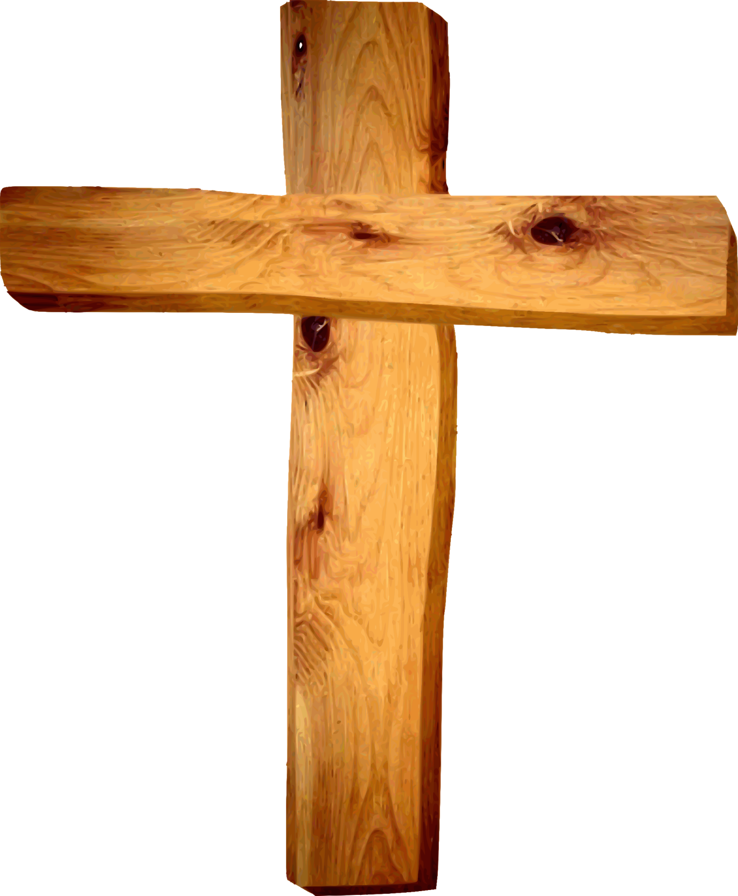
Christianity
Spread by:
- politics
- missionaries
- fear of Muslim invasion
Monasteries
- monks
- learning
- Venerable Bede
VIDEO
VIDEO
Notes:
Video 1, “Religion in Medieval Europe,” 4:27: https://www.youtube.com/watch?v=2_b-fAZ3a0g
Video 2, “Who Was Bede The Venerable,” 7:05: https://www.youtube.com/watch?v=BTUWq4nFFLk

Slide 13
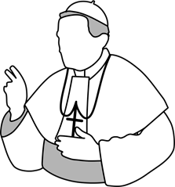
Christianity
590, Gregory I, the Great, became pope
Entwined papacy in politics
- raised army
- repaired roads
Believed responsible for regions from Italy to England and from Spain to Germany
Palace in Rome
VIDEO

Slide 14
The Catholic Church
Problems with the church:
Lay investiture
Heresy
Friars
Disunity
***THE INQUISITION***
CONVERSION OF HERETICS BY FORCE SET UP BY THE CHURCH IN 1232***
Notes:
Lay Investiture is the practice of non-clergy appointing Church positions. This can bring about corrupt political ties within the Church. Heresy is the act of going against the Church. Friars were like itinerant preachers traveling from village to village, and they were often corrupt and abused the power they had under the Church. The Inquisition was the Trial of the Church. Heretics who would not repent were burned.

Slide 15
Great Schism
1054
The church split into east (Constantinople) and west (Rome)

Slide 16
The Crusades
VIDEO
A crusade is a holy war
Called for 1st after the Battle of Manzikert--Muslims defeat the Eastern Christians (unanswered)
The crusades would lead to over 100 years of holy war in the east
Notes:
Video, “The Crusades in 5 Minutes,” 5:01: https://www.youtube.com/watch?v=CcGzQ3ga5R8

Slide 17
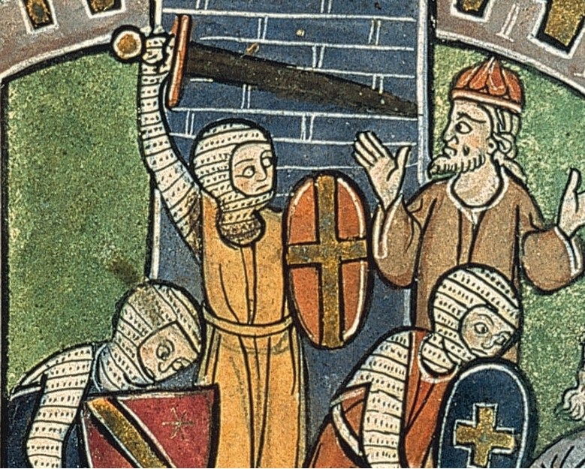
1st CRUSADE
The 1st crusade takes the Holy land (Jerusalem) in 1099 (let in through a window)
ONLY SUCCESSFUL CRUSADE IN THE EAST

Slide 18
RESULTS OF FIRST CRUSADE
Christians control Jerusalem (briefly)
Creation of military orders (Knights Templar, Teutonic, Hostpitallers)
Cannot hold the Holy Land for lack of settlers
Cause great hatred between Muslims of the east and the Christians
**Actions of the Christians show no MERCY**
Notes:
Image in Public Domain: https://commons.wikimedia.org/wiki/File:Carreau_m%C3%A9di%C3%A9val_Laon_030208_01.jpg

Slide 19
Other Crusades
2nd Crusade: failed Miserably, led by King Louis VII of France and Conrad III of Germany
Muslims wiped out Crusaders
Saladin: Kurdish leader that defeats the Crusaders and retakes Jerusalem in 1187
VIDEO
Notes:
Image of Saladin in Public Domain: https://commons.wikimedia.org/wiki/File:Saladin2.jpg
Video, “Saladin Videos,” 3:20: http://www.history.com/topics/saladin/videos/saladin?m=528e394da93ae&s=undefined&f=1&free=false

Slide 20
Crusades of Kings
Led by Richard I, Fredrick I, & Philip II
Left in 1189, Failed to regain Jerusalem
Richard executes 2700 children and women at Acre to prove a point to Saladin
Fredrick drowns halfway in and his men leave, this caused the failure of the 2nd crusade
Eventually Richard the Lionheart retreated back to England and was Kidnapped on the way by the King of Austria and ransomed back to England
Notes:
Image of Richard the Lionheart and Robin Hood in the Creative Commons: https://commons.wikimedia.org/wiki/File:Richard_The_Lionheart_-_Robinhood.jpg

Slide 21
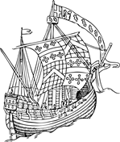
EFFECTS OF THE CRUSADES IN THE WESTERN WORLD
CENTER OF CHRISTIANITY (JERUSALEM) HELD BY MUSLIMS
LOSS OF RESPECT FOR CHURCH AND CRUSADING (BECAME POLITICAL)
DISASTEROUS FOR THE JEWS
DID LEAD TO INCREASED DESIRE FOR EASTERN GOODS LEADING TO THE AGE OF EXPLORATION
ADVANCES IN SHIP BUILDING AND NAVIGATION

Slide 22
Notes:
Map of Crusades in Public Domain: https://commons.wikimedia.org/wiki/File:GIBBON(1862)_p7.008_MAP_OF_THE_CRUSADES.jpg

Slide 23
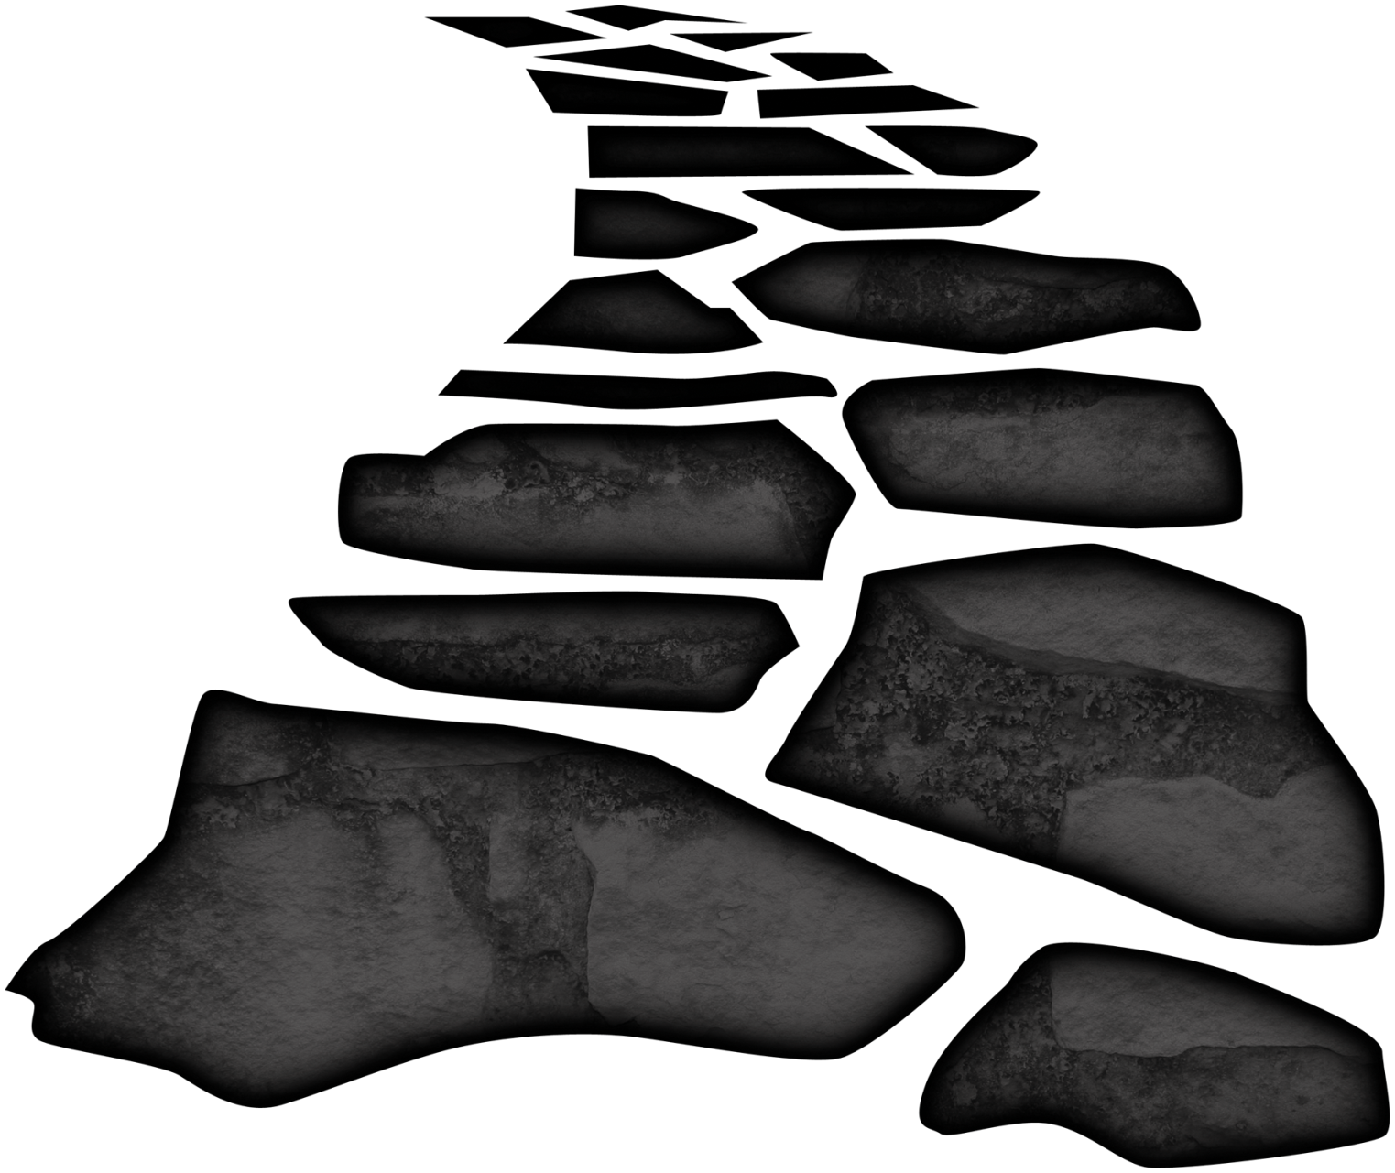
Road to Feudalism
Invaders at their worst, 850-950
- Vikings from the North
- Magyars from the east
- Muslims from the south
No security from a king
VIDEO
Notes:
Video, “Viking Invasion of England in 3 Minutes,” 4:24: https://www.youtube.com/watch?v=5ppy-jA1AF8

Slide 24
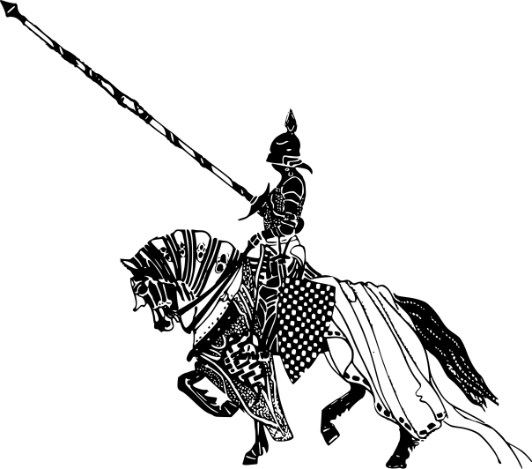
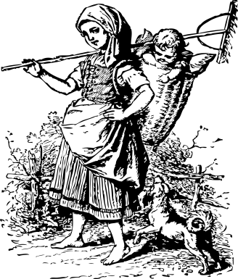
Feudalism
Based on Class
Those who fought (nobles and knights)
Those who prayed (clergy, monks, and nuns)
Those who worked (peasants)

Slide 25
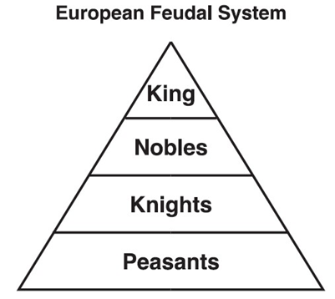
Feudalism
Lord: owned the land
Vassal: received a land grant, fief
Knight: pledged to defend lord’s land in exchange for fiefs
Serfs: peasants bound to the land

Slide 26
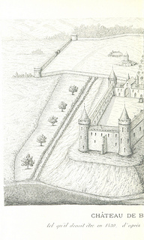
Feudalism
Manors:
- The lord’s estate, which peasants were bound to work in exchange for protection, housing, and farmland
Notes:
Image from the public domain: https://www.flickr.com/photos/britishlibrary/11307062215/in/album-72157639804554423/

Slide 27
Castles
VIDEO
Notes:
Images from the Public Domain: https://www.flickr.com/photos/britishlibrary/11304903584/in/album-72157639804554423/, https://www.flickr.com/photos/britishlibrary/11017413726/in/album-72157639804554423/
Video, “Feudalism in the Middle Ages,” 4:50: https://www.youtube.com/watch?v=zO-8f3XpNMg

