Slide 1
DEMAND DEFINED
What is Demand?
Demand is the different quantities of goods that consumers are willing and able to buy at different prices.
(Ex: You are able to purchase diapers, but if you aren’t willing to buy then there is NO demand).
What is the Law of Demand?
There is an INVERSE relationship between price and quantity demanded.

Slide 2
Example of Demand
I am willing to sell several A’s in this Economics class. How much will you pay?
Price | Quantity Demanded
Demand Schedule

Slide 3
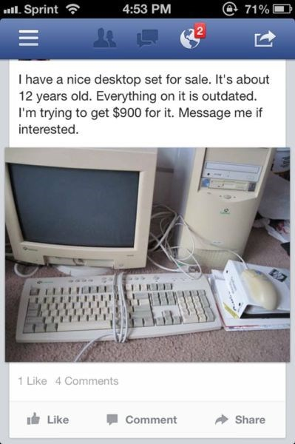

Slide 4
Why does the Law of Demand occur?
The law of demand is the result of three separate behavior patterns that overlap:
The Substitution effect
The Income effect
The Law of Diminishing Marginal Utility
We will define and explain each…

Slide 5
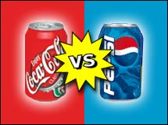
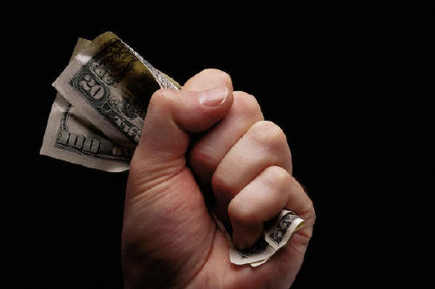
Why does the Law of Demand occur?
1. The Substitution Effect
If the price goes up for a product, consumers buy less of that product and more of another substitute product (and vice versa).
2. The Income Effect
If the price goes down for a product, the purchasing power increases for consumers -allowing them to purchase more.

Slide 6
Why does the Law of Demand occur?
3. Law of Diminishing Marginal Utility
Utility = Satisfaction
We buy goods because we get utility from them
The law of diminishing marginal utility states that as you consume anything, the additional satisfaction that you will receive will eventually start to decrease.
In other words, the more you buy of ANY GOOD the less satisfaction you get from each new unit consumed.
Discussion Questions:
What does this have to do with the Law of Demand?
How does this effect the pricing of businesses?

Slide 7
Graphing Demand

Slide 8
The Demand Curve
A demand curve is a graphical representation of a demand schedule.
The demand curve is downward sloping showing the inverse relationship between price (on the y-axis) and quantity demanded (on the x-axis).
When reading a demand curve, assume all outside factors, such as income, are held constant. (This is called ceteris paribus)
Let’s draw a new demand curve for milk…

Slide 9
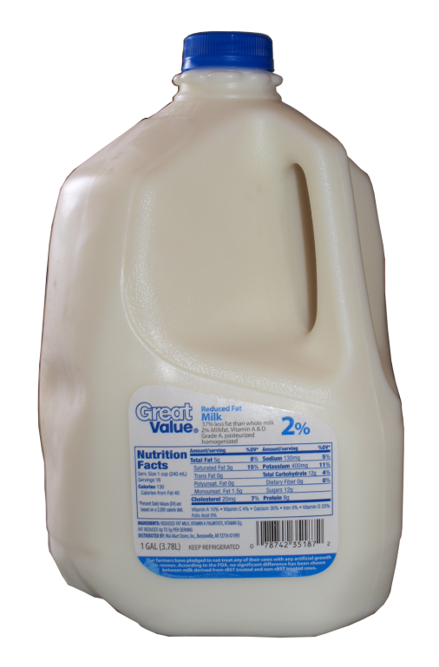
GRAPHING DEMAND
Demand Schedule
Price of Milk
Draw this large in your notes
$5
4
3
2
1
Price | Quantity Demanded
$5 | 10
$4 | 20
$3 | 30
$2 | 50
$1 | 80
10 20 30 40 50 60 70 80
Q
Quantity of Milk

Slide 10
GRAPHING DEMAND
Demand Schedule
Price of Milk
$5
4
3
2
1
Price | Quantity Demanded
$5 | 10
$4 | 20
$3 | 30
$2 | 50
$1 | 80
Demand
10 20 30 40 50 60 70 80
Q
Quantity of Milk

Slide 11
Where do you get the Market Demand?
Billy
Jean
Other Individuals
Market
Price | Q Demd
$5 | 1
$4 | 2
$3 | 3
$2 | 5
$1 | 7
Price | Q Demd
$5 | 0
$4 | 1
$3 | 2
$2 | 3
$1 | 5
Price | Q Demd
$5 | 9
$4 | 17
$3 | 25
$2 | 42
$1 | 68
Price | Q Demd
$5 | 10
$4 | 20
$3 | 30
$2 | 50
$1 | 80
P
P
P
P
$3
$3
$3
$3
D
D
D
D
3
Q
2
Q
25
Q
30
Q

Slide 12
Demand Review
What are the two key aspects of the definition of demand?
What is the Law of Demand?
Give an example of the substitution effect.
Give an example of the income effect.
Give an example of the law of diminishing marginal utility.
Explain how the law of diminishing marginal utility causes the law of demand.
How do you determine the MARKET demand for a particular good?
Name 10 fast food places.
12

Slide 13
Shifts in Demand
A shift means that at the same prices, more people are willing and able to purchase that good.
This is a change in demand, not a change in quantity demanded!
PRICE DOESN’T SHIFT THE CURVE
13

Slide 14
Change in Demand
Demand Schedule
Price of Milk
What if milk
makes you smarter?
$5
4
3
2
1
Price | Quantity Demanded
$5 | 10
$4 | 20
$3 | 30
$2 | 50
$1 | 80
Demand
10 20 30 40 50 60 70 80
Q
Quantity of Milk
14

Slide 15
Change in Demand
Demand Schedule
Price of Milk
What if milk
makes you smarter?
$5
4
3
2
1
Price | Quantity Demanded
$5 | 10
$4 | 20
$3 | 30
$2 | 50
$1 | 80
Demand
10 20 30 40 50 60 70 80
Q
Quantity of Milk
15

Slide 16
Change in Demand
Demand Schedule
Price of Milk
$5
4
3
2
1
Price | Quantity Demanded
$5 | 10 30
$4 | 20 40
$3 | 30 50
$2 | 50 70
$1 | 80 100
Demand
10 20 30 40 50 60 70 80
Q
Quantity of Milk
16

Slide 17
Change in Demand
Demand Schedule
Price of Milk
Increase in Demand
Prices didn’t change but people want MORE Milk
$5
4
3
2
1
Price | Quantity Demanded
$5 | 10 30
$4 | 20 40
$3 | 30 50
$2 | 50 70
$1 | 80 100
D₁
Demand
10 20 30 40 50 60 70 80
Q
Quantity of Milk
17

Slide 18
Change in Demand
Demand Schedule
Price of Milk
What if milk
causes baldness?
$5
4
3
2
1
Price | Quantity Demanded
$5 | 10
$4 | 20
$3 | 30
$2 | 50
$1 | 80
Demand
10 20 30 40 50 60 70 80
Q
Quantity of Milk
18

Slide 19
Change in Demand
Demand Schedule
Price of Milk
What if milk
causes baldness?
$5
4
3
2
1
Price | Quantity Demanded
$5 | 10
$4 | 20
$3 | 30
$2 | 50
$1 | 80
Demand
10 20 30 40 50 60 70 80
Q
Quantity of Milk
19

Slide 20
Change in Demand
Demand Schedule
Price of Milk
$5
4
3
2
1
Price | Quantity Demanded
$5 | 10 0
$4 | 20 5
$3 | 30 20
$2 | 50 30
$1 | 80 60
Demand
10 20 30 40 50 60 70 80
Q
Quantity of Milk
20

Slide 21
Change in Demand
Demand Schedule
Price of Milk
$5
4
3
2
1
Decrease in Demand
Prices didn’t change but people want LESS Milk
Price | Quantity Demanded
$5 | 10 0
$4 | 20 5
$3 | 30 20
$2 | 50 30
$1 | 80 60
D₂
Demand
10 20 30 40 50 60 70 80
Q
Quantity of Milk
21

Slide 22
Change in Qd vs. Change in Demand
There are two ways to increase quantity from 10 to 20
Price of Milk
P
A to B is a change in quantity demanded (due to a change in price)
A to C is a change in demand (shift in the curve)
A
C
$3
$2
B
D₂
D₁
10 20
Q Milk
Quantity of Milk

Slide 23
Change in Demand
Demand Schedule
Price of Milk
What happens to
the demand for milk if
the price of milk
goes up?
$5
4
3
2
1
Price | Quantity Demanded
$5 | 10
$4 | 20
$3 | 30
$2 | 50
$1 | 80
NOTHING!
The demand stays the same
Demand
10 20 30 40 50 60 70 80
Q
Quantity of Milk
23

Slide 24
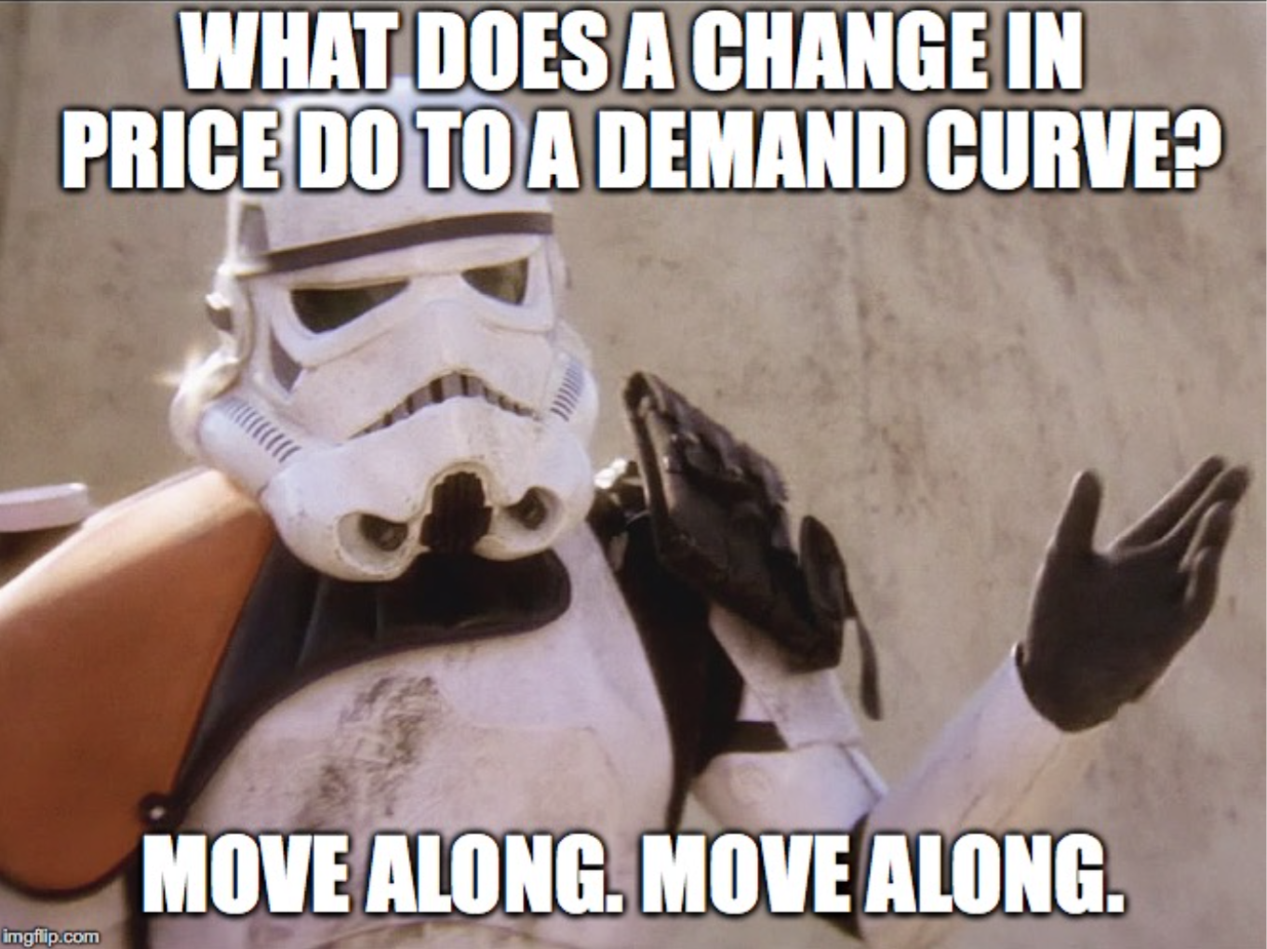

Slide 25
What Causes a Shift in Demand?
5 Shifters (Determinants) of Demand:
Tastes and Preferences
Number of Consumers
Price of Related Goods
Income
Future Expectations
Changes in PRICE don’t shift the curve. It only causes movement along the curve.
25

Slide 26
Prices of Related Goods
The demand curve for one good can be affected by a change in the price of ANOTHER related good.
Substitutes are goods used in place of one another.
Ex: If price of Pepsi falls, demand for coke will…
If the price of one increases, the demand for the other will increase (or vice versa).
2. Complements are two goods that are bought and used together.
Ex: If price of hot dogs falls, demand for hot dog buns will...
If the price of one increase, the demand for the other will fall (or vice versa).
26

Slide 27
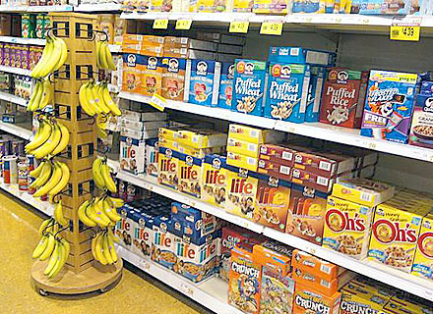
Substitutes or Complements?
27

Slide 28
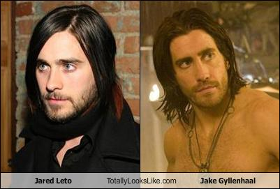
Substitutes
28

Slide 29
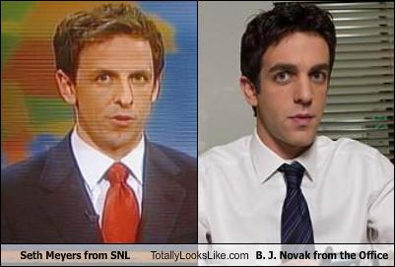
Substitutes
29

Slide 30
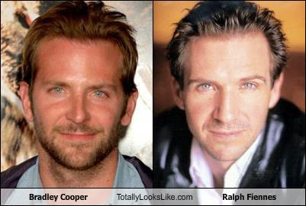
Substitutes
30

Slide 31
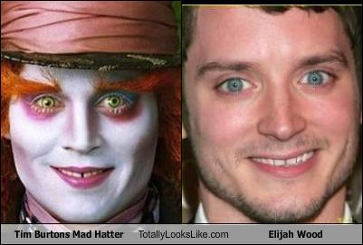
Substitutes
31

Slide 32
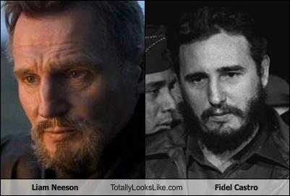
Substitutes
32

Slide 33
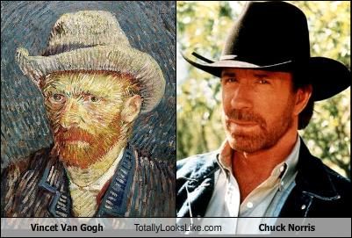
Substitutes
33

Slide 34
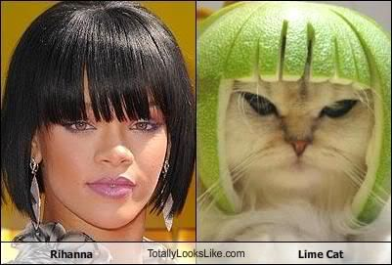
Substitutes
34

Slide 35
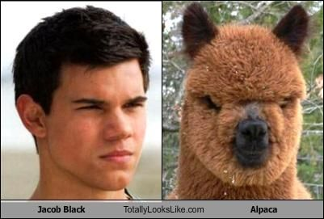
Substitutes
35

Slide 36
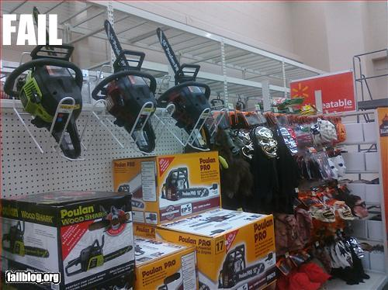
Complements
36

Slide 37
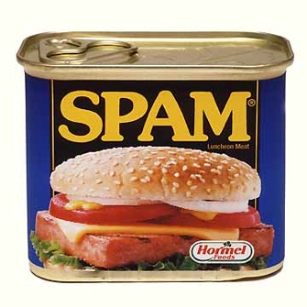
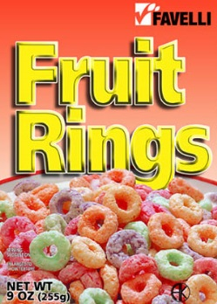
Income
The incomes of consumer change the demand, but how depends on the type of good.
Normal Goods
Ex: Luxury cars, seafood, jewelry, homes
As income increases, demand increases
As income falls, demand falls
2. Inferior Goods
Ex: Top Ramen, used cars, used clothes
As income increases, demand falls
As income falls, demand increases
37

Slide 38
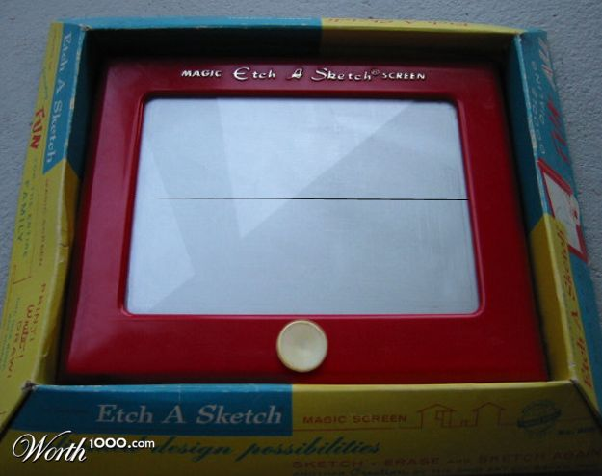
Inferior Goods
38

