Slide 1
Why Do We Trade?
Absolute and Comparative Advantage

Slide 2
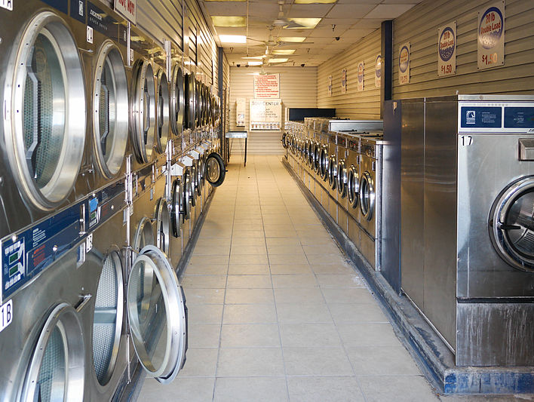
Specialization
According to CNBC, Kylie Jenner earns $1 million dollars for a sponsored Instagram post.
Should she use her time doing laundry, or pay somebody else to do it and create more Instagram posts?
© Leah Cleary 2019

Slide 3
Specialization
The development of skills in a specific kind of work; division of labor
How does each player on the field demonstrate specialization?
How do they all come together to do something they could not have achieved alone?

Slide 4
Trade
Exchange of goods, resources, and/or services
Can be among individuals, businesses, or nations
When nations exchange, it is called international trade

Slide 5
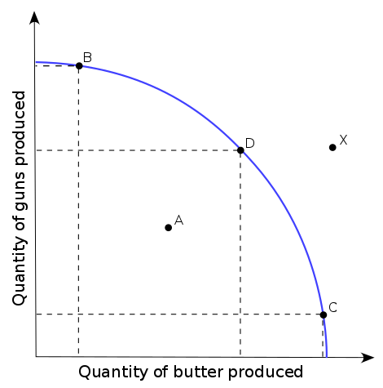
How Do We Decide What to Trade?
Remember the Production Possibilities curve?
As a nation produces more butter, it produces fewer guns. This is a trade-off.
Opportunity Costs: The most desirable alternative given up as the result of a decision
What is the opportunity cost of producing more guns?

Slide 6
Absolute Advantage
The ability to produce a good by using fewer inputs or by creating more outputs than another producer
If your input is hours, you are looking for the nation that can produce fastest
Who has the absolute advantage for donuts?
Who has the absolute advantage for cupcakes?
Input
 | Number of Hours to produce 1 dozen donuts | Number of Hours to produce 1 dozen cupcakes
Kingdom of Happy Chains | 1 | 2
Kingdom of Sappy Chains | 2 | 1.5

Slide 7
Absolute Advantage
Input: Has to do with time or other resources that go into making something (the LEAST has the absolute advantage)
Output: Has to do with quantity or amount of a product that is produced (the MOST has the absolute advantage)

Slide 8
Absolute Advantage
Who has the absolute advantage for each resource?
 | Number of Donuts Produced in One Hour | Number of Cupcakes Produced in One Hour
Kingdom of Choo-Choo Chains | 24 | 9
Kingdom of Notorious Chains | 12 | 10

Slide 9
Comparative Advantage
The ability to produce a good at a lower opportunity cost than another producer
More developed countries usually have absolute advantage over less developed countries
The law of comparative advantage shows how these nations can benefit each other by specializing and then trading

Slide 10
Comparative Advantage
Remember this simple formula when figuring out comparative advantage:
Comparative Advantage with INPUTS = “Other Goes Under”
Comparative Advantage with OUTPUTS = “Other Goes OVER”

Slide 11
Comparative Advantage with Inputs
 | Number of Hours to produce 1 unit of donuts | Number of Hours to produce 1 unit of cupcakes
Kingdom of Happy Chains | 1 | 2
Kingdom of Sappy Chains | 2 | 1.5
Opportunity cost of .5 of one unit of cupcakes
Opportunity cost of 2 of one unit of donuts
Opportunity cost of 1.33 of one unit of cupcakes
Opportunity cost of .75 of one unit of donuts
Happy Chains’ opportunity cost is less for making donuts—it should specialize in donuts
Sappy Chains’ opportunity cost for making cupcakes is less—it should specialize in cupcakes.
2
What We Produce
1
2
2
=
.75
2
Opportunity Cost
1.33
1.5
.5
1.5
2
1
What We Give Up
“Other Goes Under”

Slide 12
Comparative Advantage with Inputs Practice
Who has the comparative advantage for t-shirts?
Who has the comparative advantage for sneakers?
Who has the absolute advantage for each?
 | Number of Hours to produce a unit of t-shirts | Number of Hours to produce a unit of sneakers
Kingdom of Happy Chains | 9 | 7
Kingdom of Sappy Chains | 8 | 7.5

Slide 13
Comparative Advantage with Inputs Practice
Who has the comparative advantage for baseballs?
Who has the comparative advantage for bats?
Who has the absolute advantage for each?
 | Number of Hours to produce a unit of baseballs | Number of Hours to produce a unit of bats
Kingdom of Happy Chains | 6 | 4
Kingdom of Sappy Chains | 2 | 3

Slide 14
Comparative Advantage with Outputs
 | Number of Donuts Produced in One Hour | Number of Cupcakes Produced in One Hour
Kingdom of Choo-Choo Chains | 24 | 9
Kingdom of Notorious Chains | 12 | 10
Opportunity cost of .375 cupcakes
Opportunity cost of 2.66 donuts
Opportunity cost of .833 cupcakes
Opportunity cost of 1.2 donuts
“Other Goes Over”
Choo-Choo Chains’ opportunity cost is less for making donuts—it should specialize in donuts
Notorious Chains’ opportunity cost for making cupcakes is less—it should specialize in cupcakes.
What We Give Up
10
24
9
12
=
Opportunity Cost
2.66
.833
.375
12
1.2
24
9
10
What We Produce

Slide 15
Comparative Advantage with Outputs Practice
Who has the comparative advantage for smart phones?
Who has the comparative advantage for tablets?
Who has the absolute advantage for each?
 | Number of Smart Phones Produced in One Hour | Number of Tablets Produced in One Hour
Kingdom of Choo-Choo Chains | 8 | 6
Kingdom of Notorious Chains | 9 | 5

Slide 16
Comparative Advantage with Outputs Practice
Who has the comparative advantage for cars?
Who has the comparative advantage for microchips?
Who has the absolute advantage for each?
 | Number of Cars Produced in One Day | Number of Microchips Produced in One Day
Japan | 12 | 6
Korea | 10 | 4

Slide 17
Comparative Advantage
Helps us decide what to import and export
Import: “bring (goods or services) into a country from abroad for sale.”
Export: “send (goods or services) to another country for sale.”

Slide 18
Comparative Advantage
Look back over all four exercises with your partner and answer these questions:
Who should export baseballs?
Who should import cars?
Who should import sneakers?
Who should export smart phones?

