Slide 2
India

Slide 4
Indus River Valley
Well-organized cities
Cotton cloth
Jewelry
Silk

Slide 5
Questions
Why don’t we know much about these people?
How do we know as much as we do?

Slide 6
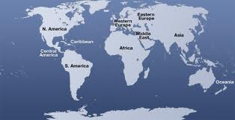
Aryan Migration
1500BCE Aryan invaders came across Hindu Kush (related to Persians)

Slide 7
Aryans Developed a Caste System
Priests
Warriors
Merchants, Artisans, Farmers
Unskilled Workers and Servants
Pariahs (untouchables)

Slide 8
The Caste System is how the Aryans remained in power.
Hinduism already existed when they got there.

Slide 9
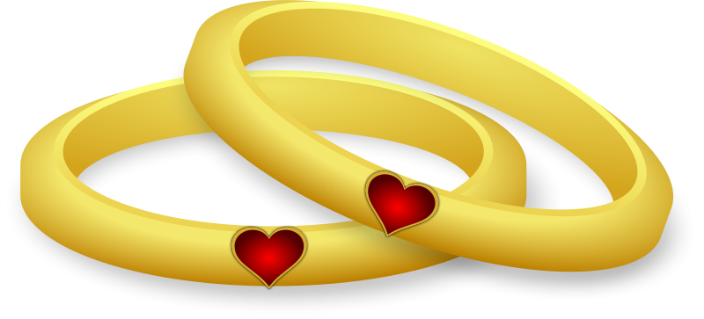
The Caste System and Hinduism were a perfect marriage.
Karma + Reincarnation + Caste System
Do your duty + You will come back in a higher caste =
Aryans in power

Slide 11
Buddhism
Ashoka became a Buddhist and spread political peace and non-violence across India.
Ashoka spread Buddhism across Asia and Mediterranean Europe.

Slide 12
Buddhism & Hinduism
MONOTHEISTIC, but Westerners tend to think of them as POLYTHIESTIC
Originally Atheistic
Nirvana and Moksha
Anyone can achieve enlightenment
Reincarnation
Only the highest caste can achieve enlightenment

Slide 13
China

Slide 15
Huang He(Yellow River) Civilization
Isolated because of its geography and distance from other civilizations
Middle Kingdom: It was the center of the world to them.

Slide 16
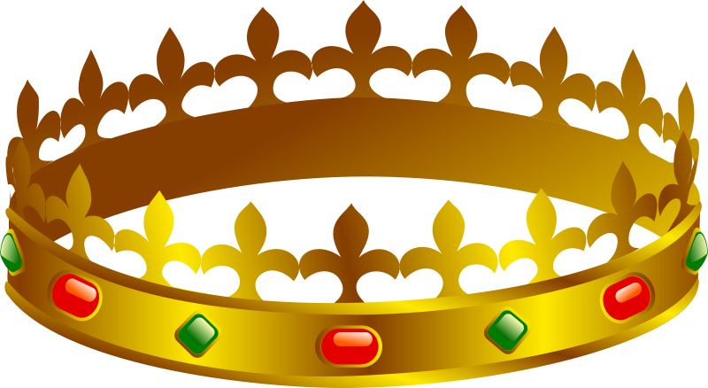
Mandate from Heaven
The Universe gives a dynasty the right to rule
In exchange, the ruler must rule well.
This leads to the….

Slide 17
Dynastic Cycle
By a new DYNASTY
New Emperor
Everything’s great in China
He dies
Everything’s bad in China
He is overthrown
High taxes, drought…
Low taxes, bountiful harvest…
His son takes over

Slide 18
Zhou
Zhou Dynasty: (1122 BC to 256 BC) The Zhou dynasty lasted longer than any other in Chinese history.

Slide 19
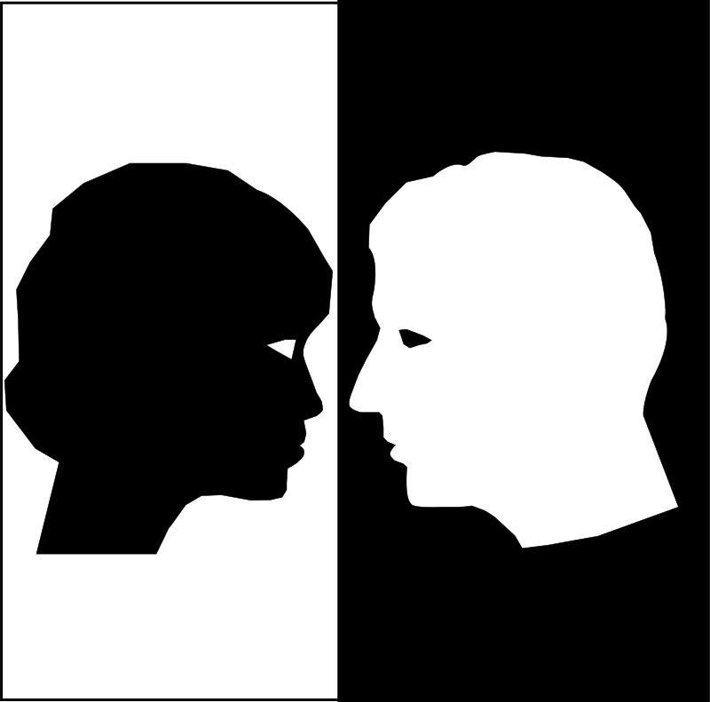
Zhou
Many powerful families began fighting each other for more power.
Confucius developed a system to bring order to China.

Slide 20
Confucianism
Not a religion
An Ethical System
Based on relationships

Slide 21
Confucianism
5 Relationships
King | Father | Brother (Older) | Husband
Subject | Son | Brother (younger) | Wife
Friend | Friend

Slide 22
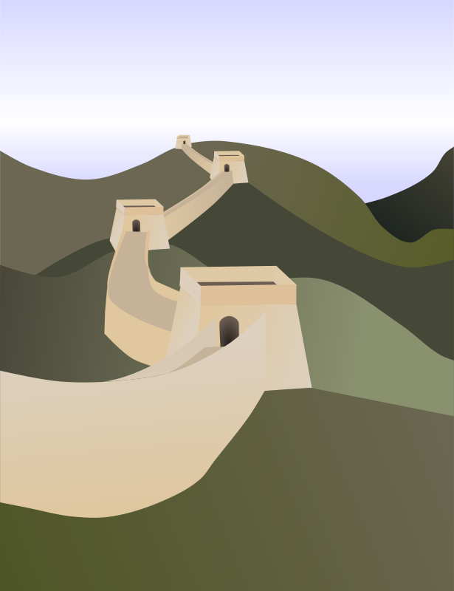
Qin Dynasty
The Qin Emperor was able to defeat the other warring dynasties (powerful families)
Established organized bureaucratic system.
Persecuted Confucians that criticized them.
Started the building the Great Wall.

Slide 24
Great Wall
VIDEO

