Slide 1
Market Failure #2: Externalities
1

Slide 2
What are Externalities?
An externality is a third-person side effect.
There are EXTERNAL benefits or external costs to someone other than the original decision maker.
Why are Externalities Market Failures?
The free market fails to include external costs or external benefits.
With no government involvement there would be too much of some goods and too little of others.
Example: Smoking Cigarettes.
The free market assumes that the cost of smoking is fully paid by people who smoke.
The government recognizes external costs and makes policies to limit smoking.
2

Slide 3
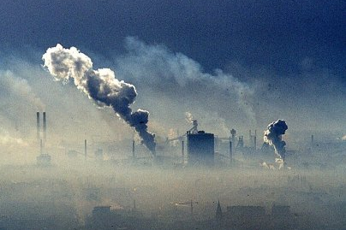
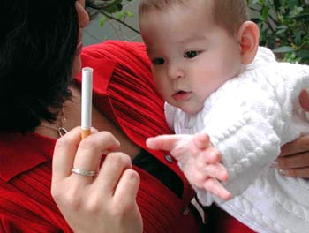
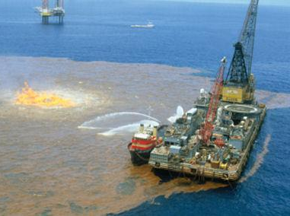
Negative Externalities
3

Slide 4
Negative Externalities
(aka: Spillover Costs)
Situation that results in a COST for a different person other than the original decision maker.
The costs “spillover” to other people or society.
Example: Zoram is a chemical company that pollutes the air when it produces its good.
Zoram only looks at its INTERNAL costs.
The firms ignores the social cost of pollution
So, the firm’s marginal cost curve is its supply curve
When you factor in EXTERNAL costs, Zoram is producing too much of its product.
The government might limit its production.
4

Slide 5
What are some possible negative externalities of building this new beach resort?

Slide 6
Barking Dog
6
Notes:
https://www.youtube.com/watch?v=umzfEer-7So

Slide 7
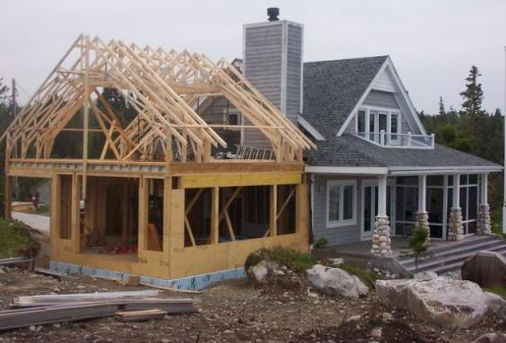
Positive Externalities
7

Slide 8
Positive Externalities
(aka: Spillover Benefits)
Situations that result in a BENEFIT for someone other than the original decision maker.
The benefits “spillover” to other people or society.
(EX: Flu Vaccines, Education, Home Renovation)
Example: A mom decides to get a flu vaccine for her child
Mom only looks at the INTERNAL benefits.
She ignores the social benefits of a healthier society.
So, her private marginal benefit is her demand
When you factor in EXTERNAL benefits the marginal benefit and demand would be greater.
The government recognizes this and subsidizes flu shots.
8

Slide 9
2000 Exam
Notes:
D

Slide 10
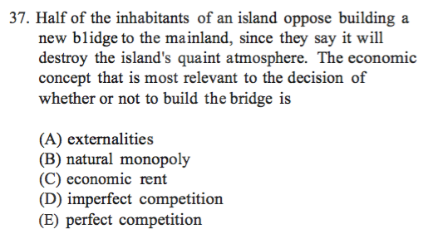
1995 Exam
Notes:
A

Slide 11
Review
1. What is an Externality?
When EXTERNAL benefits or external costs are on someone other than the original decision maker.
2. Why are Externalities Market Failures?
The free market fails to include external costs or external benefits.
3. Explain what negative externality is.
Situation that results in a COST for a different person other than the original decision maker.
4. Explain what a positive externality is.
Situations that result in a BENEFIT for someone other than the original decision maker.
11

Slide 12
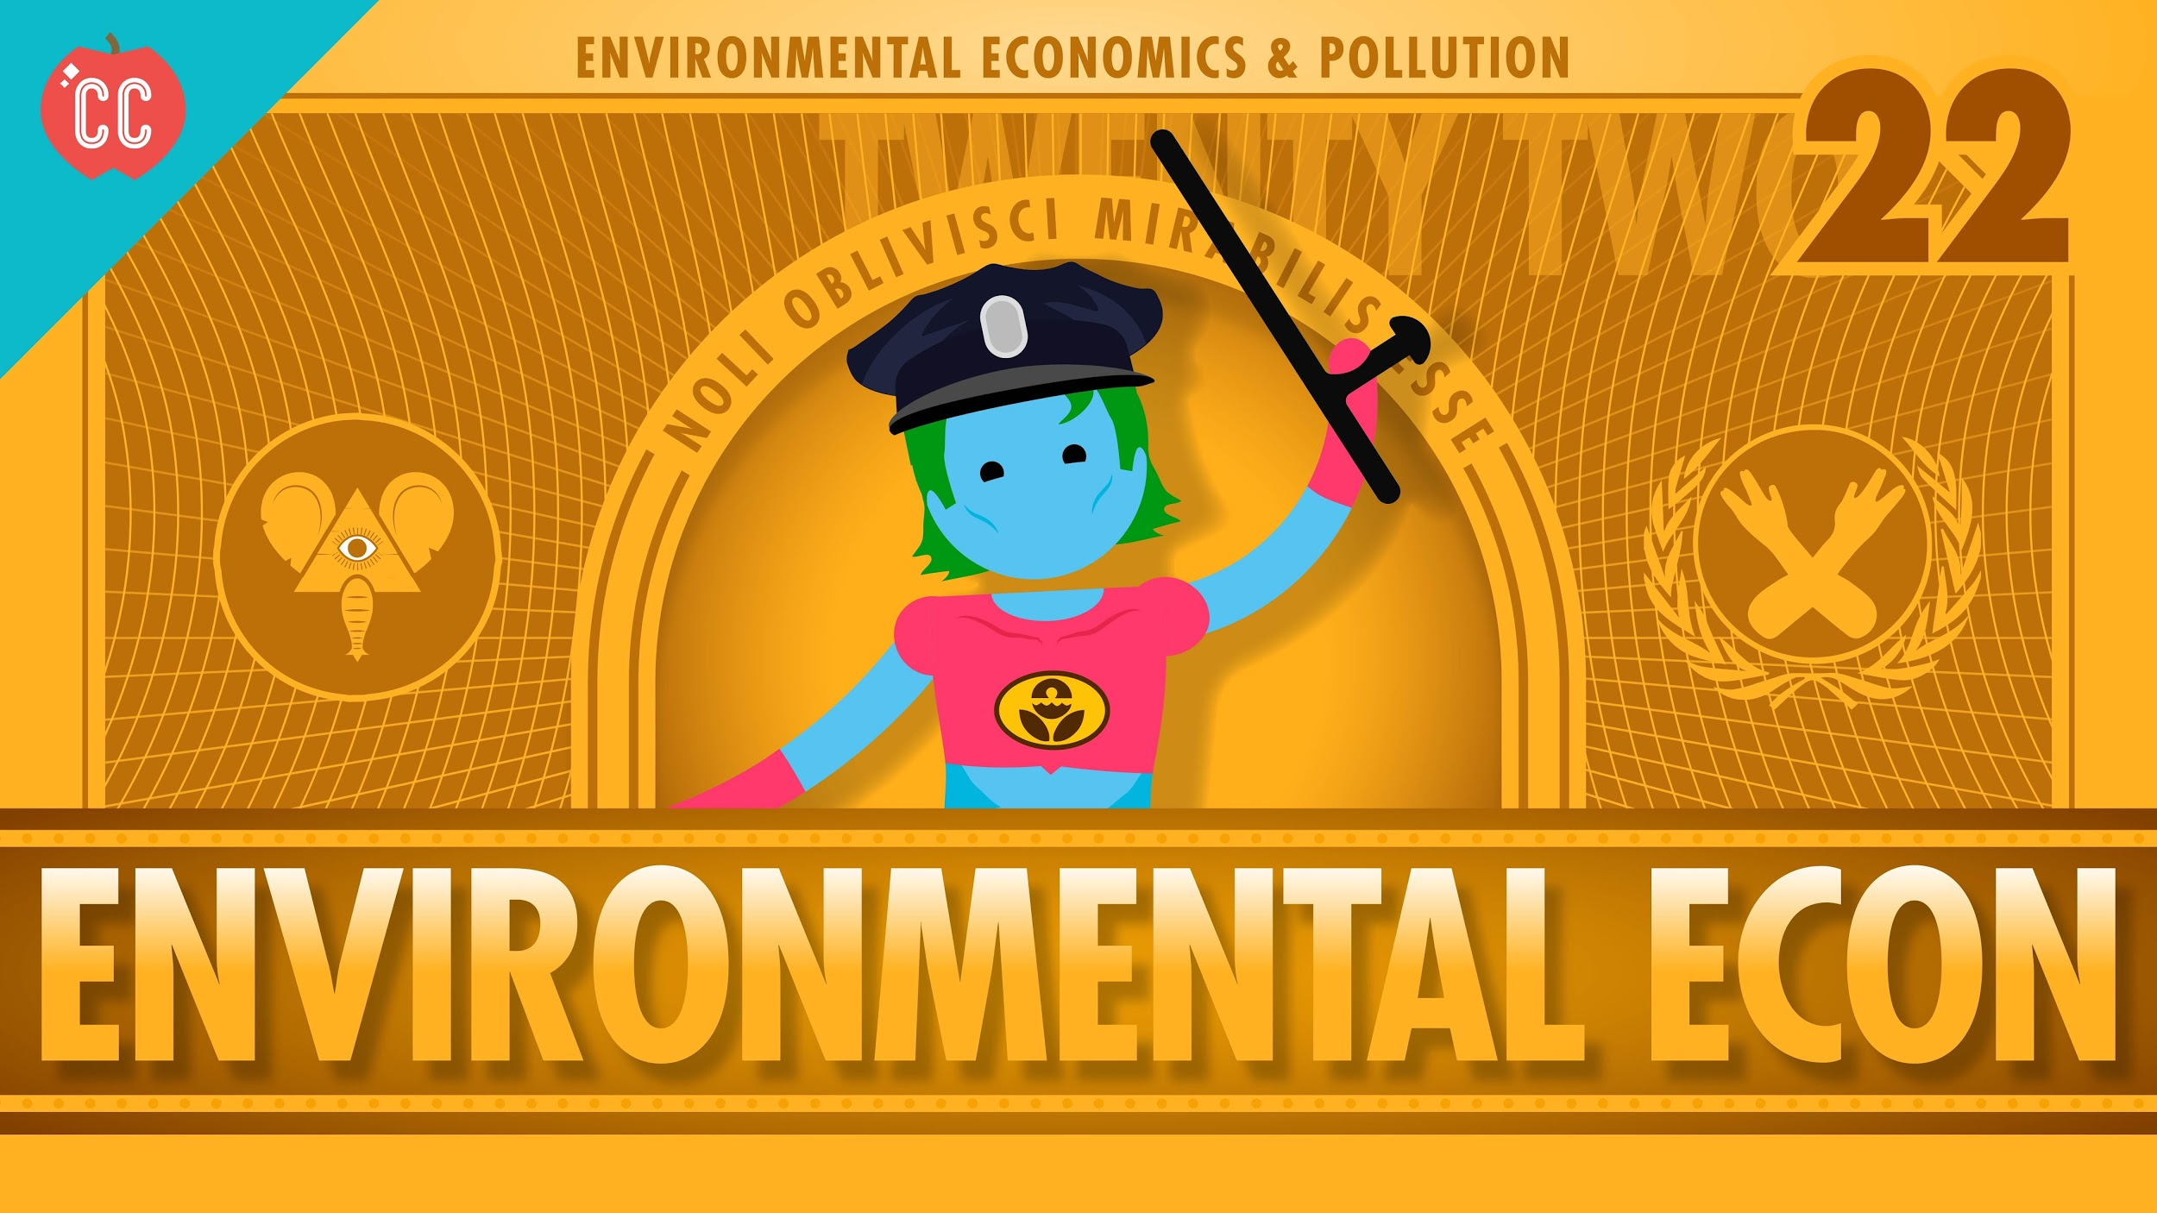
Notes:
https://www.youtube.com/watch?v=BlAfFgKQ5r8

Slide 13
The Common Pool Problem
13

Slide 14
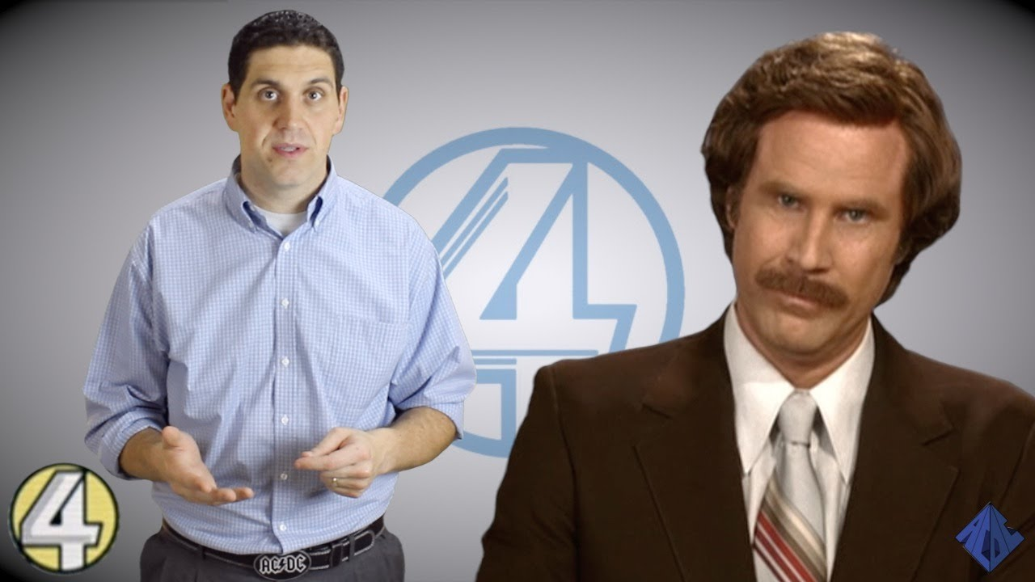
This videos comes with a worksheet. It is in the Ultimate Practice Packet
Notes:
https://www.youtube.com/watch?v=FBjFDtH-iZM

Slide 15
Externalities in Movies
Think of a popular movies where a decision made by a person or business created an externality.
Identify the character, the movie, the decision, and what kind of externality was created.

