Slide 1
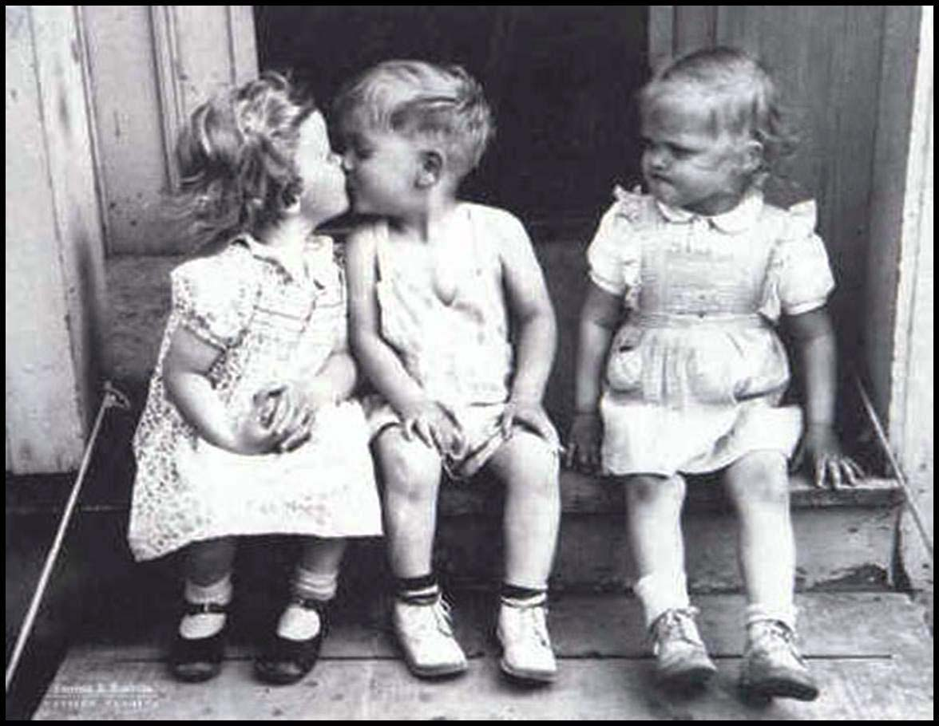
Scarcity Means There Is Not Enough For Everyone...
..So society must decide how resources will be allocated (distributed).
1

Slide 2
The Three Economic Questions
Every society must answer three questions:
What goods and services should be produced?
How should these goods and services be produced?
Who consumes these goods and services?
The way these questions are answered determines the economic system.
An economic system is the method used by a society to produce and distribute goods and services.
2

Slide 3
Economic Systems
Command Economy
Market Economy
Mixed Economy
3

Slide 4
Notes:
https://www.youtube.com/watch?v=B43YEW2FvDs

Slide 5
Command Economies
(aka Communism)
5

Slide 6
Command Economies
In a command economy (communism) the government…
owns all the resources
answers the three economic questions
Examples:
Cuba, North Korea, former Soviet Union, and China?
Why do command economies face problems of poor-quality goods, shortages, and unhappy citizens?
There is little incentive to work harder and central planners have a hard time predicting preferences.
6

Slide 7
Advantages and Disadvantages
What is GOOD about Command Economies?
What is BAD about Command Economies?
Low unemployment - everyone has a job
Great Job Security - the government doesn’t go out of business
Less income inequality
“Free” Health Care
No incentive to work harder
No incentive to innovate or come up with good ideas
No Competition keeps quality of goods poor.
Corrupt leaders
Few individual freedoms
7

Slide 8
8
Notes:
https://www.youtube.com/watch?v=yC0sBAKZsiA

Slide 9
Market Economy
(aka Capitalism)
9

Slide 10
Characteristics of Market Economy
Little government involvement in the economy. (Laissez Faire = Let it be)
Individuals OWN resources and answer the three economic questions.
The opportunity to make PROFIT gives people INCENTIVE to produce quality items efficiently.
Wide variety of goods available to consumers.
Competition and Self-Interest work together to regulate the economy (keep prices down and quality up).
10

Slide 11
Example of Market Economy
Example of how the free market regulates itself:
If consumers want smartphones and only one company is making them…
Other businesses have the INCENTIVE to start making smartphones to earn PROFIT.
This leads to more COMPETITION….
Which means lower prices, better quality, and more product variety.
We produce the goods and services that society wants because “resources follow profits”.
The End Result: Most efficient production of the goods that consumers want, produced at the lowest prices and the highest quality.
11

Slide 12
Example of Command Economy
Example of why communism failed:
If consumers want smartphones and only one company is making them…
Other businesses CANNOT start making computers.
There is NO COMPETITION….
Which means higher prices, lower quality, and less product variety.
More phones will not be made until the government decides to create a new factory.
The End Result: There is a shortage of goods that consumers want, produced at the highest prices and the lowest quality.
12

Slide 13
Is China Communist or Capitalist?
Read the articles linked below.
http://www.pewresearch.org/fact-tank/2014/10/10/chinas-government-may-be-communist-but-its-people-embrace-capitalism/
https://www.thoughtco.com/chinas-special-economic-zones-sez-687417
Underline how China displays characteristics of command economy and highlight characteristics of a market economy?
What are some of the pros and cons of China’s economic system?

Slide 14
The Invisible Hand
The concept that society’s goals will be met as individuals seek their own self-interest.
Example: Society wants fuel efficient cars…
Profit seeking producers will make more.
Competition between firms results in low prices, high quality, and greater efficiency.
The government doesn’t need to get involved since the needs of society are automatically met.
Competition and self-interest act as an invisible hand that regulates the free market.
14

Slide 15
Mixed Economies
A system with free markets but also some government intervention.
Almost all countries, including the US, have mixed economies.
15
Notes:
https://www.youtube.com/watch?v=KPpmAUk1olA

Slide 16
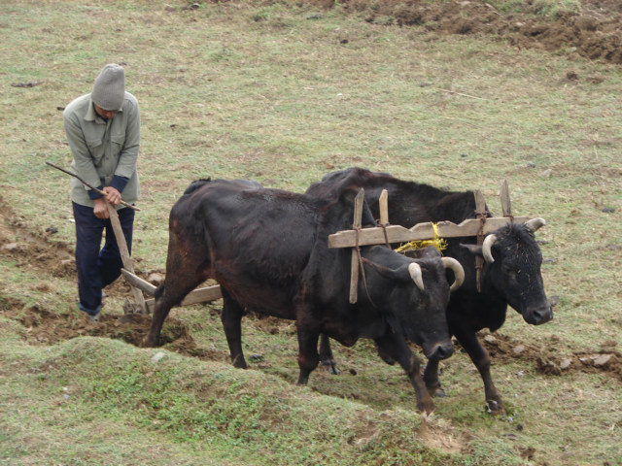
Productivity Creates Wealth
Countries with free markets, property rights, and The Rule of Law, have historically seen greater economic growth because they are more productive.
3rd World Countries
Developed Countries
16

Slide 17
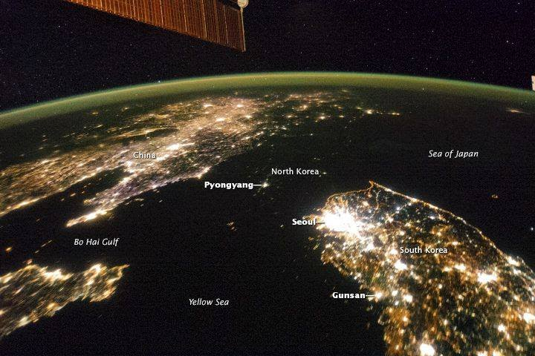
The difference between North and South Korea at night North Korea's GDP is $13 Billion
South Korea's GDP is $1.6 Trillion
17

Slide 18
Incentives Matter
Notes:
https://www.youtube.com/watch?v=FdiQl7urd2w

Slide 19
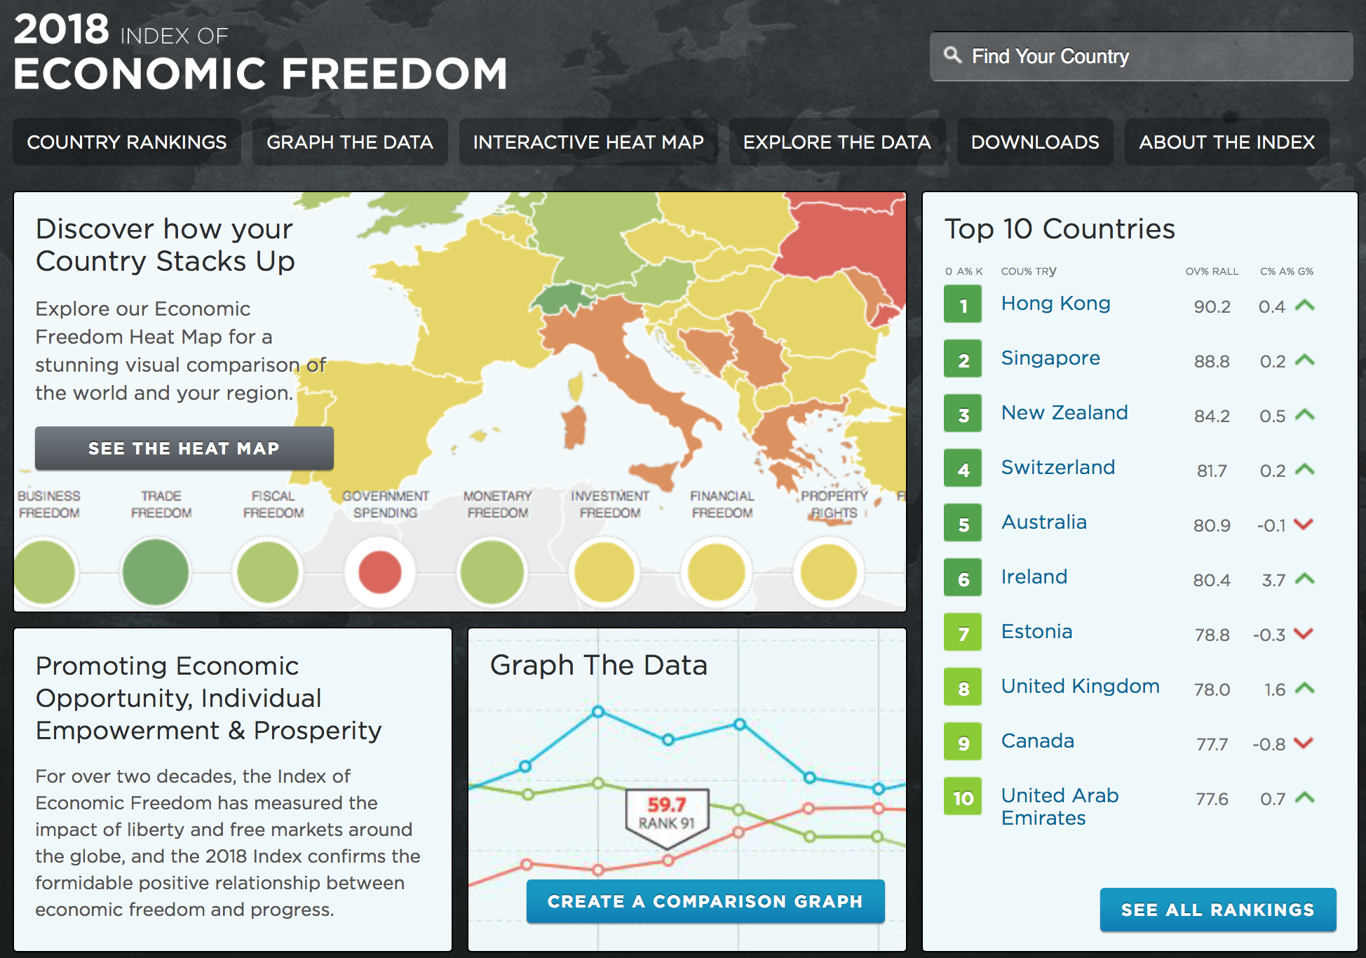
Economic Freedom
Notes:
https://www.heritage.org/index/

Slide 20
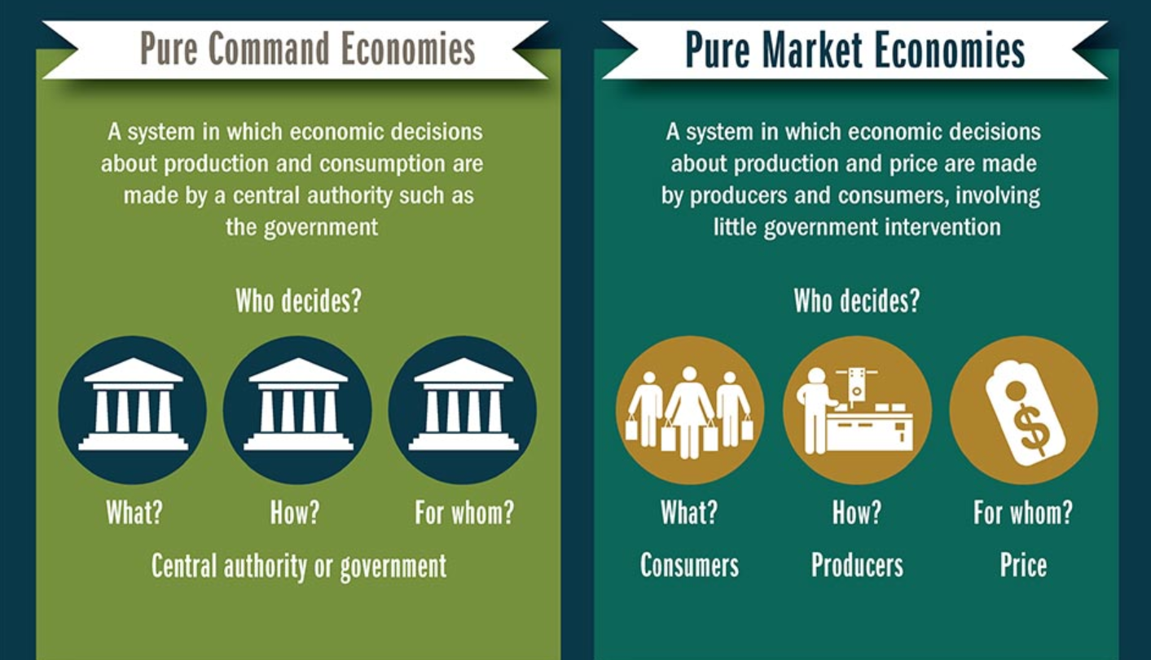
Where does the U.S. fall?

Slide 21
